Slide 1

Early Literacy Program with the ABCD Approach
Oleh:
Dr. Evi Fatimatur Rusydiyah, M.Ag
UIN Sunan Ampel Surabaya
International ABCD (un) Conference
Hari Rabu, 24 Juni 2020

Slide 2

Introduction
Community Engagement Grants Program in Literacy, Partneship UIN Sunan Ampel Surabaya- INOVASI AUSTRALIA
10 Islamic Elementary Schools in Rejoso, Pasuruan
The program ran for 10 months
Class Target 1-3 grades for Islamic Elementary Schools

Slide 3
Purposes of Literacy Program with ABCD Approaches
Improving student ability in reading/early literacy
Improving teacher ability in designing and integrating literacy in teaching-learning
Improving literacy culture in Islamic Elementary Schools
Suistanibality literacy program

Slide 4
Asset Identification
Person
Head Master of Islamic Elementary Schools
Teachers
Supervisor
Students
Parents
Facilities
Library
Schools
Class room
Policy Support
MORA (Ministry of Religion Affairs)
Distric Government/Education Office
Partnership with INOVASI AUSTRALIA
Supporting for local culture and community
Religious Community
Community who want to make change

Slide 5
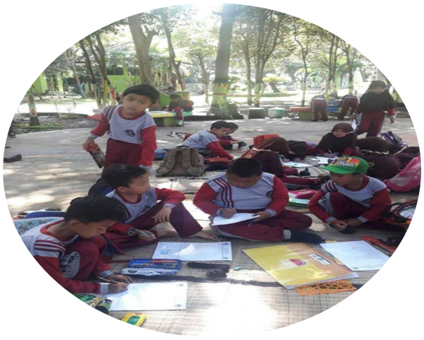
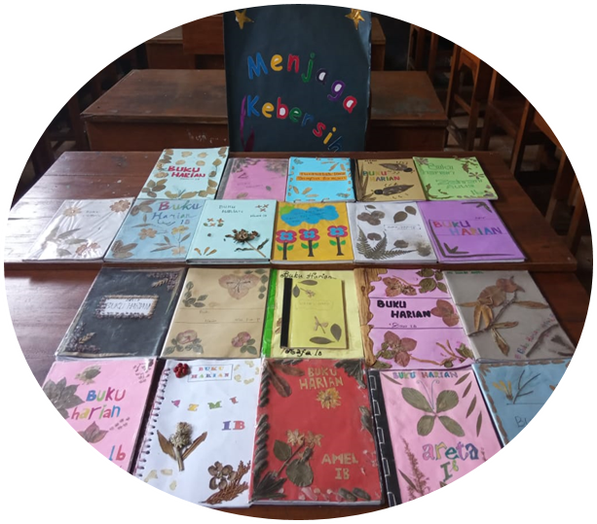
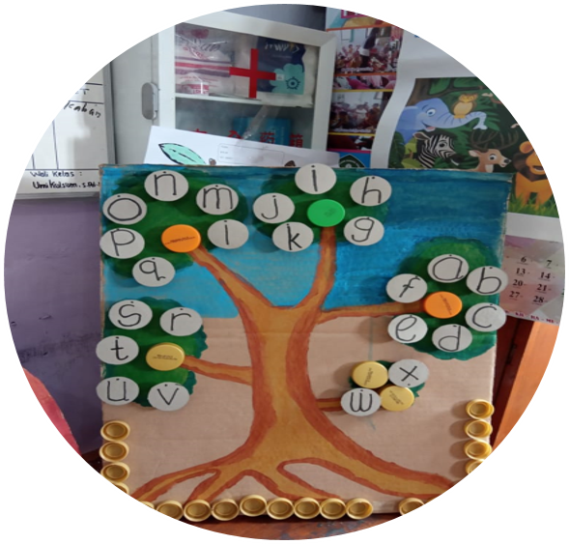
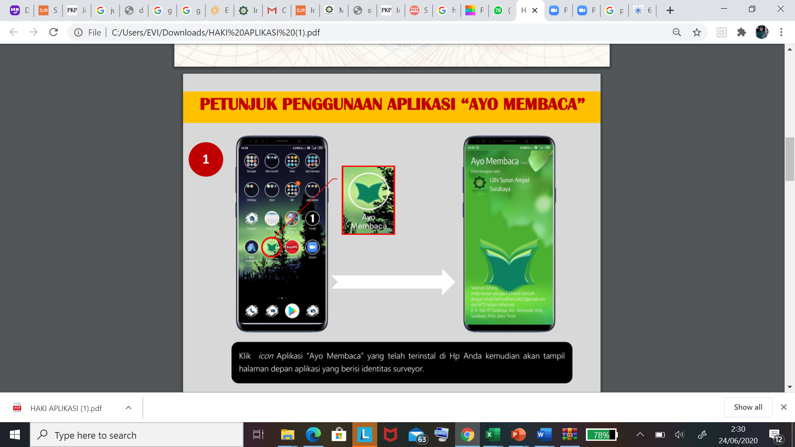
Facilitation Programmes
Training of Trainer
Designing Literacy Program in school
Itegrating Literacy in Leasson Plan
Data Analyzing
Reading Assessement “Ayo membaca”
The Text Levelling
College Students

Slide 6






Program Implementation
Meeting at Cluster
Mentoring
7 times
Driven by Distric Facilitator, headmater, and teachers
Discussion of Designing program
7 times
Driven by distric facilitator and headmaster
Program Implementation from meeting at cluster
Monitoring and Evaluation
Approaches
3 times
Indepenten Team
Using Theory of Change Instrumens (GESI and childhood protection, dan effect of ABCD Approaches in Program)
ABCD
Meeting Evaluation
ToC (Theory of Change)
2 times
Driven by Haedmaster
Dessiminating program results and recommendation

Slide 7
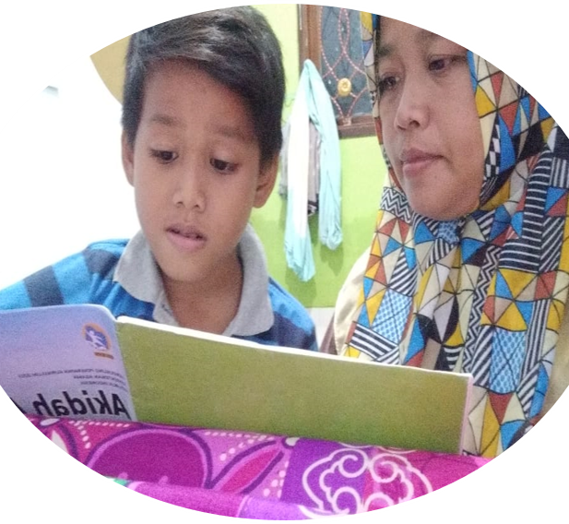
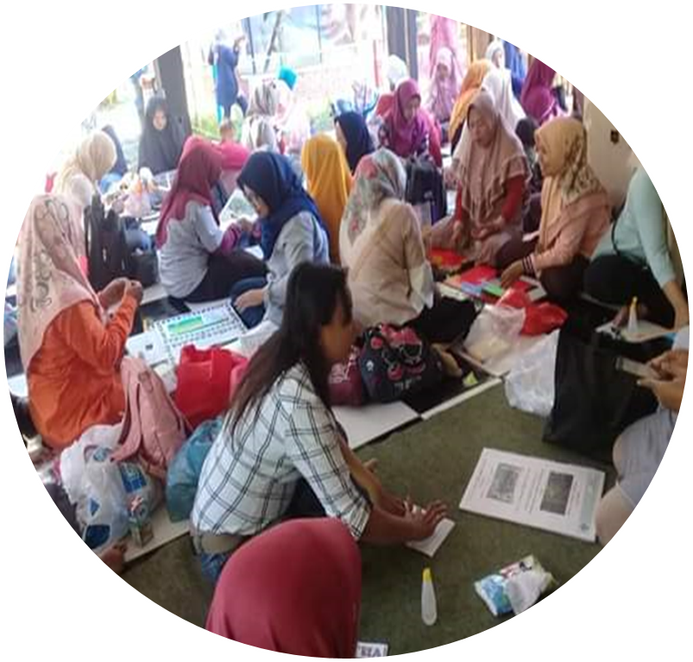
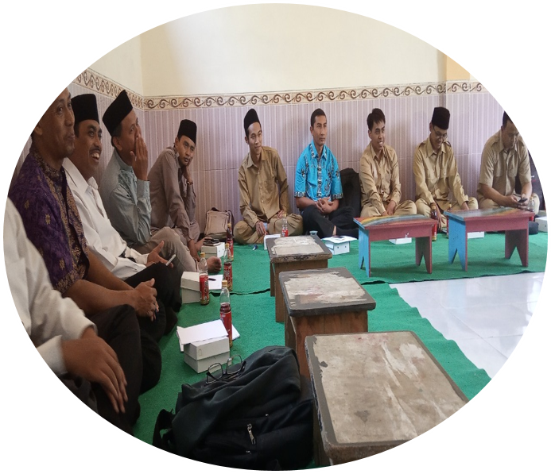
Program Achievement Results
Teacher Awareness for improving literacy ability for students
Teacher ability for using Reading Assesment “Ayo Membaca”
Teacher ability for data processing and data analyzing
Teacher ability for designing literacy program
Teacher ability for using balance reading strategy based on individual differences from students ability
Teacher ability for integrating literacy in lesson plan and teaching-learning process
Headmasters develop a literacy regulation in school
Headmasters make budget plan based on literacy program
Headmaster supervise class regularly on literacy
Improving Mathematics achievement after getting literacy program with ABCD Approaches

Slide 8
Thank you!
Any questions?

