Slide 1
INTERNATIONAL ABCD (UN)CONFERENCE
HARUM FAMILY CENTER
(LKSA HARAPAN UMMAT)
Malang City - East Java Indonesia
June 24th-25th, 2020

Slide 2
AT FIRST ... THE REASON WHY WE EXISTED
an area that is identical with thugs and gambling areas
parents fail to become role models for children
children's education is not a priority
GADANG (2011)
“Children live in a social environments that are not conducive to their best growth and development, vulnerable to violence, neglect and other mistreatment”
“Parents are constrained in terms of caring and livelihood capacities”
MUHARTO (2006)
LOWOKWARU (2004)
Muharto is one of the main areas where street children come from
children are forced by their parents to beg and busking
parents prioritize their children getting money rather than education
there are some children who fail to enter primary school because they do not pass the literacy test
these children do not go to kindergarten because of family poverty
parents are illiterate so they cannot teach their children to read

Slide 3
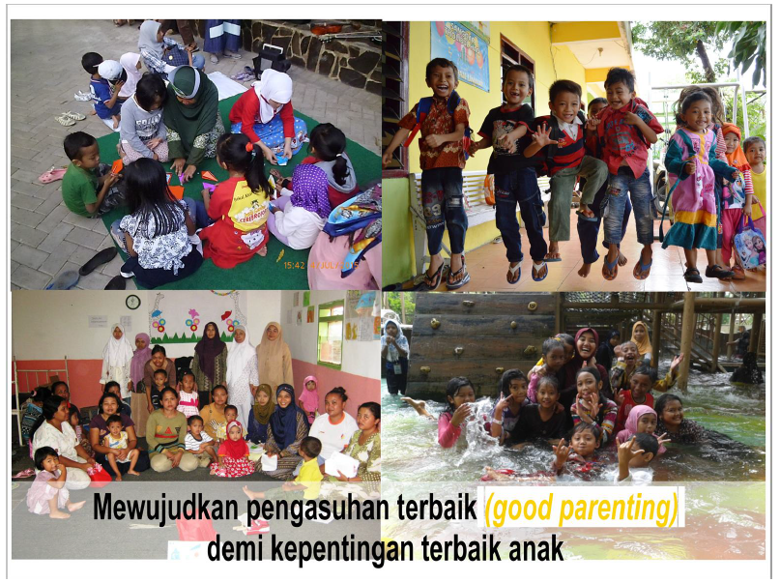
Realizing The Best Care for The Best Interests of Children

Slide 4
What We Do…
OUR STRATEGY:
CHILDREN'S ECOLOGICAL APPROACH
Children see, children do. Children's problems are the result of environmental problems. If we want a change in children, we have to start from the adults around them.
STRENGTH APPROACH
start from what they know, build on what they have. Learn, plan & work with them
Teach by showing, learn by doing. Not to conform but to transform, not to relief, but to release”
Children’s Activity
Parent Activity
Lowokwaru-Muharto-Gadang
Local Community (Institution Sponsor, Individual Sponsor, Member, Local Volunteer)
Public (Government, International Volunteer)
Pondok Parenting Harum
(profit center)
LKSA HARUM
(non profit)
Sharing
Benefits
Preschool Age Day Care
Children’s Learning Center
Youth Learning Center
Mom & Dad Learning Center
Case Respon
International Volunter’s Program
Childcare Institution Resource Center
Piloting Foster Care (New)
School of Parenting
Training – Seminar Parenting
Children & Family Counseling
Parenting Talkshow on the Radio
Online Parenting Class
School Assistance

Slide 5
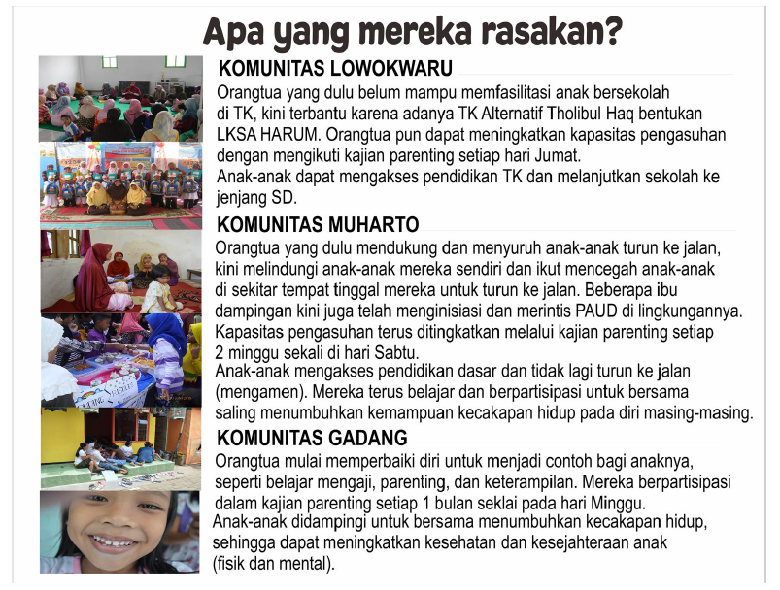

Slide 6
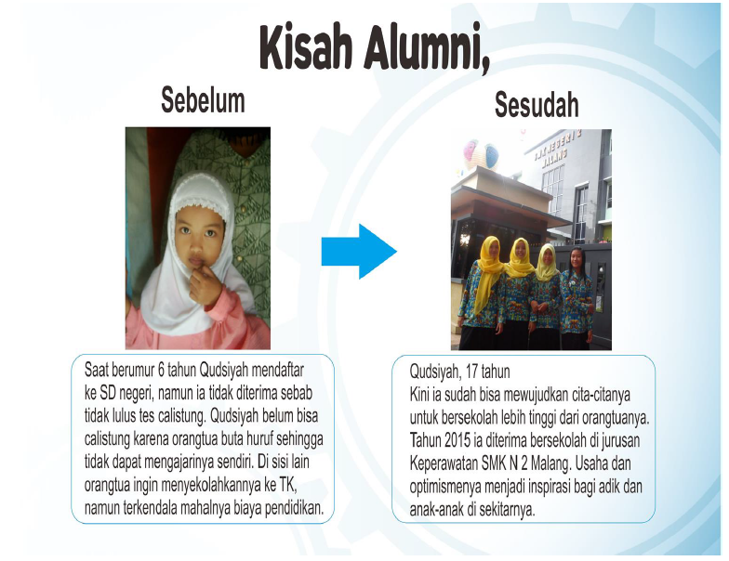
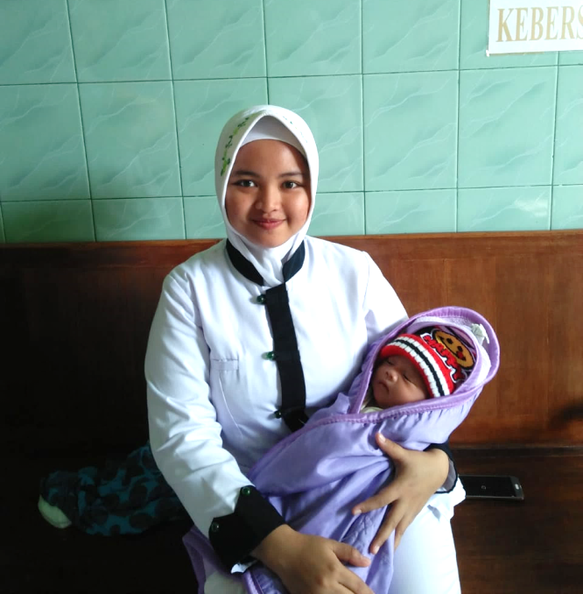
Saat berumur 6 tahun, Qudsiyah mendaftar ke SD negeri, namun ia tidak diterima sebab tidak lulus tes calistung. Qudsiyah belum bisa calistung karena orangtua buta huruf sehingga tidak dapat mengajarinya sendiri. Di sisi lain orangtua ingin menyekolahkannya ke TK, namun terkendala mahalnya biaya Pendidikan.
Qudsiyah, 21 tahun,
Saat ini tengah menyelesaikan studinya di Poltekkes Kemenkes Malang Program Studi Kebidanan Kediri, semester 5 melalui beasiswa bidikmisi.

Slide 9
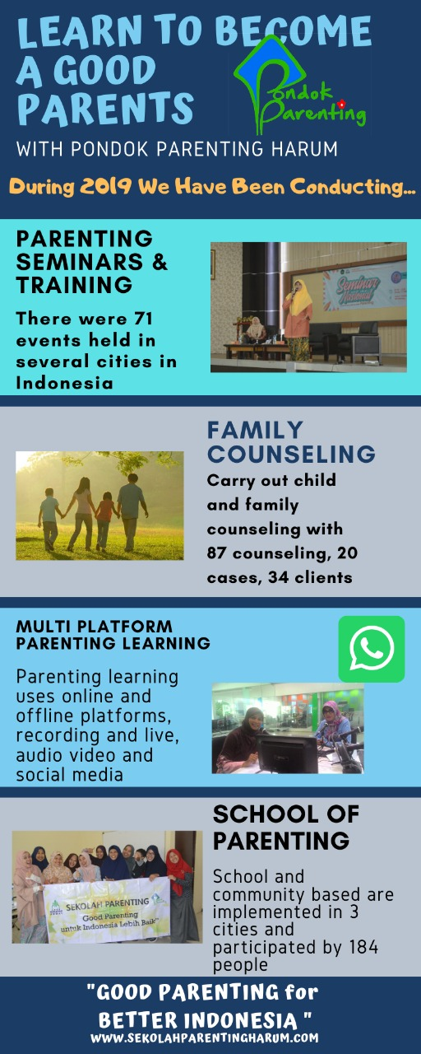

Slide 10
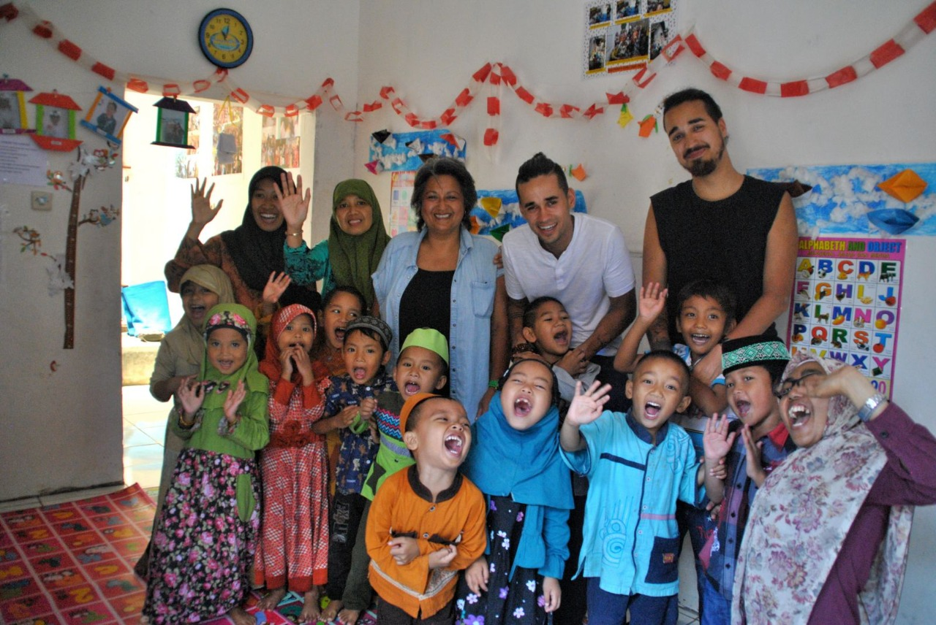
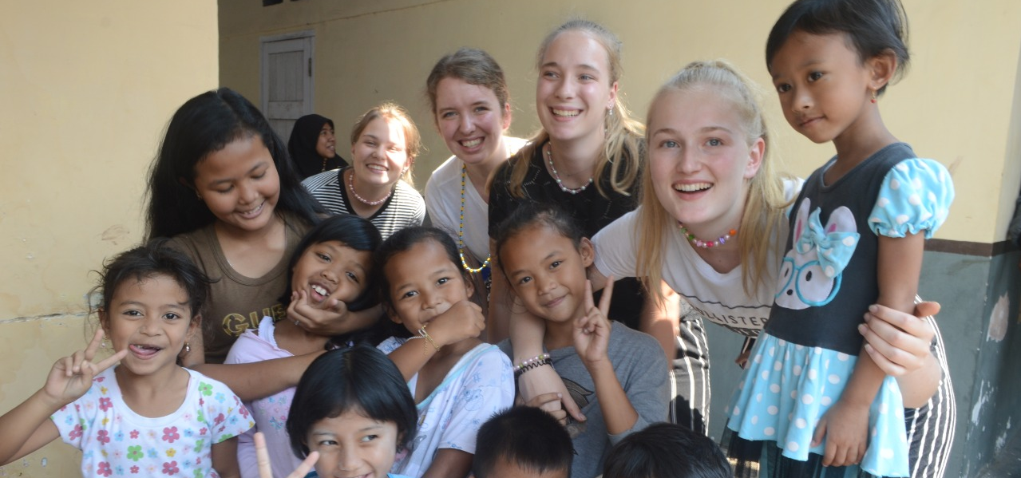
Testimony of Foreign Volunteers
“I have been a volunteer in Malang for 3 months, but it felt like I have only been here for 3 weeks. It is true what they say, time flies when you are having fun.”
Danielle - Netherlands
“It was an amazing experience to do this together and we felt very welcome. I want to thank all the HARUM staff for creating an opportunity for the young children from the village to go to school. Keep smiling and dancing, the rest will follow ☺, Terima kasih.”
Damian - Netherlands

Slide 11
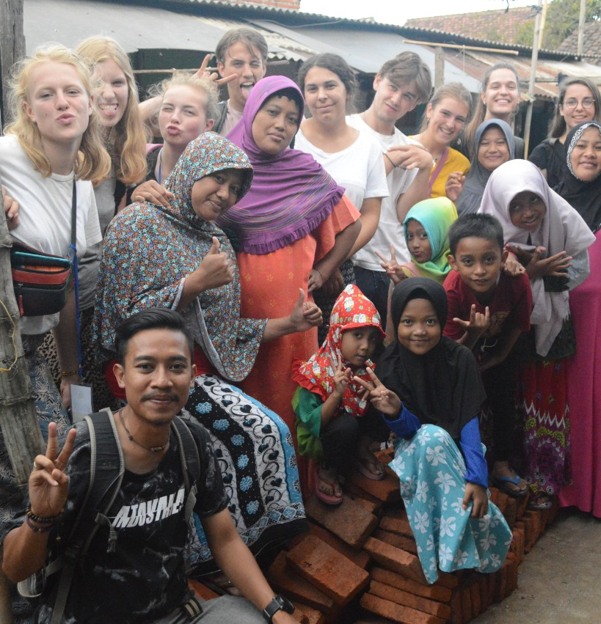
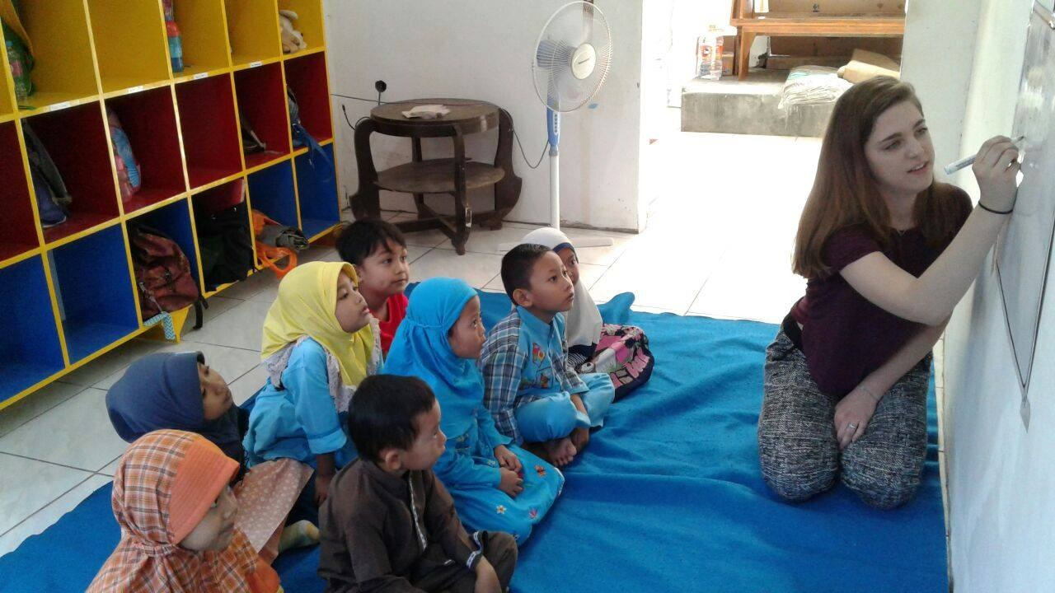
Testimony of Foreign Volunteers
“I really felt very welcome and appreciated by the HARUM Community and I will never forget it. Thank you for everything, I shall never forget it. Hearts of love.”
Tom - Netherlands
“We helped with the toilets and painted the well and the playground. We really enjoyed our stay in Malang and of course the lovely meals that you guys made for us. Furthermore, we would like to thank all the lovely people in the village. They were so kind to us. You’e very lovely! Hopefully we can come back sometime. And we wish you all the best for the future. ♥Lots of Hugs and kisses♥.”
Eva, Evi, Beau and Naomi - Netherlands

Slide 12
FUTURE AGENDAS
1. Implement social welfare, care and child protection services. Includes prevention and response to cases that are standardized and appropriate for the new normal era
2. Conducting Foster Care piloting in East Java, to realize an alternative form of family-based care in order to realize quality care in the best interests of the child
3. Good Parenting Campaign for a Better Indonesia in the form of parenting schools, talk shows, training and counseling as well as digitalization of Pondok Parenting services HARUM

Slide 13
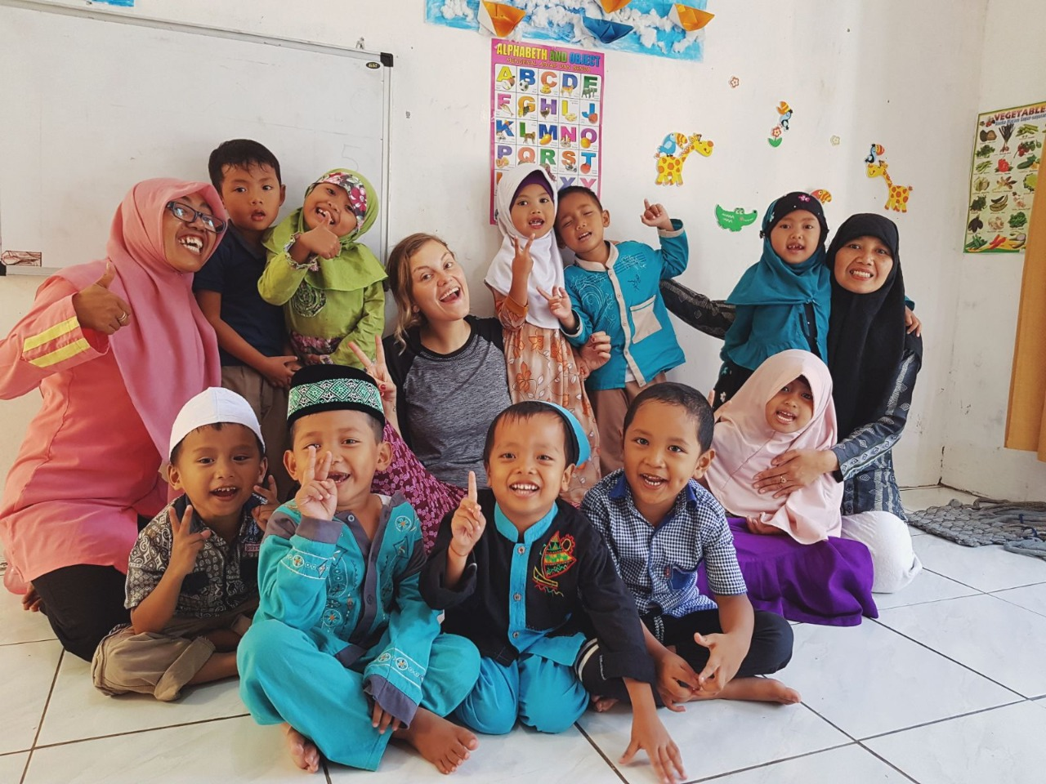
THANK YOU

