Slide 1
Actions to stop sexual and gender-based violence towards women and girls with disabilities through activist work
Do Thi Huyen
Vice-Chairwoman
Hanoi Association of Persons with Disabilities, Vietnam

Slide 2
Stories of WWDs face different kinds of violence

Slide 3
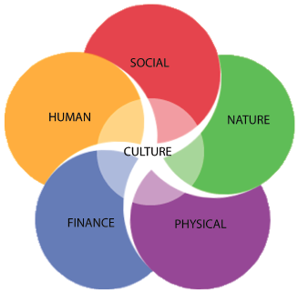
Overview on Persons with Disability (PWDs) in Vietnam
According to Vietnam Disability Survey, 2016:
6,225.000 PWDs (7.06% of population) aged 2 and over are persons with disabilities (PWDs)
Of which about 3.5 millions are women with disabilities (WWDs) and girls with disabilities (GWDs).

Slide 4
Related to laws and regulations to PWD in Vietnam
Law on Persons with Disabilities 2010
National Action plan in achieving SDGs
Vietnam ratified UN CRPD in 2015
The National Plan Number 1019 in supporting persons with disabilities period 2012-2020 => affirming that persons with disabilities have rights to take part in an equal basis with others in every sphere of life

Slide 5
Situtations on sexual and gender-based violence to women and girls with disabilities
A research indicated that 4 in 10 WWDs have ever been at least one form of sexual abuse.
Lack of actions to preventing and responding to sexual abuse and violence towards WWDs and GWDs
Public and community’s attitudes and misconception to PWDs in general and WWDs in particularly,

Slide 6
Why so?
Gender prejudice
Rooted in gender inequality (traditional attitudes, male dominant, …
Contributes to the social tolerance of the violence and the widespread impunity
Lack of awareness, especially from WWDs themselves
Misunderstanding about what is acceptance
Lack knowledge
Lack reliable institutions to address sexual violence and GBV
Discrimination and misconception about disability
Ignore sexual violence issue to PWDs, WWDs
Intersectionality of gender and disability → sexual violence often lasts longer and is more intense
A weak social network to empower and raise voice of PWD over the issue of violence

Slide 7
Brief about DP Hanoi
Hanoi Association of People with Disabilities (DP Hanoi) was officially established in 2006
An umbrella organization of 48 organization members, > 15.000 individual members
Areas of work: capacity building, awareness raising, education, employment, advocacy for the rights of PWDs

Slide 8
Pilot project: Actions to stop sexual and gender-based violence towards women and girls with disabilities through activist work

Slide 9
Project: Actions to stop sexual and gender-based violence towards women and girls with disabilities through activist work
Objectives
Capacity building for 20 leaders of organizations of people with disabilities (DPOs) on sexual and gender-based violence (GBV), social skills and networking
Awareness raising on disability rights
Policy advocacy: recommendations on gender issues

Slide 10
Project: Actions to stop sexual and gender-based violence towards women and girls with disabilities through activist work
Methodology
The project has been divided into 2 phases:
Phase 1: Restore ego and self-esteem so that PWDs recognize their abilities
Needed knowledge have been provided
Explore leadership skills
Phase 2: Build an inclusive community
Networking within the participants:
Awareness raising activities to different audiences
Speaking contest in public

Slide 11
Project: Actions to stop sexual and gender-based violence towards women and girls with disabilities through activist work
ABCD as a method
Identify the capacity of PWDs and their strengths: hard working, patience, passionate…=> everyone has gifts and skills
Recognize the existing resources in the community: guest speakers, inspired leaders who are willing to support
Good relationship with local government: contact with social department in gender issue, women union, contact with social media (journalists)
Existing of DPOs at different provinces

Slide 12
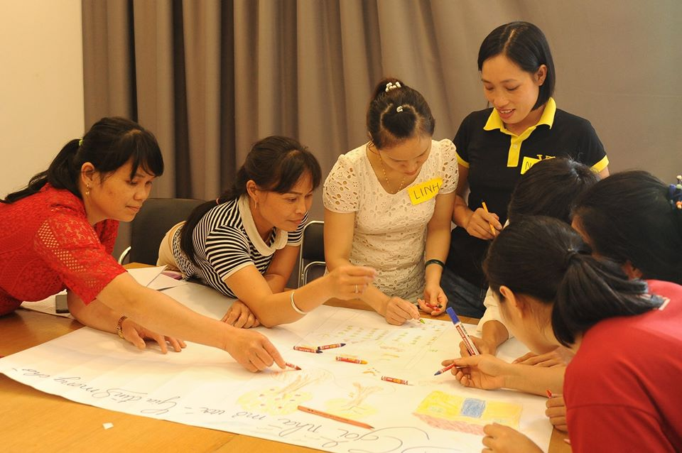
Training course on sexual and gender based violence for 20 core leaders from DP Hanoi and DPO Ha Giang

Slide 13
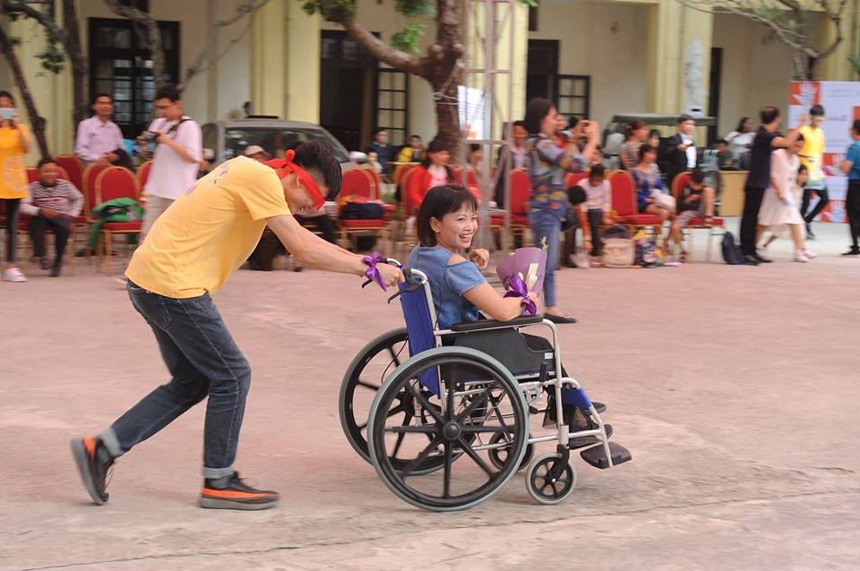
Raising awareness campaign: “Amazing tour”

Slide 14
Disability Activist Challenge: “Speaking in public”

Slide 15
Project: Actions to stop sexual and gender-based violence towards women and girls with disabilities through activist work
Impacts: =>changes in awareness, action plans
Persons with disabilities (males and females) and children with disabilities
PWDs’ family members
DPOs
Local authorities, women union
CSOs, INGOs, local NGOs
Community members: students, teachers, villagers, etc.

Slide 16
Project: Actions to stop sexual and gender-based violence towards women and girls with disabilities through activist work
How we try to sustain the project
Action plans from trainees will be implemented in the community with support from DP Hanoi and trainees’ organizations
The existing of network of WWDs run by WWDs definitely attracts local government’s attention (Vietnam Women union)

Slide 17
Project: Actions to stop sexual and gender-based violence towards women and girls with disabilities through activist work
Our next steps:
Provide mentor and coaching for potential leaders from DPOs
Maintain and promote the Network of women with disabilities in the North
Set up the National Network of women with disabilities in Vietnam

Slide 18
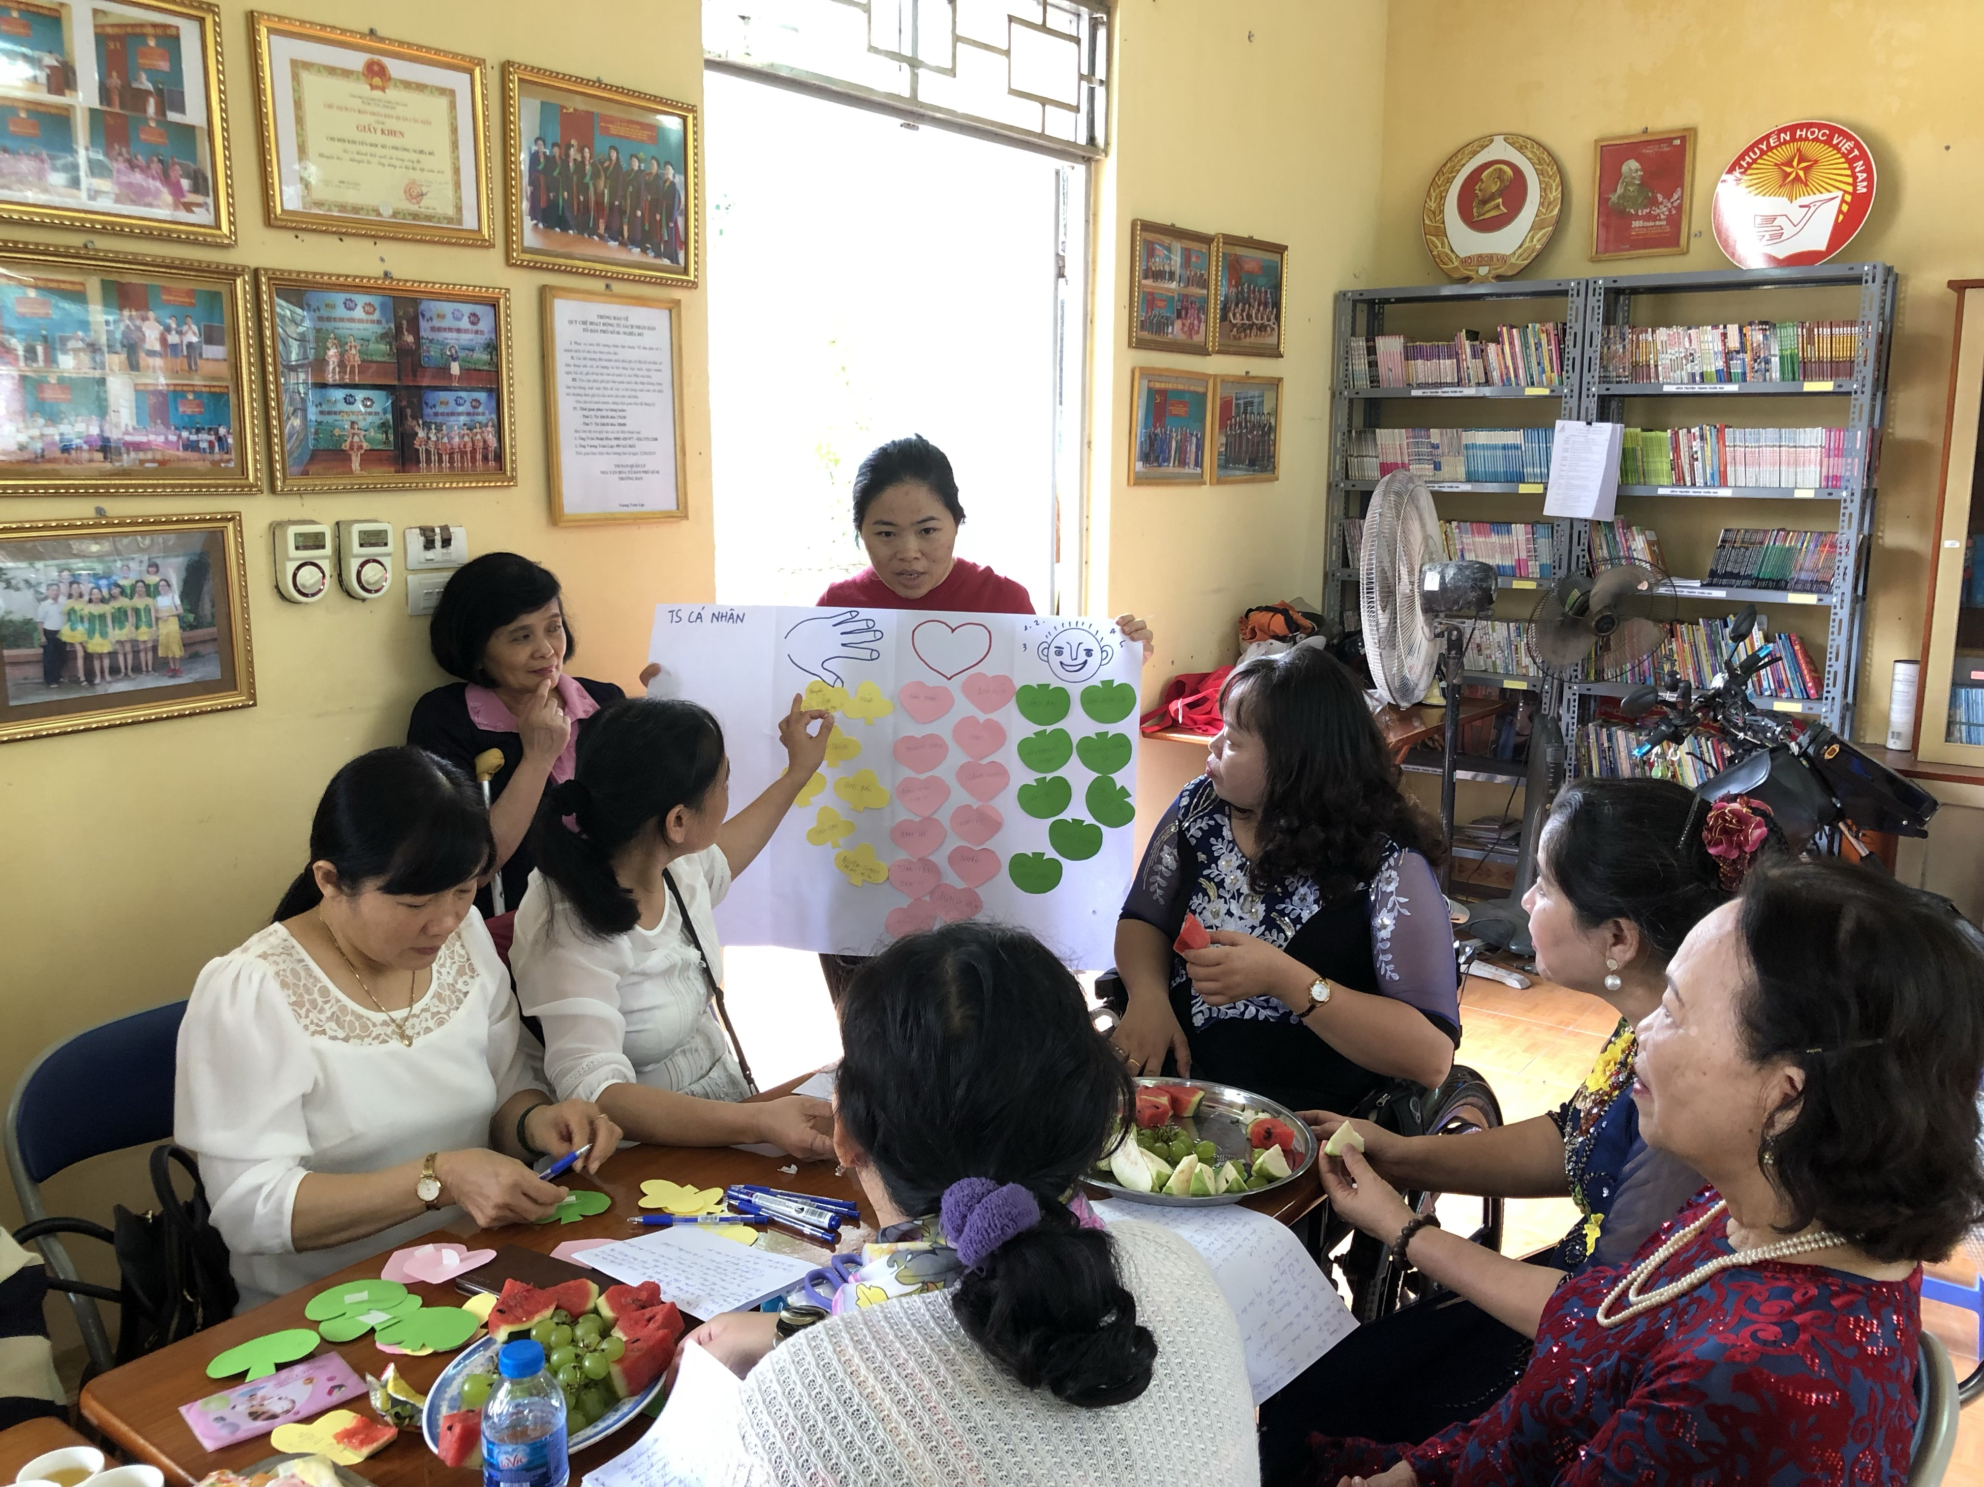
Questions?
Contact:
huyendt@dphanoi.vn
Tel: +84-24-35379257
Mobile: +84-943868385
http://dphanoi.org.vn

Slide 19
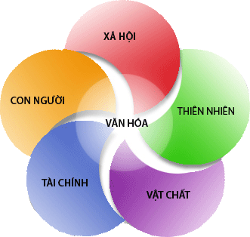
THANK YOU!

Slide 20
BREAKOUT SESSION
ROOM 1
Who are the key stakeholders in empowering PWD to address sexual and GBV?
How to engage different stakeholders in preventing and responding to sexual and gender-based violence against women and girls with disabilities?
ROOM 2
What are social network and resources that support women disability to address sexual and GBV
Develop a network of women with disabilities in Vietnam : How it looks like, its organization structure and operation?.
=> How to sustain the network?

