Slide 1
Techy ABCD in a ‘glocal’ world The inclusion of tech in ABCD: A look at the challenges and opportunities World Agroforestry (ICRAF) ABCD team
Levi Oreo, Data specialist Lisa Fuchs, Social scientist Victoria Apondi, Field officer Langat Kipkorir, Field officer

Slide 2
Brief outline: Leveraging technology for ABCD
Who we are and what we do
Which role does ABCD play in what we do?
How do we use technology – and how is it related to ABCD?
What are the challenges… and ways of dealing with them?

Slide 3
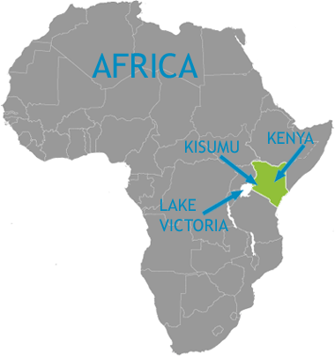
Who we are and what we do
World Agroforestry (ICRAF) is a centre of science and development excellence that harnesses the benefits of trees for people and the environment.
Promotion of agroforestry and integrated agricultural farming practices.
Creation of meaningful relationships for targeted, context- specific provision of external support.

Slide 4
Background and context
We (often) assess the starting point…
Point B
We have an idea of where we want to go….
HouseholdCommunity
Landscape
‘Development’
1] ‘Adaptation’
But how do we get there?
a] Diversified livelihoods
Point A
b] Improved material welfare
c] Resilience
HouseholdCommunity
Landscape
2] ‘Mitigation’
a] Carbon sequestration
b] (Re)forestation
c] Emission reduction
Timeline

Slide 5
We know…
Point B
HouseholdCommunity
Landscape
Uptake at scale
Participation
Knowledge & skills
Point A
… but how?
HouseholdCommunity
Landscape
Context
Which process?
Which sequence?
Which tools?
What matters?
Timeline
Notes:
© Copyright PresentationGo.com – The free PowerPoint template library

Slide 6
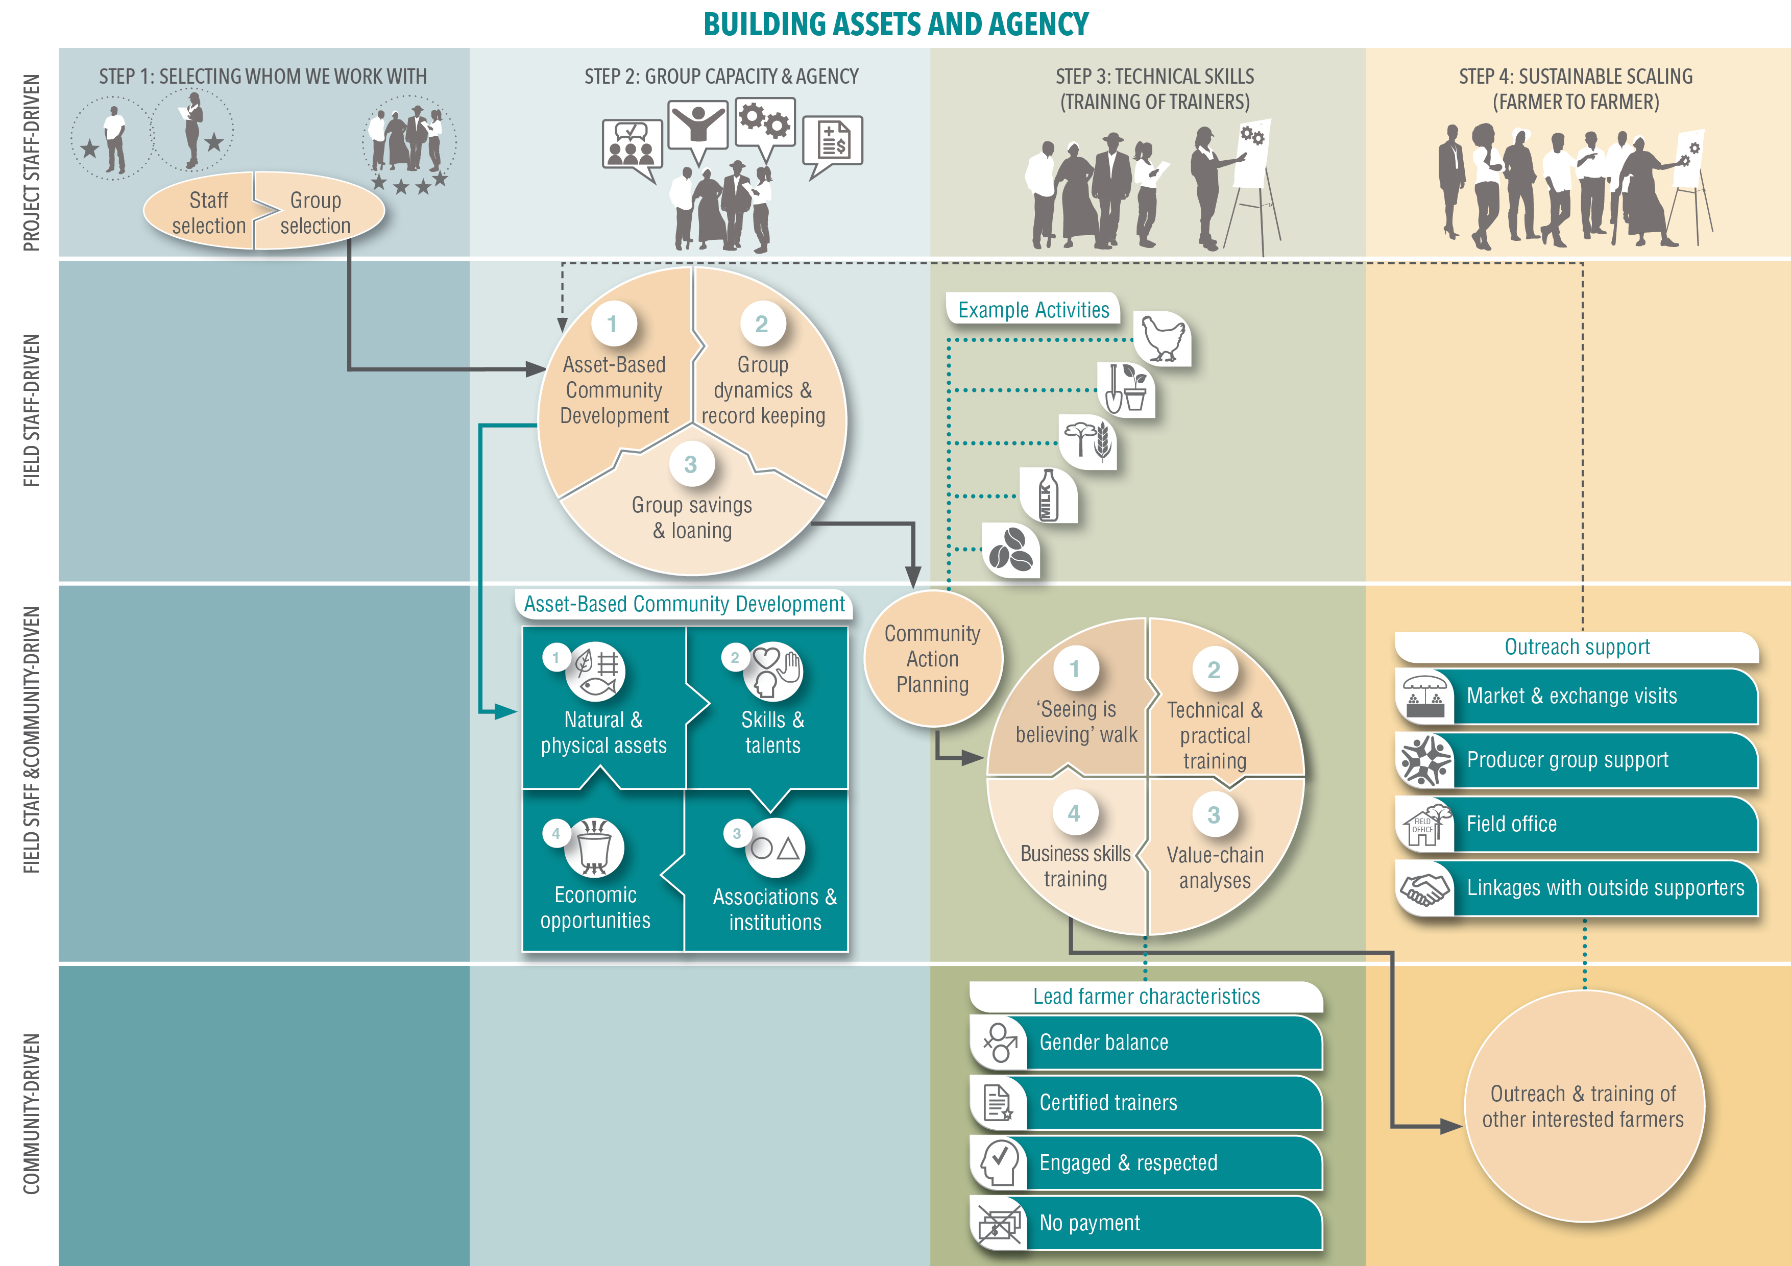
What’s the role of ABCD?
Community mobilisation at two scales: collective and individual
At community level
Community only
With us
With others

Slide 7
Using tech – and how does it relate to ABCD?
Using tech for mobilisation at individual and community level
Main uses
communication/staying in touch/being accessible for feedback and support requests
knowledge sharing
documentation/record keeping
mobilization
creating linkages

Slide 8
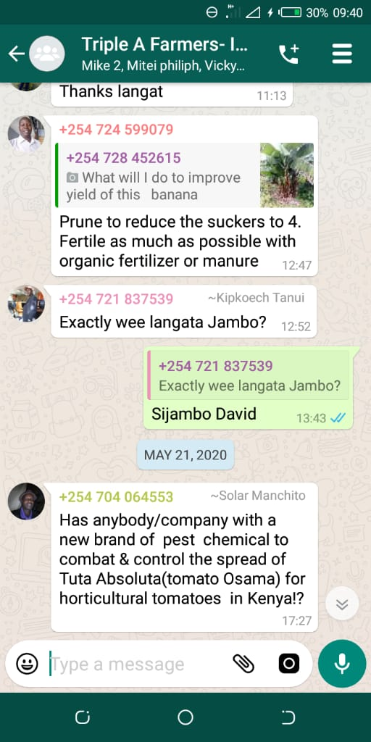
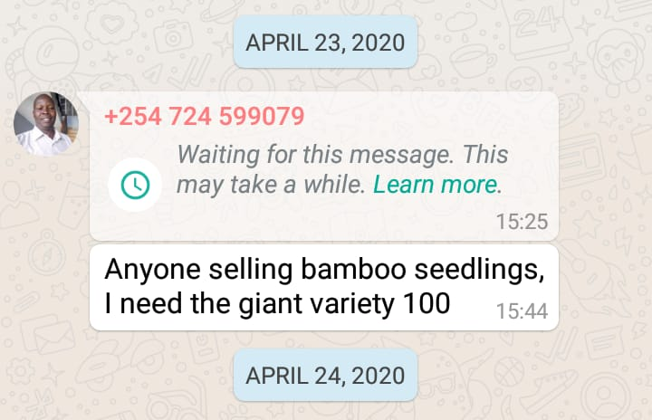
Collective use of tech
WhatsApp groups to exchange success stories, share contacts, consult.
The power of photography
Ultimately: creation of farmer-produced, contextually-relevant agricultural knowledge – a farmer-centred evidence base!

Slide 9
[Discussion]: How do you use tech for community organizing?
Which experiences do you have – first-hand or second-hand - with using tech for community mobilisation?
10 minutes

Slide 10
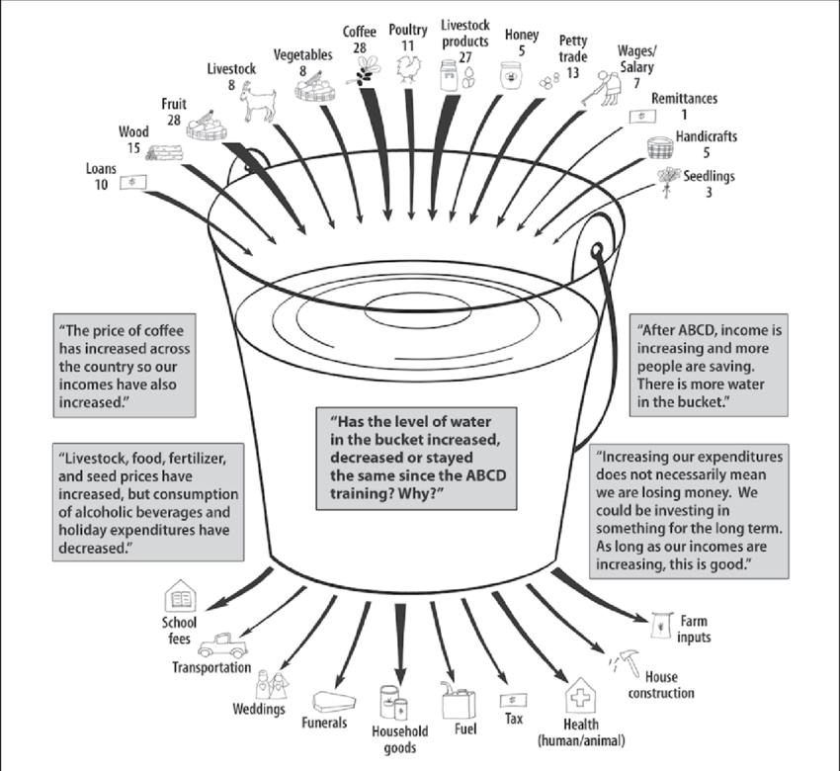
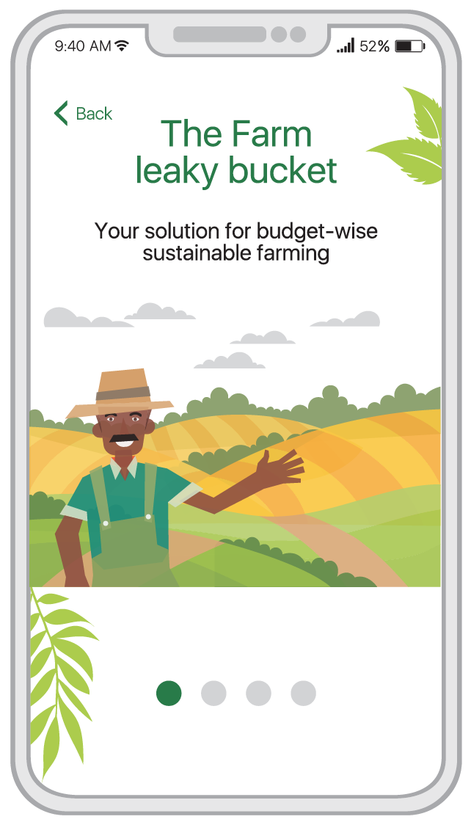
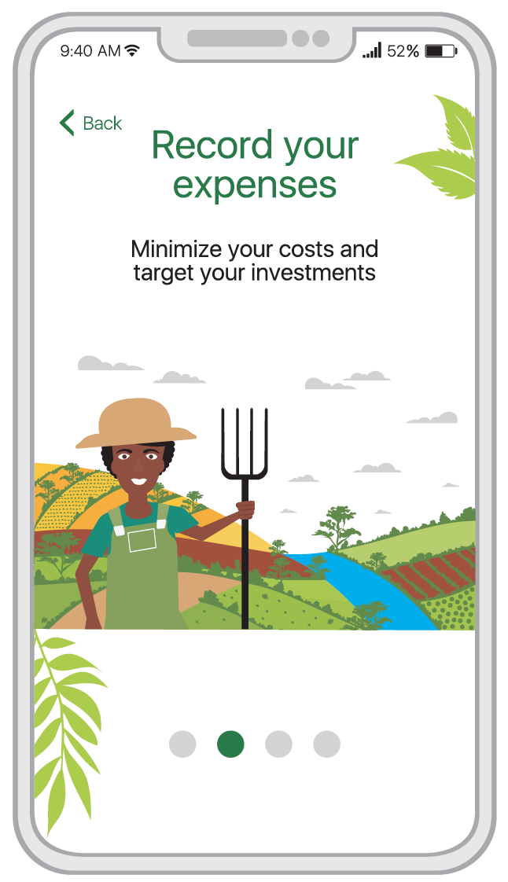
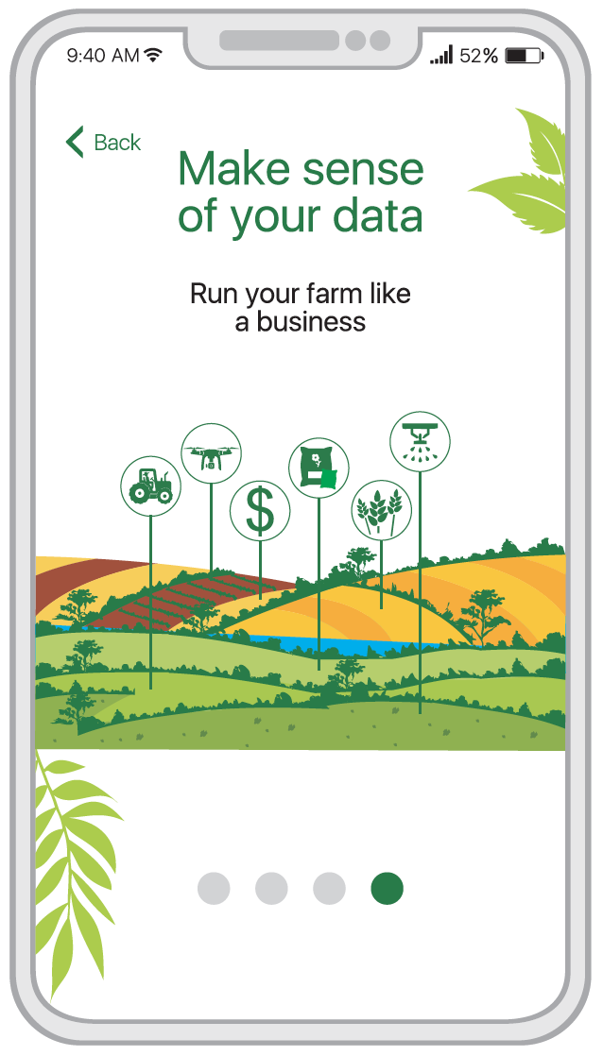
Individual use of tech
Individual phone use
‘Farm Leaky Bucket’ mobile phone application

Slide 11
[Discussion]: How do you use tech for individuals?
Which experiences do you have – first-hand or second-hand - with using tech to support individuals to realise, actualise and use their resources better?
10 minutes

Slide 12
Challenges we see…
Availability, accessibility, affordability?
Social acceptability?

Slide 13
[Discussion]: Which challenges do you see… and how do you deal with them?
Which experiences do you have – first-hand or second-hand - with the challenges that come with using tech for ABCD?
Do you have experience or ideas about how to deal with them?
10 minutes

Slide 14
Any other questions or remarks?
And let’s not forget to ‘harvest’…
What were some of the stories and experiences shared that caught your attention?
What were the key themes that emerged from the discussions and experiences?
What was your most significant learning from this session and why?
Was there anything that surprised or challenged you?

Slide 15
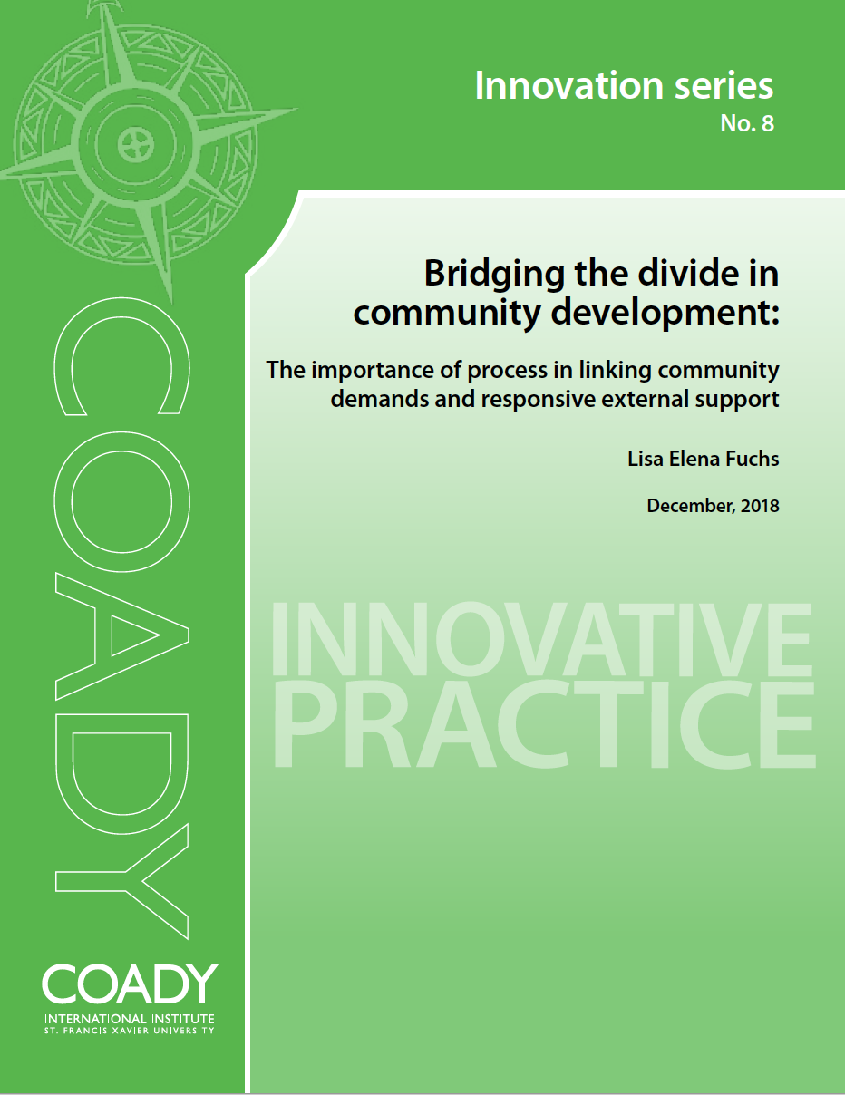
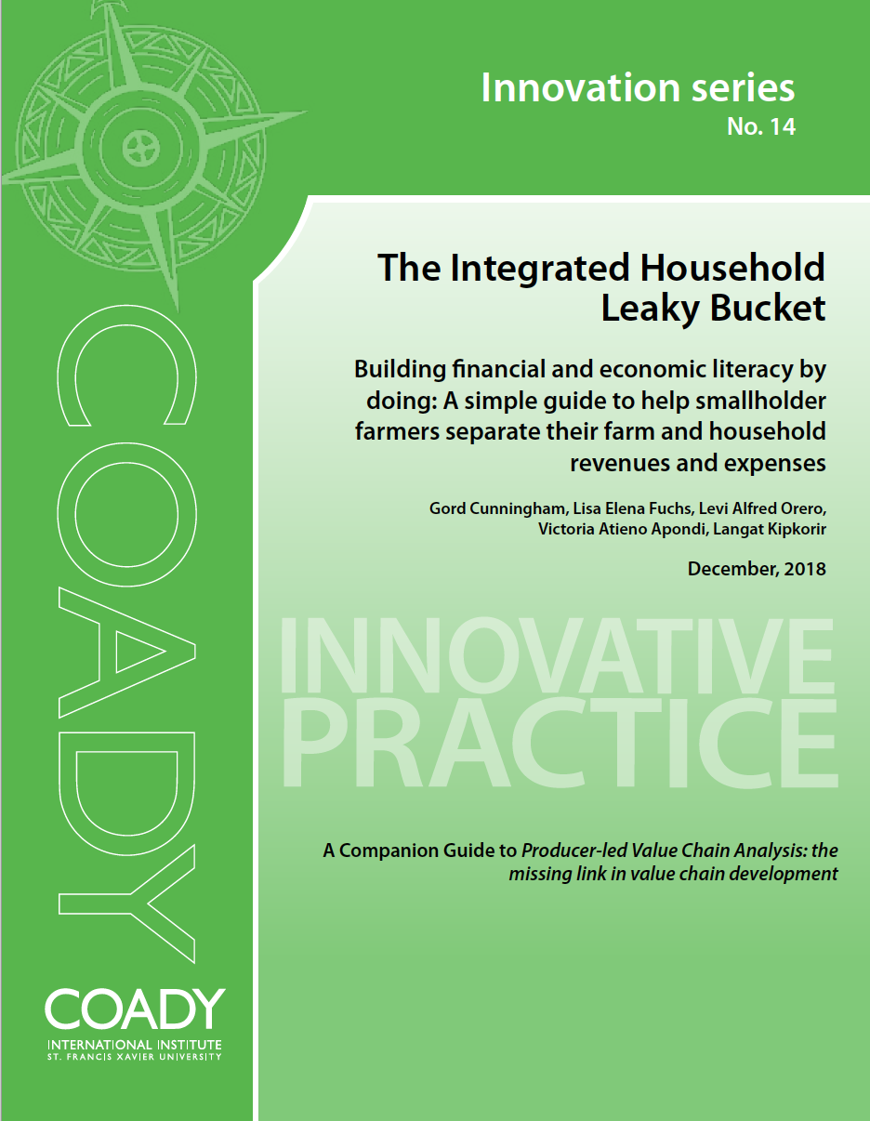
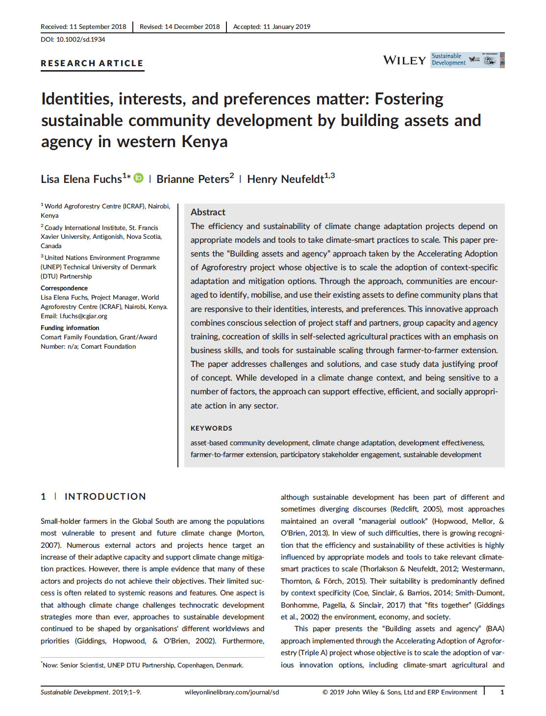
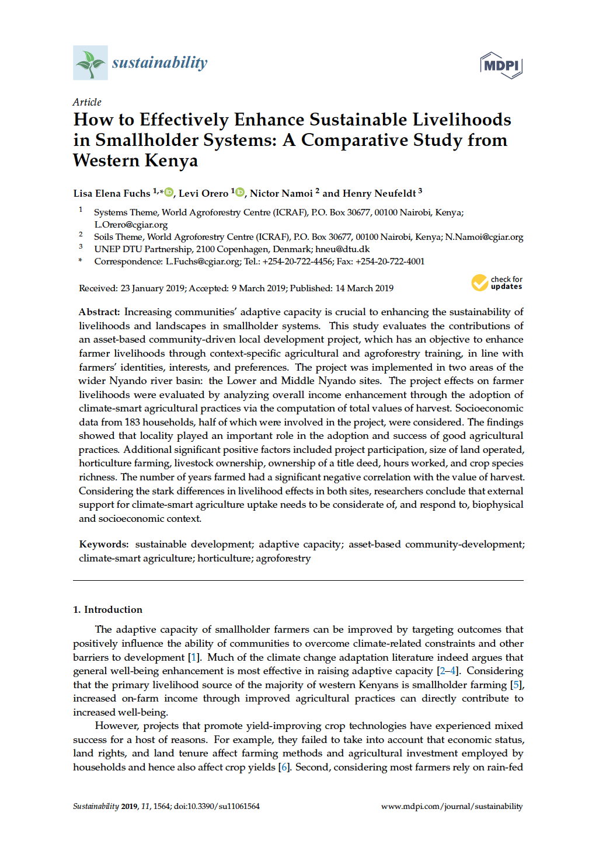
Core publications

Slide 16
Publications
Fuchs LE, Peters B, Neufeldt H. Identities, interests, and preferences matter: Fostering sustainable community development by building assets and agency in western Kenya. Sustainable Development. 2019; 1–9. https://doi.org/10.1002/sd.1934
Fuchs, LE, Orero, L, Namoi, N, Neufeldt, H. How to Effectively Enhance Sustainable Livelihoods in Smallholder Systems: A Comparative Study from Western Kenya. Sustainability. 2019, 11 (Special Issue Sustainable Development of Tropical Agriculture), 1564; https://doi:10.3390/su11061564
Fuchs, LE. Bridging the divide in community development: The importance of process in linking community demands and responsive external support. Coady Innovation Series, (8), 2018, 11 pp. https://coady.stfx.ca/wp-content/uploads/2018/12/IS8.pdf
Cunningham, G., Fuchs, LE, Orero, L, Apondi, VA, Kipkorir, L. The Integrated Household Leaky Bucket. Building financial and economic literacy by doing: A simple guide to help smallholder farmers separate their farm and household revenues and expenses. Coady Innovation Series, (14), 2018, https://coady.stfx.ca/wp-content/uploads/2018/12/IS14.pdf
News media content (selected)
Onyango, S., Fuchs, L., ‘Smallholder farmers in Kenya in the race against climate change’, Agroforestry World, 24 May 2017, http://blog.worldagroforestry.org/index.php/2017/05/24 /smallholder-farmers-kenya-race-climate-change/
Mbugua, S., ‘Kenyan farmers reap economic, environmental gains from ABCDs of agroforestry’, Mongabay, 4 December 2017, https://news.mongabay.com/2017/12/kenyan-farmers-reap-economic-environmental-gains-from-abcds-of-agroforestry/
Mbugua, S., ‘Agroforestry delivers holistic outcomes for Kenyan farmers’, 27 December 2017, http://www.moffittsfarm.com.au/2017/12/27/agroforestry-delivers-holistic-outcomes-for -kenyan-farmers/
Mbugua, S., ‘The Village That Gave Up FGM and Gender Taboos – Because of Economics’, NewsDeeply, 23 January 2018, https://www.newsdeeply.com/womensadvancement/articles/2018/01/23/the-village-that-gave-up-fgm-and-gender-taboos-because-of-economics/
Other media content
Draft new website: www.abcd-agroforestry.org (including ‘Humans of Triple A’ stories)
YouTube: ‘Accelerating Adoption of Agroforestry’ videos : https://www.youtube.com/watch?v=GMSGvOMEr-M&list=PLhnzWXR6gFgqQPA9xiypJU_lDwxGgQcIt

Slide 17
Thank you!
World Agroforestry (ICRAF),
United Nations Avenue, Gigiri,
P.O Box 30677-00100, Nairobi, Kenya
Phone: +254 20 722 4000
Fax: +254 20 722 4001
Email: L.Fuchs@cgiar.org
Website: http://www.worldagroforestry.org/project/accelerating-adoption-agroforestry-western-kenya-triple-project
Also see: http://www.abcd-agroforestry.com

