Slide 1
Addressing Well-being Improvements within Multiculturalism Communities by Mainstreaming Religious Moderation
June 24, 2020
Hernik Farisia, et.all
Center for Research and Community Service
UIN Sunan Ampel Surabaya

Slide 2
Brief Description
This course aims to enhance students’ capability in conducting collective work within academician and multiculturalism community. More further, it is important to encourage the outreach function of universities to bring empowerment to the people in transforming better lives.
This program was located at East Nusa Tenggara with theme peace building in which spiritual and cultural asset as the basis and to disseminate moderate values at the wider community.
Held by representative of students at State Islamic Universities in Indonesia organized by Sunan Ampel State Islamic University and supervised by Ministry of Religious Affair of Republic Indonesia.
The program is known as “KKN Nusantara”, literally translated as Archipelago Community Outreach

Slide 3
Community Partner (Sulamu District, Kupang, East Nusa Tenggara)
7 areas of partner: Sulamu village, Pantulan, Pitay, Pantai Beringin, Pariti, Oeteta, and Bipolo
Sulamu district as part of Kupang is usually very peaceful and had been relatevely harmonious; there are lots of religions and beliefs, tribes, and races represented in this place. There were Bajo tribe which is predominantly moslems, Rote tribe which is predominantly Christian, and others. That is why this place is so vibrant.
2
1
Religious local leaders are central figures in a plural society in the Sulamu region so it become key aspect in optimizing their potential asset through Interfaith youth group and interfaith community
3
Potential of natural resources; seaweed, crabb shell, tenun-traditional cloth material, marine tourism, etc.
4

Slide 4
Potential Assets of Natural and Human Resources at Sulamu District
Sulamu Village | Pantulan Village | Pitay Village | Pantai Beringin Village
Seaweeed | Panfolok beach | Farming | Seafood
Animal husbandry | Colour sand |  | Farming
 | Savana |  | Animal husbandry
Farmer and breeder | Fisherman | Farmer | Fisherman and civil servant
Pariti Village | Oeteta Village | Bipolo Village
Banana product | Farming | Forest tourism
Seafood | Salt | Farming
Animal husbandry |  | Tenun-traditional cloth material
 |  | Salt
 |  | Mining
Trader and civil servant | Farmer and enterpreneur (in small to medium scale) | Farmer and craftmans

Slide 5
Potential Assets of Spiritual and Cultural at Sulamu District
The dynamic of tolerance and moderate values within communities’ life of Sulamu
When there are events, weddings, family parties, and grieving, etc. there will be cuisine that is set aside for Muslims since they were a rule of halal-haram food
The community follows the prevailing cultural norms in Sulamu while still prioritizing the the values based on another religion. Such as, when there are welcoming guests they conduct “Budaya Minum Sofi (Arak)” and there’s exception for muslims
The community are able to organize diversity and freedom of religion and belief as the basis of creating unity for better live, such as by forming interfaith youth group
Religious local leaders are central figures in a plural society in the Sulamu region so it become key aspect in optimizing their potential asset through Interfaith youth group and interfaith community

Slide 6
Stages
Define
Acting on findings; the students facilitated the program
Inculturation
Visiting local leaders and institution
Discovery
Design
FGD (Focus Group Discussion); designing program framework
Joining social and cultural event (Pa-pi Ma-mi)
Forming Core Group that represented interfaith leader, local leader, interfaith youth leader, and village leader
Mapping the asset (the result as presented to the above slide)
FGD; negotiating the mobilicazion of findings and knowledge to the widespread communities
Mobilizing asset and community
Defining priority scale: optimization of spiritual and cultural assets as the main social capital of the Sulamu District community to work together and create economic development opportunities
Strengthening partnership networks (Department of agriculture, interfaith leader, training institute, etc.)
The dissemination of this work was presented on meeting forum in Governor’s office attended by some relevant stakeholders, February 14, 2020. The result also written on a book chapter

Slide 7
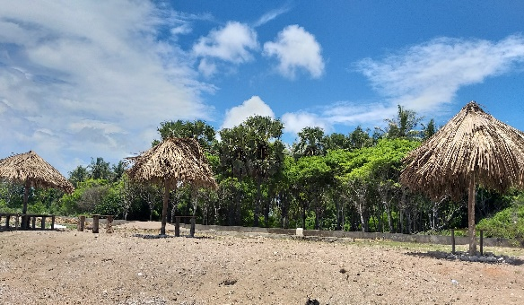
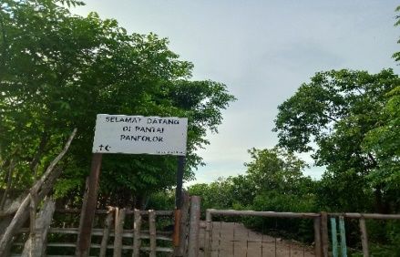
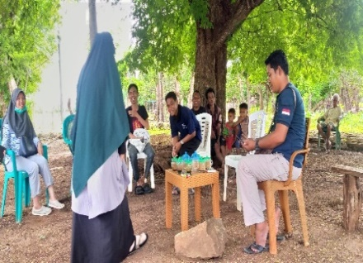
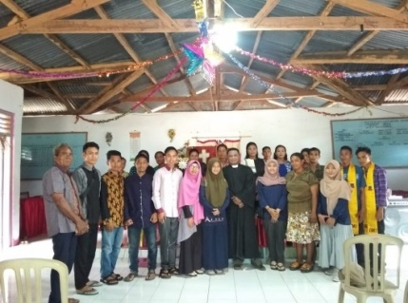
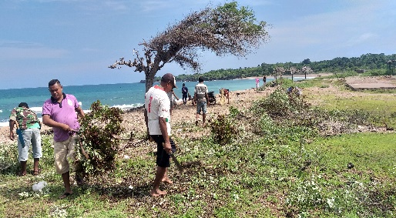
Outcomes
Pioneering Panfolok and Color Sand Tourism Village through interfaith youth group-Pokdarwis “Kelompok sadar wisata pemuda lintas iman”. They work collaboratively to beautify the beach, build gazebo and photo spots, etc.)

Slide 8
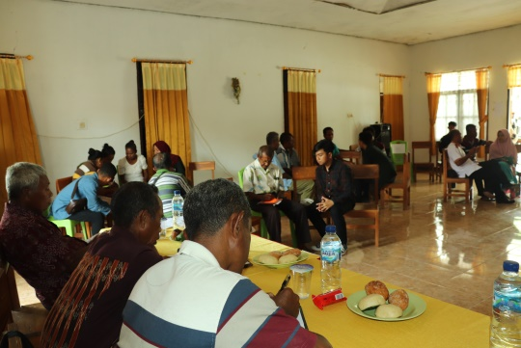
Outcomes
Sulamu
Pitay
The community started to develop increased product value of seaweed product through interfaith working group for more inclusive management
Empowering woman-Pitays’ community to produce “healthy drink” in a small scale

Slide 9
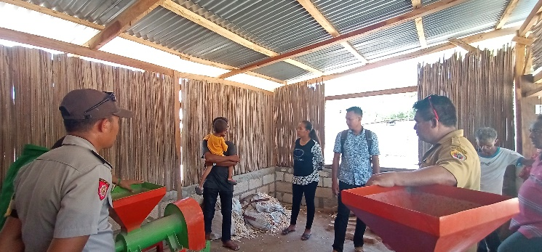
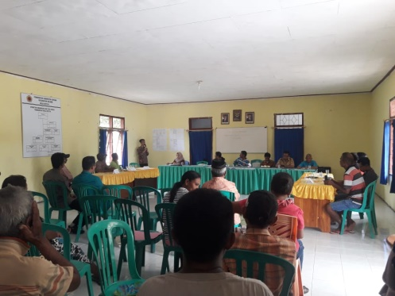
Outcomes
Pantai Beringin
Pariti
The community developed an increased product value added of crab shell waste for animal feed production
Pariti developed increased product values of banana plantation through local group community

Slide 10
Outcomes
Bipolo
Oeteta
Developing trading system by strengthening BUMDes and build e-commerce system in collaboration with JNE
Empowering farmer community group to cultivate “kelor plantation” and its added value product such us flour, kelor coffee, etc

Slide 11
Lesson Learned
Those works reveal that religious moderation mainstreaming as spiritual and cultural asset positively contributed to establish self-reliance among people and enabling them to have better economy access.

