Slide 1
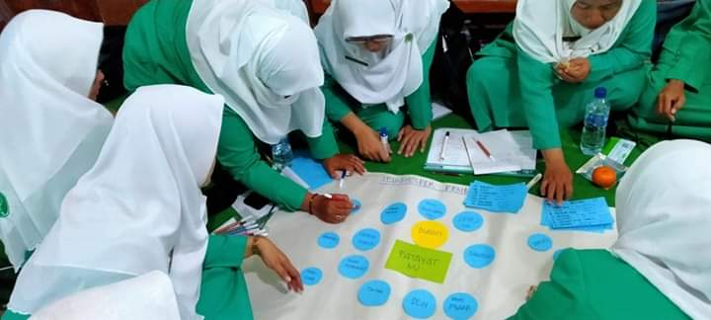
Asset Mobilization for Strategic Planning Fatayat NU’s New Way to Improve Community Services
Yeni Lutfiana (PW Fatayat NU Jawa Timur)

Slide 2
Topics
Profile
Background
Process
Achievements
Challenges
Lesson Learn

Slide 3
FATAYAT NU Profile
One of the largest women's organizations in Indonesia, focusing on social and religious affairs with management from the village level to the national level.
Fatayat NU East Java has 45 branches in all districts
400,000 members aged 20 to 45 years

Slide 4
Background
The “Finding a Problem” approach gives rise to pessimism
Organizational assets that are less useful because they are not mobilized properly

Slide 5
Process
Convincing
discussion
Recognize the method
Preparation
Training
Multiply actors
Application
Workshop
Strategic Planning Facilitation
Monitoring and Evaluation
Monitoring
Evaluation

Slide 6
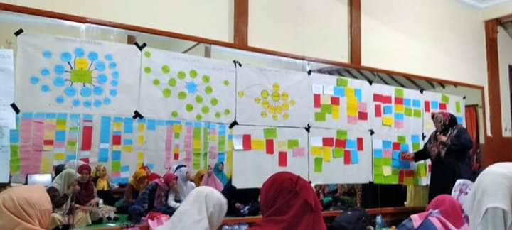
Achievements
Optimistic
Mainstreaming
Priority Program
Replication

Slide 7
Challenges
management thinking paradigm
less challenging
less critical
Area and number of members

Slide 8
Lesson Learn
To strengthen the organization's role in serving the community is to build confidence that organizational assets will be the main driving factor if mobilized properly

