Slide 1
Constructing Women’s Narratives of Intimate Partner Violence using
Asset-Based Community Development (ABCD) Method
Savy Amira WCC
Presented by Siti Mazdafiah

Slide 2
The Background of the Program
The persisting narratives about woman and violence against woman (VAW) have been disempowered women, perpetuated the oppression of women, and normalized VAW.
Narratives about woman are the product of patriarchal society that are full of false beliefs about women has been disempowering to women.
Savy Amira believed that only if the current narrative be changed therefore can women free themselves from oppression

Slide 3
Methodological Question
Savy Amira have been using Narrative-based Counseling which is focused on the power of language and story in shaping women’s life. It should be concordance with the basic principle of ABCD’s that is language shaped the world
Previously we focused on individual one to one counseling session —with limited organizational resource we cannot deliver the service to all women needed.
We were thinking about to form a group of women with history of gender-based violence to support each other.
ABCD seems to deal with economic empowering in the community. Is it possible to empower the community of women psychologically?

Slide 4
Activities
This is the story of the implementation of ABCD method in the period of 2018-2020 to in facilitating self-help group for women with the history of intimate partner violence (IPV).
Forming battered women group—all women joined voluntarily to the group: those are previously working together with us, those who are joining because of our promotions in social media and other community of survivors which previously the support been undertaken by organization partners —(Fatayat NU Wilayah Jawa Timur and WCC Jombang
Aim: to provide an environment of mutual self-help and support that will enable participants to address their experiences as survivors of domestic violence and to empower each other.

Slide 5
Manstream Narratives about IPV that disempower women
Violence against women is women failures
VAW is a way to discipline woman
Women deserve to receive violence
Violence is a shameful for the family therefore we cannot share the story in public or make a report
women should remain silent if they receive violence
Woman who is not showing their resistance to violence happens to her is stupid
victims of violence is passive
Violence is an “exam” from God to achieve higher level of devotion to God.
etc

Slide 6
Changing Narrative to Empower women
Making failures is OK, but violence is never OK. Violence is the responsibility of the perpetrator.
Violence is not a way to discipline anybody
nobody deserve to receive violence
committed to do violence is shameful. Violence is a crime. We have to make a report.
Whenever people are badly treated, they always resist. Sometimes we cannot notice them.
Victims of violence live in a complex situation. They’re actively trying to find a way to safe not only themselves but also those who they love
The purpose of marriage is to love each other
etc

Slide 7
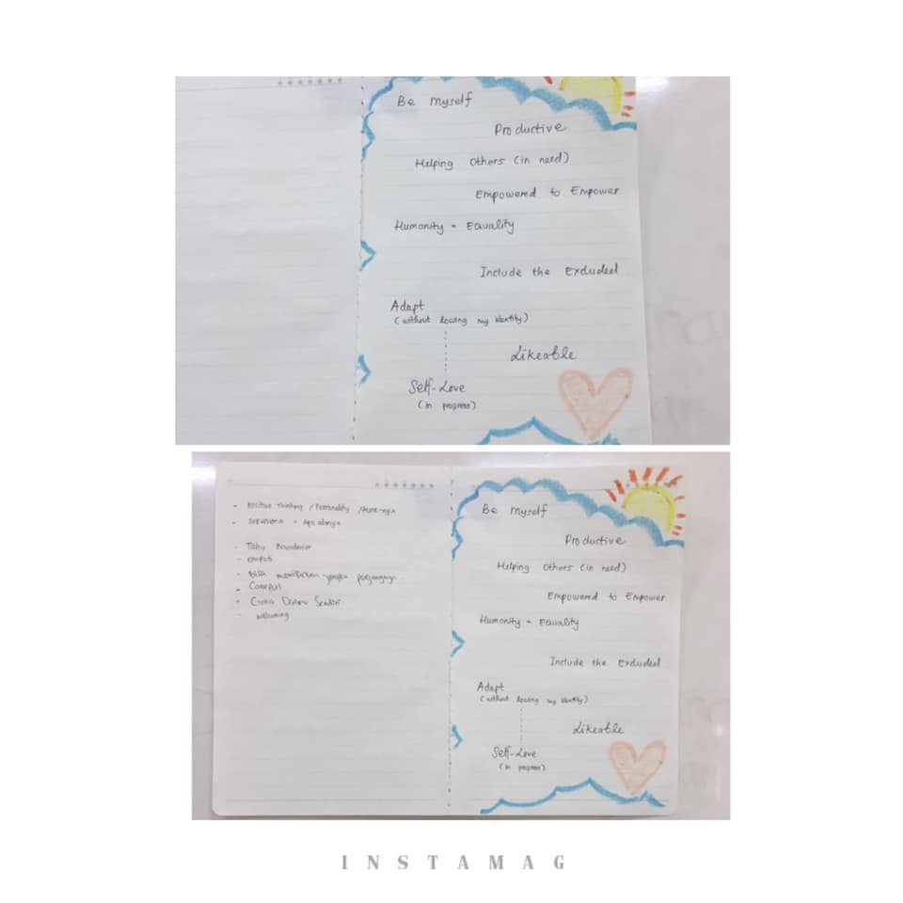
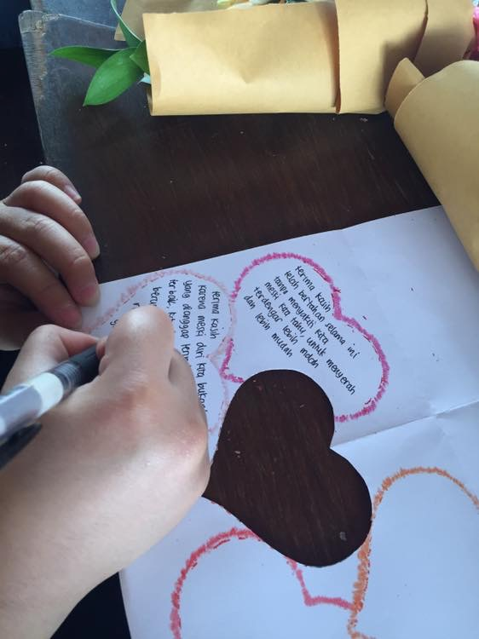

Slide 9
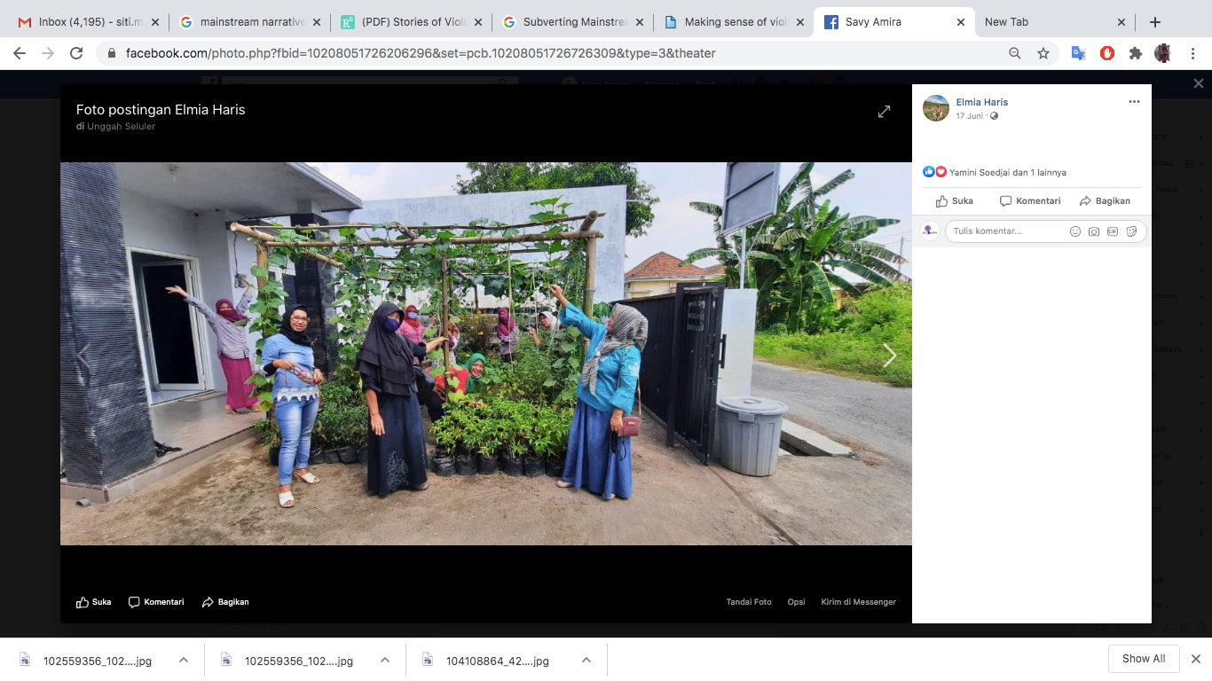

Slide 10
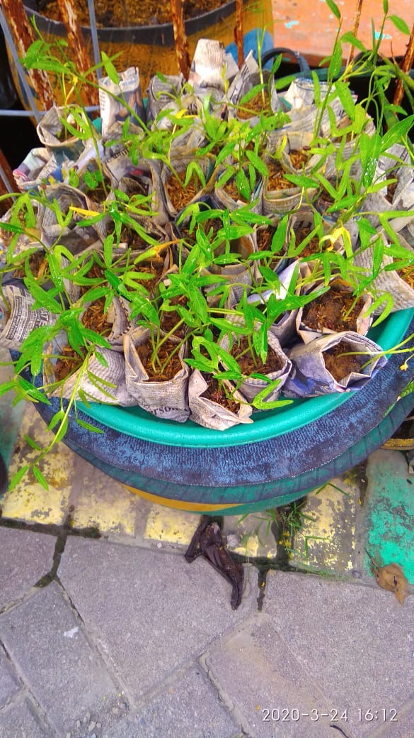
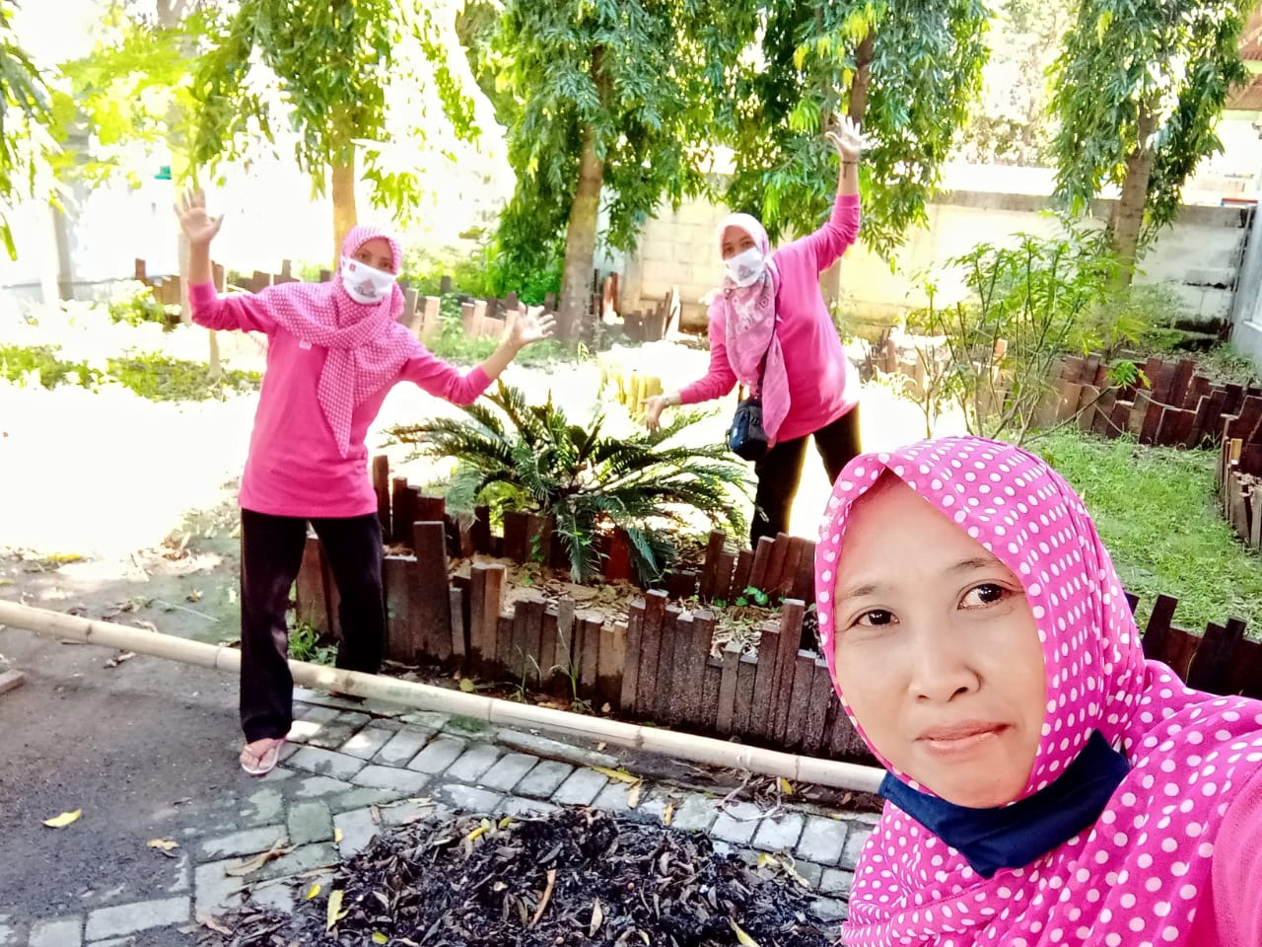

Slide 11
Telling (Success) Stories to Identify Personal Asset -1
increase women’s self esteem to identify their strength.
women try to recognize their individual strength (power within, power with and power to)
Power within: ability to rise, ability of letting go, self fulfilled, ability to deal with conflicts and pain, ability to free from violence and financial difficulties, ability to learn from experience,ability to control own emotions, self regulation, self reliance and strong motivation to make everything she wants come true,

Slide 12
Telling (Success) Stories to Identify Personal Asset-2
Power with: ability to make social connection, built a network, active in social movements, to help another women.
Power to: Ability to build a small business, ability to self sufficient and support the family, ability to keep being active everyday and maintain creativity even though they are sad, ability to end abusive/toxic relationship, ability to free themselves from toxic people, to create new narrative that “divorce” or “leaving their abusive partner” is no longer means “failure” or “end” but it is the “beginning”, “success”, ‘freedom.” and “new life.”

Slide 13
Terimakasih kepada:
All women as participants
Project Sile UINSA, Coady International Institute, Jeder Institute
Organization Partners: WCC Jombang, Fatayat NU wilayah Jatim, Mantasa
Voice.Global dan Grand Challenge Canada

