Slide 1
Loving Life - Creating safer spaces for Adolescent Girls and Women
Tharuni in collaboration with Women SAFETY WING, TELANGANA POLICE
Event description
Interaction between women police officers and rural adolescent girls on how to be safe and secure in this turbulent times when there is an increase in domestic violence, child marriage, child labour and abuse in India during this pandemic. The interaction will inspire the girls to be the change agents in order to help others in their communities.

Slide 2
PANDEMIC LEADING TO ANOTHER PANDEMIC ? INCREASE IN CASES OF VIOLENCE
Violence against women is an indicator of the depth of societal conflict and crisis
Women and children who live with domestic violence have no escape from their abusers during quarantine.
The epidemic has had a huge impact on domestic violence, 90% rise in cases in CHINA
In Brazil a state-run drop-in centre has already seen a surge in cases – 40% to 50% rise in cases
In Italy activists said there is an “explosive increase” in the number of reports of domestic abuse
Increase in Child Marriages, Child Abuse, Online Harassment in most of the countries.
Police in India have launched a new domestic violence helpline as cases surged
In India, child helpline had seen a 50% surge in demand for help from children.

Slide 3
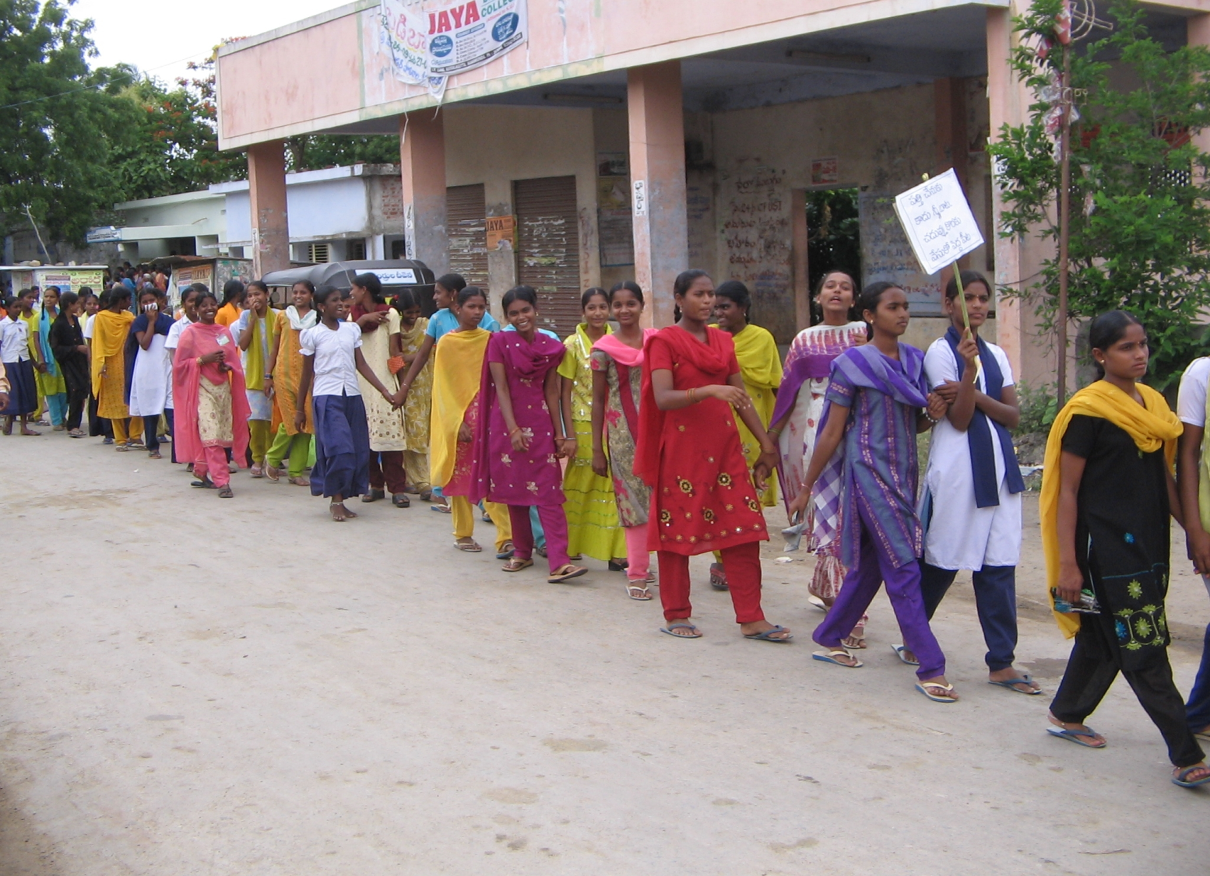
If we walk together …….
www.tharuni.org

Slide 4
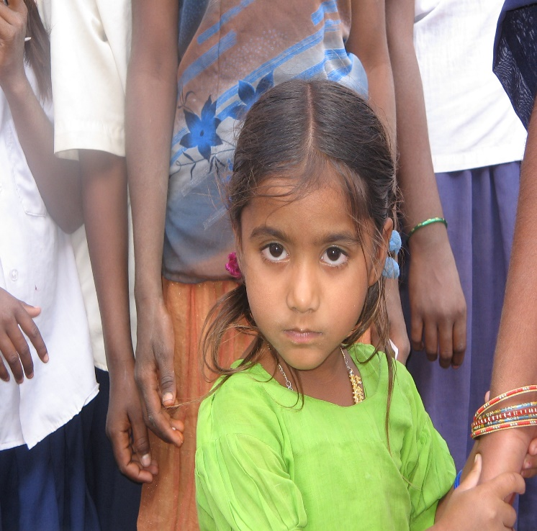
Tharuni @ 2020
Problems Identified:
Gender based Violence
Human Trafficking
Child Labour
Early Marriages
Infanticide and Foeticide
Lack of opportunities
Addressed through…
Creating forums
Sensitizing the Stakeholders
Advocacy and Campaigns
Building Pressure on
Officials
Rescue and Rehabilitation
Legal Battle, Policy Changes

Slide 5
BALIKA SANGHAS (GIRL CHILD CLUBS)
‘Bringing them together is the only answer!’
In a village 20 girls belonging to a colony form one Balika Sangha. Elect two leaders among themselves.
A preliminary meeting with the mothers of these girls is held involving community leaders.
The leaders of the Balika Sangha are trained on Leadership Skills, Life Skills, Family Life Education, etc
The girls will meet every fortnight and discuss various issues which are hindering their development and try to arrive at solutions.
Resource Centres have been set up in each village equipped with Digital learning facilities, Library, Sports material.
Through Balika Sanghas, girls find support to resist gender stereotypes, express themselves freely, take pride in their successes, feel comfortable with their bodies, have confidence, nip violence at the onset and explore a world of opportunities.

Slide 6
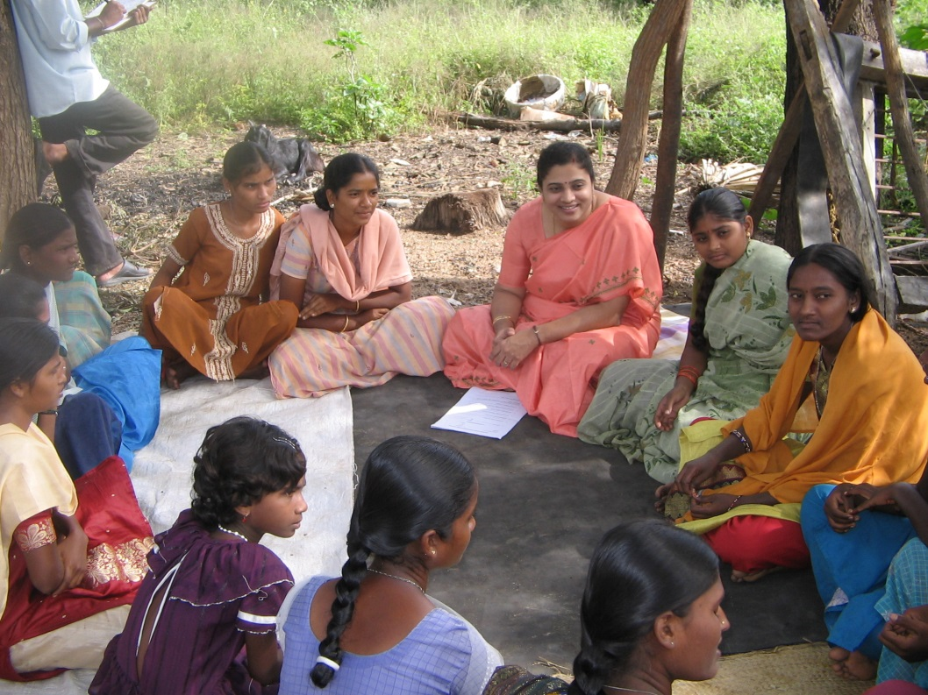
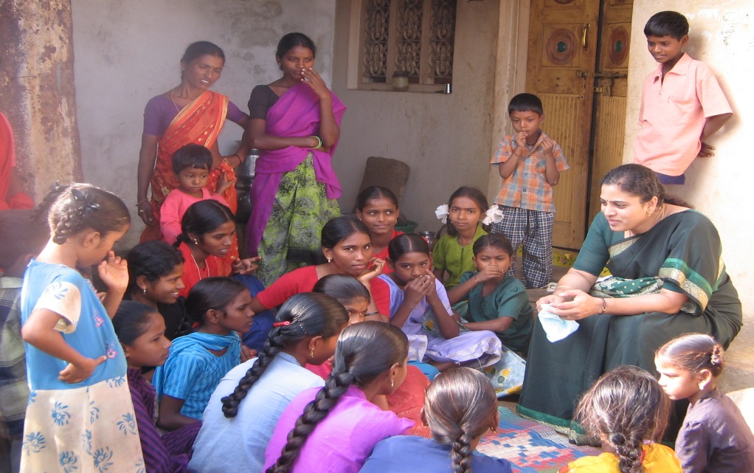
TRANSFORMING GIRLS
17,000 girls mentored through 500 Balika Sanghas (Girl Child Clubs) in the age group of 10-18 year old Adolescent girls

Slide 7
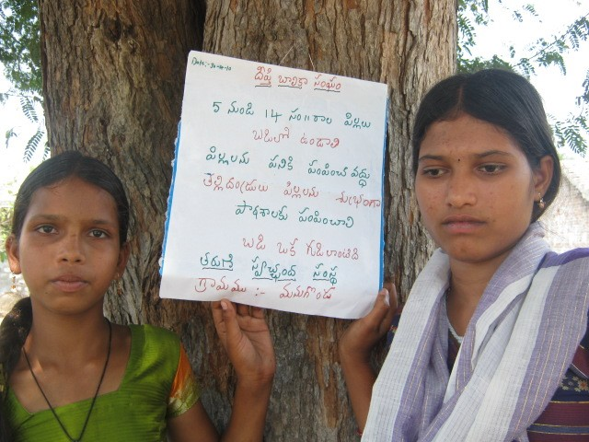
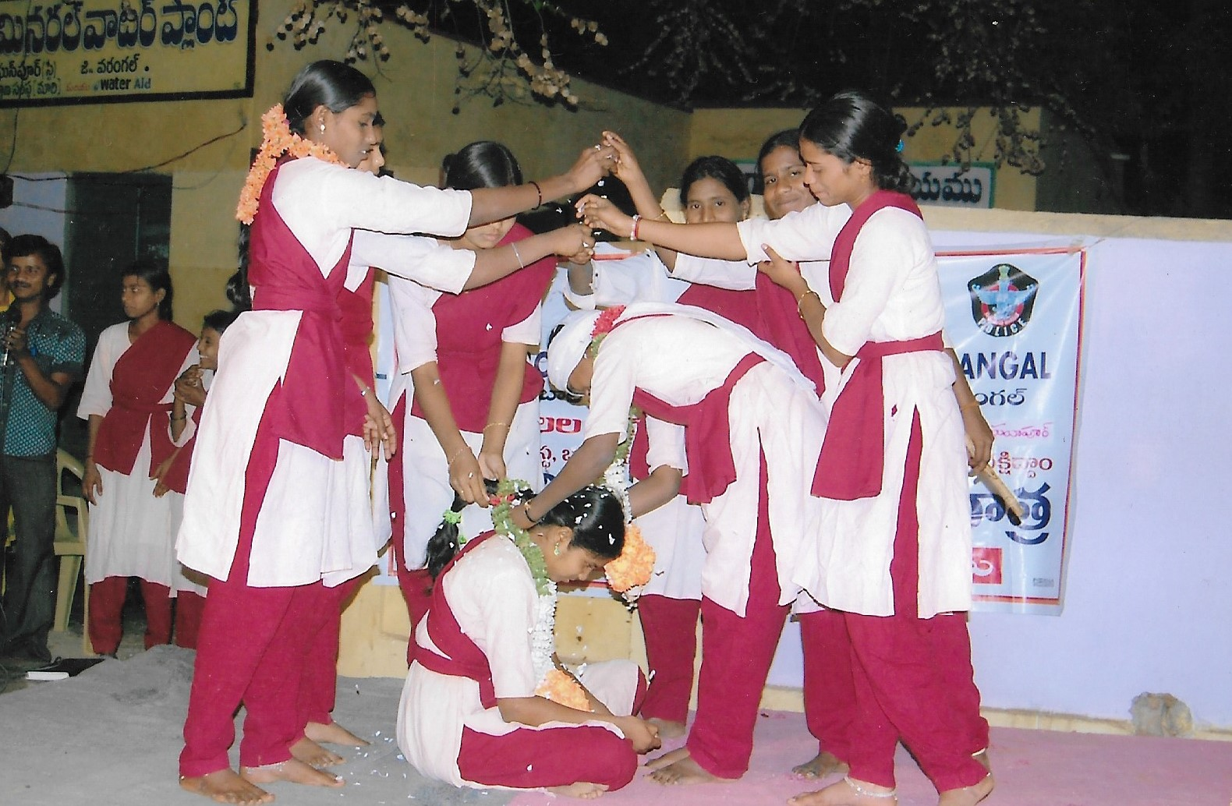
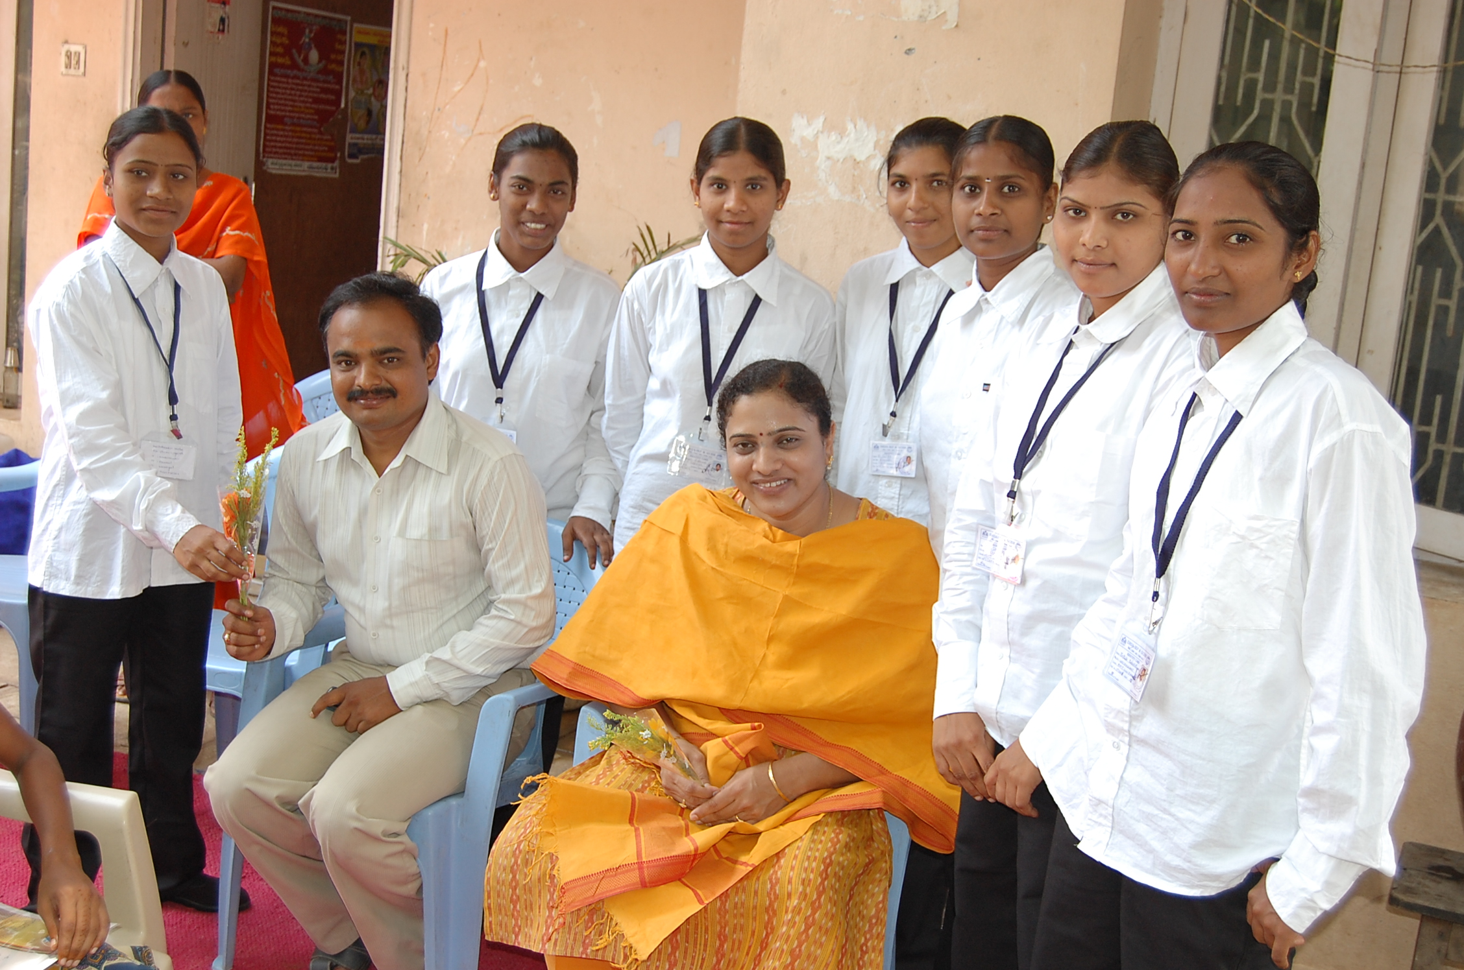
Balika Sangha Members transformed as change agents in their communities.
Stopping Child Marriages & Abuse
Mainstreaming the drop outs
Empowering themselves

Slide 8
IDENTIFYING OUR STRENGHTS & UTILISING THE ASSETS
Discussion Points:
Safety in Public Spaces
Child Marriage
Child Abuse
Domestic Violence
Cyber Harassment

Slide 9
participants
Adolescent Girls from Villages:
Team lead by N. Harshini, Project Manager, Tharuni
Safety in Public Spaces : Krushi,
10th standard, Elgur Station
Child Marriage : Pavani,
10th standard, Ramachandrapuram
Child Abuse : Sravya,
10th standard, Thimmapuram
Domestic Violence : Akshaya,
9th standard, Kapula kanaparthy
Cyber Harassment: Kaveri,
9th Standard, Aashalapally
THARUNI – Dr Mamatha Achanta,
Founder, Tharuni
Telangana Police – Ms Swati Lakra IPS,
Additional Director General of Police
- Ms B. Sumathi IPS,
Deputy Inspector General of Police

Slide 10
SWATI LAKRA IPS
Swati Lakra is an Indian Police Service Officer. She Joined IPS in 1995. Now She Is working as the Adl DGP, Women Safety, & Law and Order in Telangana. She is Known for her women-centric initiatives like SHE Teams, Bharosa and iron hand in dealing with offenders.

Slide 11
B. Sumathi IPS
Ms B.Sumathi belongs to Indian Police Service of 2006 batch. She is presently working as DIG, CID & Women Safety Wing. She is known for her effective strategies in finding solutions for the problems and being tough with the offenders.

Slide 12
INTERACTION WITH ADOLESCENT GIRLS FROM WARANGAL

Slide 13
QUESTIONS FOR DELIBERATION
1) Eve-teasing in public spaces - Q) We heard that you have started She teams in rural areas. How can they curb Eve-teasing.
2) Child marriage - Q) What is the police role in stopping child marriages
3) Child Abuse - Q) We heard that our Tharuni and Telangana police starting Bharosa centres in rural areas. How can Bharosa centres help in supporting child abuse victims
4) Domestic Violence - Q) What is that police doing during Covid pandemic about the increase in domestic violence cases
5) Cyber Harassment - Q) How to be safe online as now we are having online classes due to Corona.

Slide 14
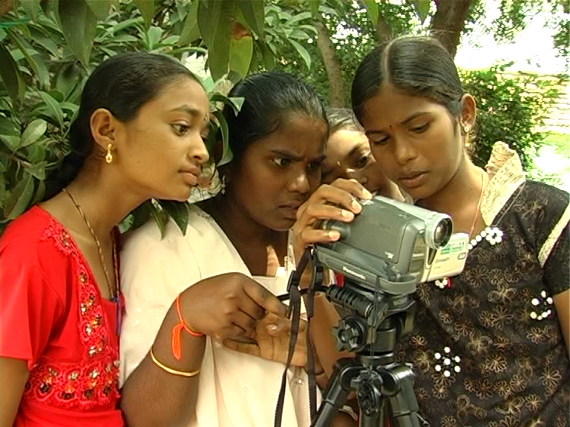
SAVE GIRL CHILD TO SAVE MANKIND
WORK FROM
HOME
BE SAFE
Thank You

