Slide 1
An Analysis of Six Power Ladders, Wheels, and Progressions
Date and time
Wed 24th Jun 2020, 2:00 pm - 4:00 pm PDT

Slide 2
Agenda
Welcome, host introductions, and overview of session
Introductions of participants
Discussion of 6 Six Power Ladders, Wheels, and Progressions
Closing

Slide 3
Hosts
USA Host team members: ABCD Institute Faculty, USA
https://resources.depaul.edu/abcd-institute/Pages/default.aspx
Ivis Garcia, U of Utah
Mark Chupp, Case Western Reserve University

Slide 4
Article: https://drive.google.com/file/d/1ehVcKKnSgSgcvqEQn6TsM8q-goTAd4OO/view?usp=sharing

Slide 5
Event description
This conversation will look closely at 5 power ladders
(1) Sherry Arnstein’s “Ladder of Citizen Participation,”
(2) the South Lanarkshire Council’s “Wheel of Participation,”
(3) the International Association of Public Participation (IAP2) “Public Participation Spectrum”
(4) Asset-Based Community Development(ABCD) Institute’s “Citizen Power Ladder” developed by Jody Kretzmann and John McKnight,
(5) Deborah Puntenney the “Resident Power Progression”
(6) developed by Jody Kretzmann, John McKnight, Sarah Dobrowolski, and Deborah Puntenney “Residents and their Associations: A Power Ladder.”

Slide 6
We will answer 4 questions for each ladder regarding:
1. What is its history?
2. How it has been used by participants?
3. What is great about the ladder?
4. What are Its shortcomings and how it could be improved?
In the end, we will compare and contrast the ladders.

Slide 7
Introductions

Slide 8
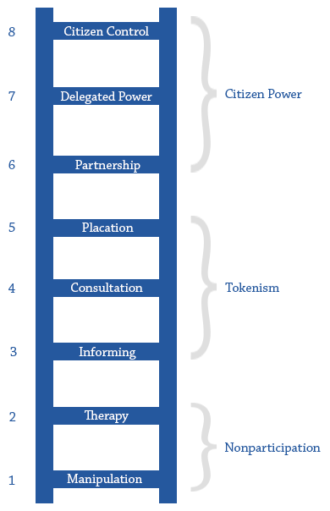
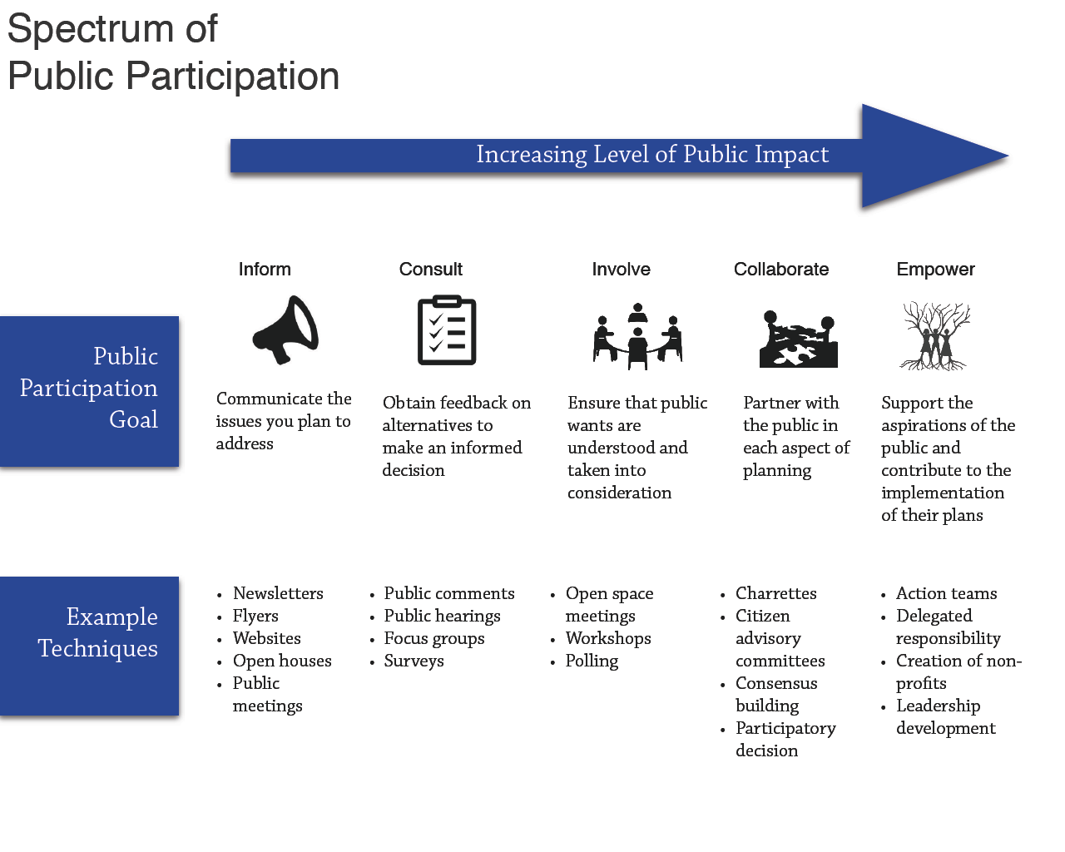
Non-ABCD
Ladders, Wheel and Spectrums
1. Sherry Arnstein’s Ladder of Citizen Participation
2. South Lanarkshire Council’s Wheel of Participation
3. The International Association of Public Participation (IAP2)

Slide 9
1. Sherry Arnstein’s Ladder of Citizen Participation
1. What is its history?
2. How it has been used by participants?
3. What is great about the ladder?
4. What are Its shortcomings and how it could be improved?

Slide 10
2. South Lanarkshire Council’s Wheel of Participation
4. Empowerment
4.1 Delegated Control
4.2. Independent Control
4.3. Entrusted Control
1. What is its history?
2. How it has been used by participants?
3. What is great about the ladder?
4. What are Its shortcomings and how it could be improved?
Participatory Planning
3. Participation
3.1. Effective Advisory Body
3.2 Partnership
3.3. Limited Centralized Decision-Making
1. Information
1.1. Minimal Info.
1.2. Little Info.
1.3. High-quality Info.
2. Consultation
2.1 Limited Consultation
2.2. Customer Care
2.3. Genuine Communication

Slide 11
1. The International Association of Public Participation (IAP2)
1. What is its history?
2. How it has been used by participants?
3. What is great about the ladder?
4. What are Its shortcomings and how it could be improved?

Slide 12
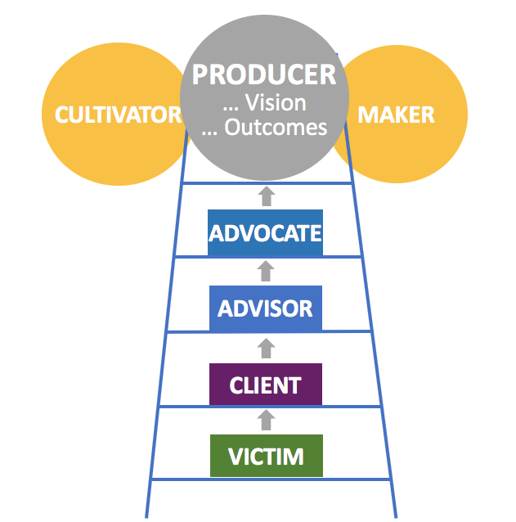
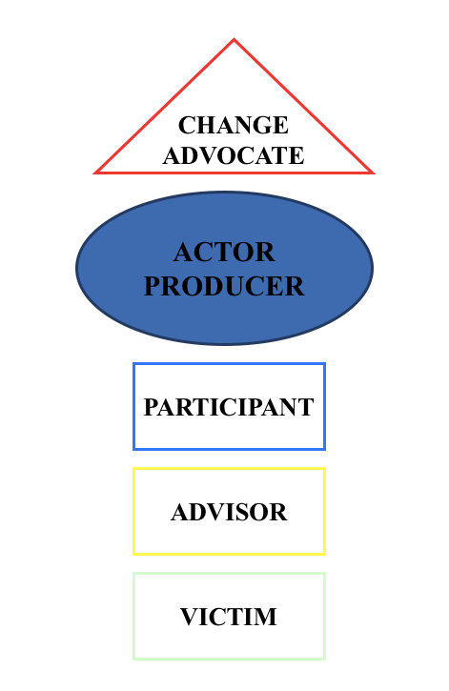
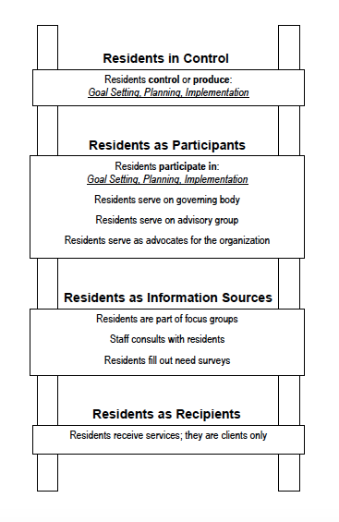
Asset-Based Community Development Institute Power Ladders
1. Jody and John’s Citizen Power Progression
3. Residents and their Associations: A Power Ladder
2. Deborah Puntenney’s Resident Power Progression

Slide 13
4. Jody and John’s Citizen Power Progression
1. What is its history?
2. How it has been used by participants?
3. What is great about the ladder?
4. What are Its shortcomings and how it could be improved?

Slide 14
5. Deborah Puntenney’s Resident Power Progression
1. What is its history?
2. How it has been used by participants?
3. What is great about the ladder?
4. What are Its shortcomings and how it could be improved?

Slide 15
6. Jody and John’s Citizen Power Progression
1. What is its history?
2. How it has been used by participants?
3. What is great about the ladder?
4. What are Its shortcomings and how it could be improved?

Slide 16
Closing
Now lets compare and contrast the ladders.

Slide 17
Thank you!
ivis.garcia@utah.edu
mark.chupp@case.edu
https://resources.depaul.edu/abcd-institute/Pages/default.aspx

