Slide 1
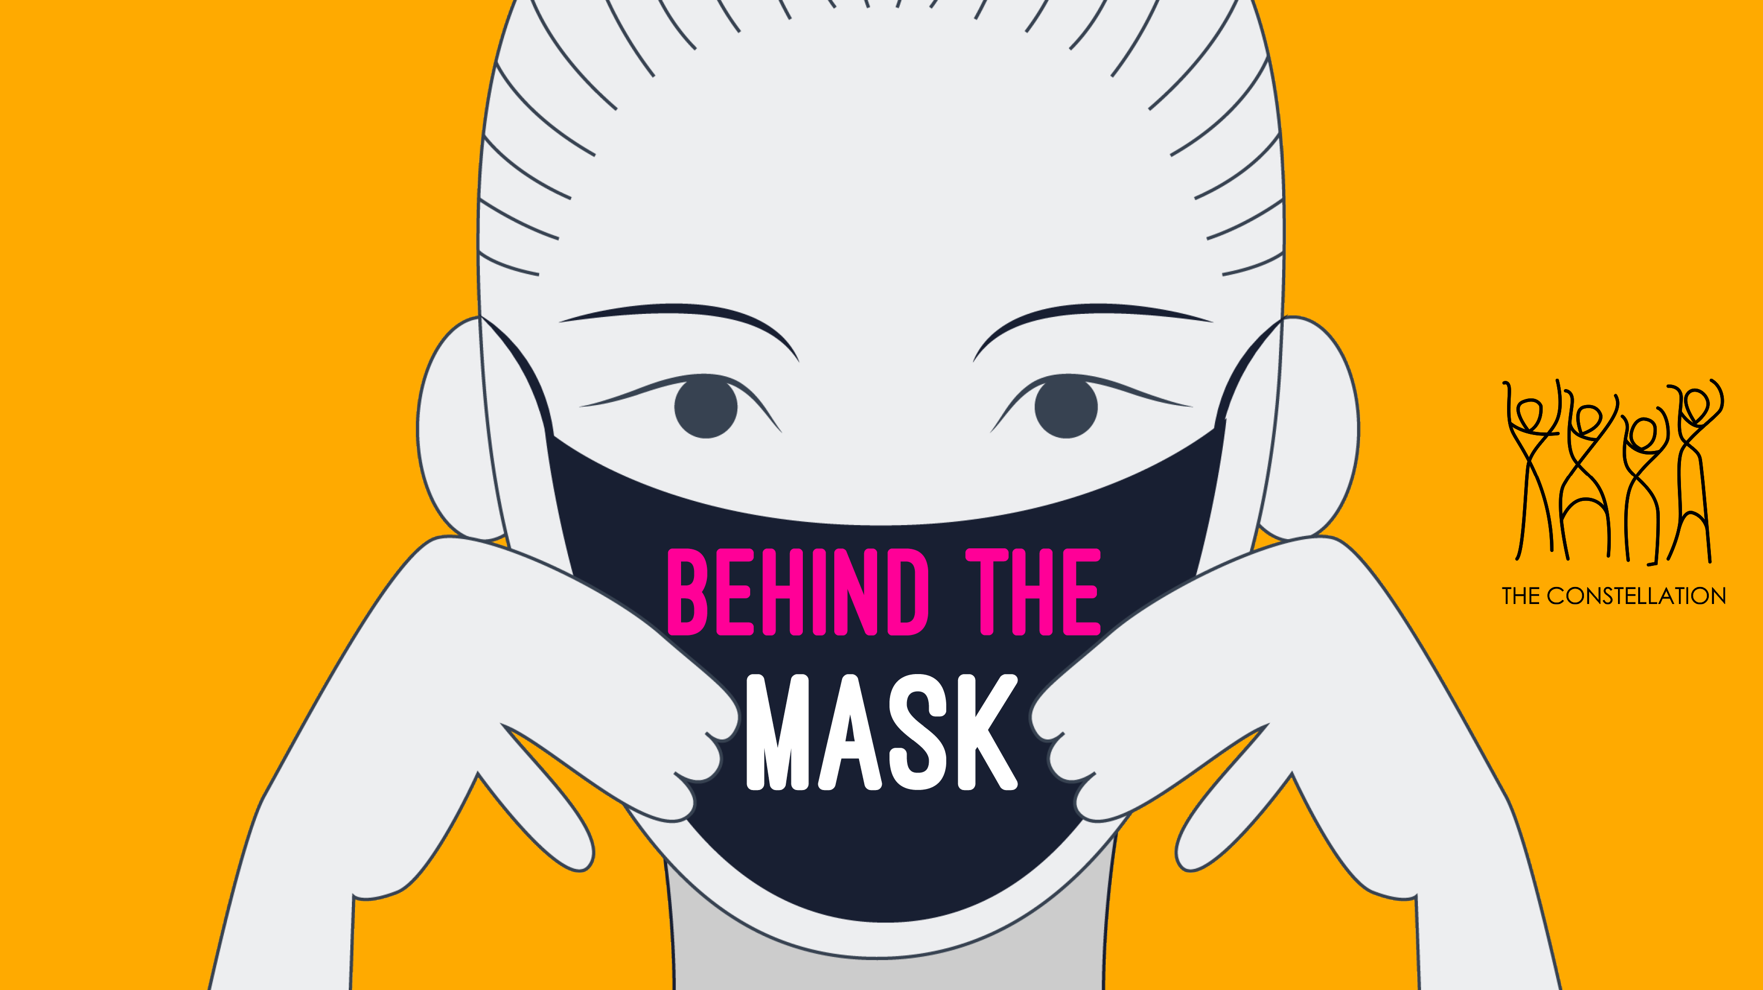

Slide 2
Harvesting Strengths developed ‘Behind the Mask'

Slide 3
Welcome! We will start at 10:05 CET
Harvesting Strengths developed 'Behind the Mask'

Slide 4
Please introduce yourself in the chatbox
Name, country
What pulled you to this session?

Slide 5
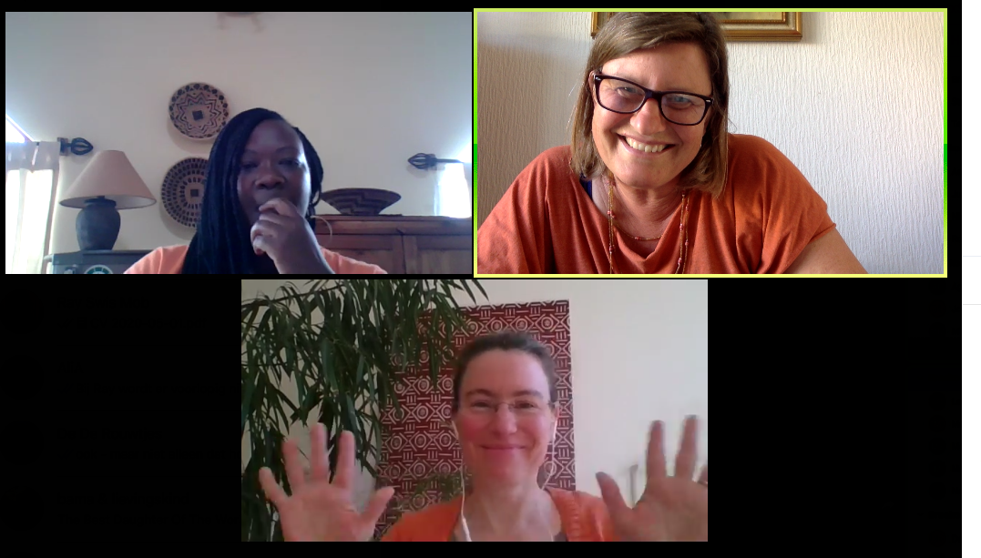
Your hosts
Meble Birengo Marie Lamboray Marlou de Rouw

Slide 6
The Constellation – Stimulating and Connecting Local Responses around the world

Slide 7
WAYS OF WORKING
Community Life Competence Process
Community takes action on its own challenge
LOCAL RESPONSE
S Support, Stimulate
A Appreciate
L Listen, Learn, Link
T Team, Transfer
Step 3
Where are we now?
SELF-ASSESSMENT
Step 4
What are we going to do?
ACTION PLAN
Step 2
Where do we want to be?
SHARED DREAM
Step 1
Who are we?
Who will join?
MOBILIZE
S A L T
Step 5
Let’s do it!
ACTION!
WAYS OF THINKING
People and communities have capacities to respond to their own issues.
Step 6
Where did we get to?
What did we learn
LEARN AND SHARE
People own the issue and the response.

Slide 8
asyouopenyoureyes.com

Slide 9
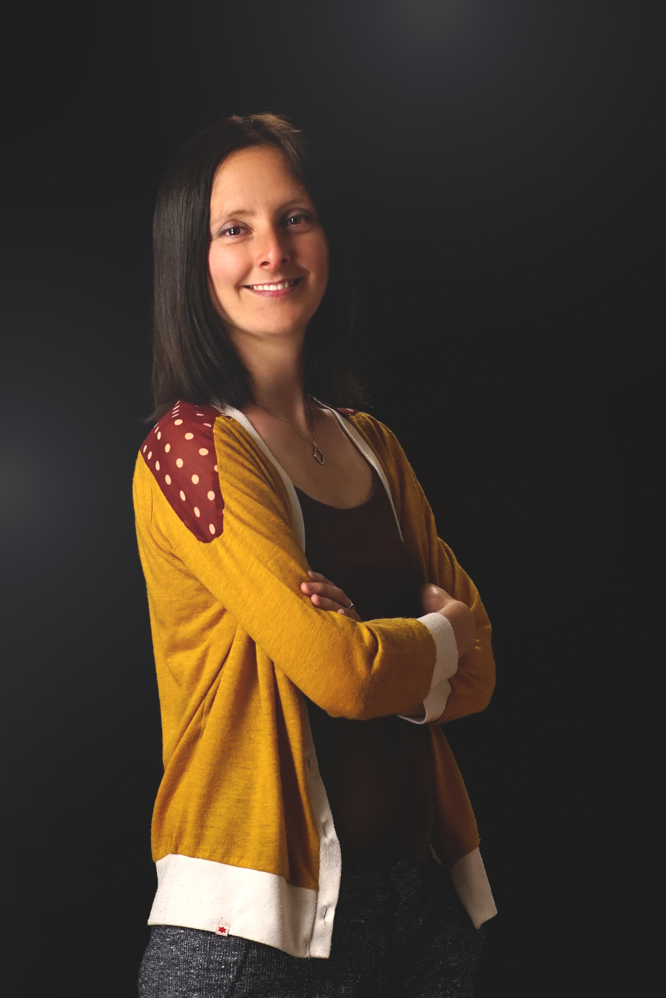
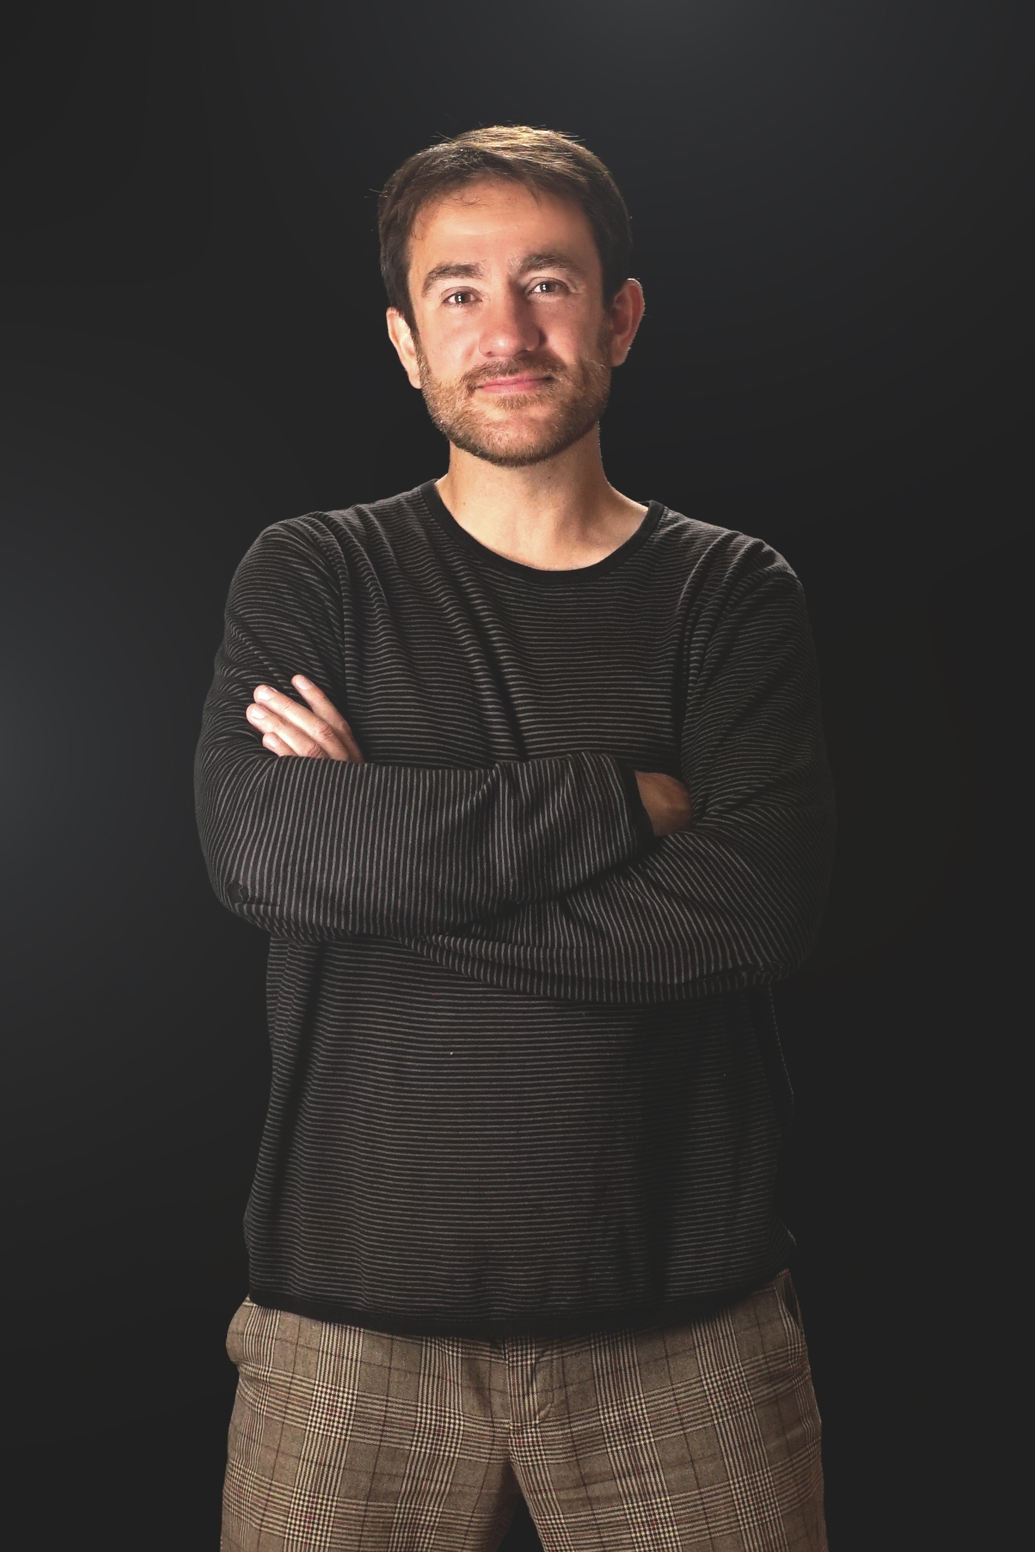
Jessica and David of Visual Development, the filmmakers for Behind The Mask
About Behind the Mask:
“It is a very interesting project. We changed our plans for our As You Open Your Eyes documentary series when the pandemic started. With COVID-19 and Behind The Mask, we learned to collaborate differently with people. People take the film project into their hands and they enjoy it!”
A unique experience…
“… Allowing people to take the experience into their own hands. It is usually always us behind the questions and the camera, in control. Here we learned to let go.” “The protagonists of Behind the Mask captured their lives in a way we could not have done (in their households).” “Yuyun told us that her group was proud to learn to film themselves and their stories.”

Slide 10
Watch 2 episodes BEHIND THE MASK
GROUP 1 Share
https://vimeo.com/421079754
Skilful https://vimeo.com/425808519
GROUP 3
Positive vibes
https://vimeo.com/418490483
Move
https://vimeo.com/423535799
GROUP 4
Stay Safe https://vimeo.com/430312860
Positive vibes
https://vimeo.com/418490483
GROUP 2
Neighbors first
https://vimeo.com/416003688
Imagine https://vimeo.com/428041423
GROUP 5
Imagine https://vimeo.com/428041423
Skilful https://vimeo.com/425808519

Slide 11
Discuss in your group:
1. What strengths did we see from the videos?
2. What do you think was the motivation behind the strengths highlighted in the videos?

Slide 12
The strengths we found Behind the Mask
Group 5
The video from Togo shows us the real situation. People working with what they have. The cultural tunes were amazing and so was the creativity; the foot pedal for the washing hands device. Shared responsibility came out strong. The bonus of having time for connections and relationships. This a gift from Covid-19.
Group 4
What we could see… for example from the body language was that different skills are valued and shared. The situation is getting people to do things together, to become a resilient community showing smiles and kindness.
Group 3
The videos showed personal resilience and the contrast between places, but everyone doing their best. This brought the following question: “What makes somebody bring resilience forth?”
Group 2
We reflected on the importance of art, how we take it for granted, underestimate its ability to bring people together. We talked about resilience. Believe that people have the innovations! When systems are strong, people’s resilience weakens, and vice versa.
Group 1
The drive to action that we talked about are the feeling of helplessness, care for each other, making a difference for the wider community, seeing that we have the resources and the will to have new skills. With the pandemic, we are thinking differently.

Slide 13
Discuss in your group:
1. What have been my pressing worries/concerns in the covid-19 era?
2. What strengths have I seen in myself/my community/family/neigborhood/workplace during this covid-19 era?
3. What have been my greatest lessons on how we live together?

Slide 14
Top two priorities
Group 1
We talked about the wider social and economic impact of the pandemic and our fear to see the virus spreading in our community. However, we are quickly adapting, and we have the ability to come up with new ways to care.
Group 2
It is important to be mindful of each other, to take the time to listen to each other. We all have different concerns, different interpretation and understanding of the situation. There is confusion from so much different information.
Group 3
Our common concern is our family, that they are OK and they are cared for appropriately.
We highlighted the strength of creativity. Knowing that you have the strength to go on.
Group 4
We realised the similarities between our concerns. Our strength is our resilience. When in situation of difficulty, we use what is around us, the local economy, maybe things we forgot about, creating a better life for ourselves.
Group 5
Michael shared the practical challenges he is facing simply for getting around. We are all challenged in different ways. We talked about the diversity and the complexity of the situation and that perhaps tensions will arise.

Slide 17
Thank you for showing who you are behind your mask!
Dolores
David
Astrid
Mohammed
Lisa
Phil
Michelle
Anne
Jude
MariJo
Nisar
Roisin
Brian
Stacy
Tevi
Agnes
Joanne
Michael
Lévi
Anita
Meble
Marie
Marlou
Mohammed
Jessica
Tarek
Noémi

Slide 18
“Why did it take a crisis to bring us together?”
And more inspiring quotes:
“See the world with different lenses.” Meble
“Creativity is the unsung hero of Covid-19.” Teri
“Shining a light on people who prove that we can respond.” Marlou
“Our concern with our work as community developers is that people become dependent on food banks, etc. We want to come up with the right solutions, trusting people to find them themselves.” Roisin
“Universal experience, yes - but not the same in any way - we may all be in the same storm, but we are definitely not in the same boat. The videos Group 3 watched highlighted that.” Anita
“Knowing our neighbours better, deepening connections, stimulating and supporting each other is real living. Hopefully, we will continue living that way.” Meble
“We need to think globally. It is about our future together.” Tery
“I have seen the same inspiration happening in my place, an immense kindness no matter what their walk of life is and where they are coming from.” Mohamed
“I was blessed many years ago when Rituu explained SALT to me.” Michelle

Slide 19
STAY IN TOUCH
The Constellation:
communitylifecompetence.org
https://www.facebook.com/constellationclcp/
Behind The Mask movies and more:
asyouopenyoureyes.com
https://www.facebook.com/ayopenye/
Meble@communitylifecompetence.org
Marlou@communitylifecompetence.org
Marie@communitylifecompetence.org

