Slide 1
Sustainability Ready: What it Takes to Support
& Measure Lasting Change
Jindra Cekan, Valuing Voices
Isabella Jean, Independent Consultant
Holta Trandafili, World Vision USA

Slide 2
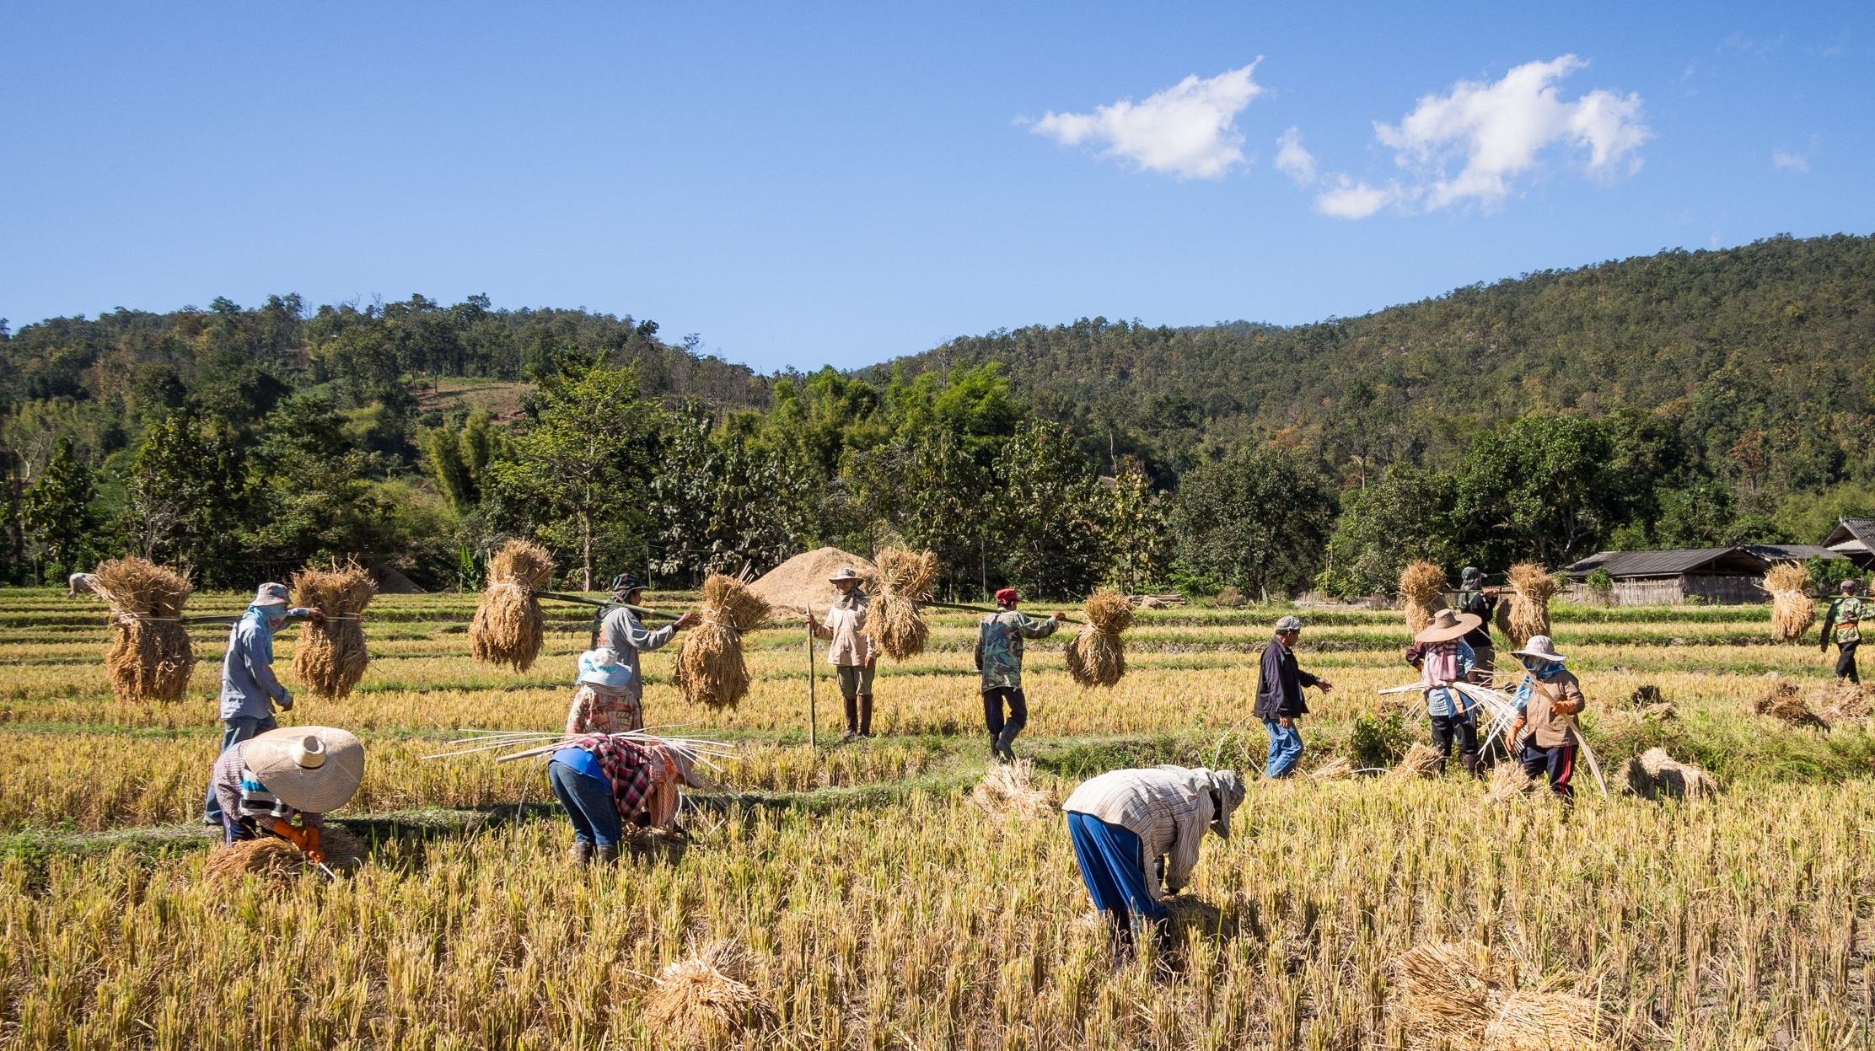
Expenditures: $5.5 trillion spent on public foreign aid since 1945
$137 billion was spent in 2014 alone on development projects
While almost all projects are evaluated for results at conclusion,
Less than 1% of all projects have been evaluated for sustained impacts

Slide 3
Defining Sustainability in Final and Post Project Evaluations
Final/ Terminal Evaluation:
“The systematic and objective assessment of [a]…completed project or programme, its design, implementation and results…. to determine the relevance and fulfillment of objectives, development efficiency, effectiveness, impact and [projected] sustainability…. Will the benefits last?”
(OECD-DAC, 1991 and 2019)
(Ex-) post project Evaluation:
“Ex-post evaluation is generally conducted three years after the project’s completion with the emphasis on the effectiveness and sustainability of the project.”
(JICA : Japanese International Cooperation Agency)
http://mentalfloss.com/

Slide 4
We make unproven assumptions about global aid projects’ sustainability at final evaluation
DO
DO NOT

Slide 5
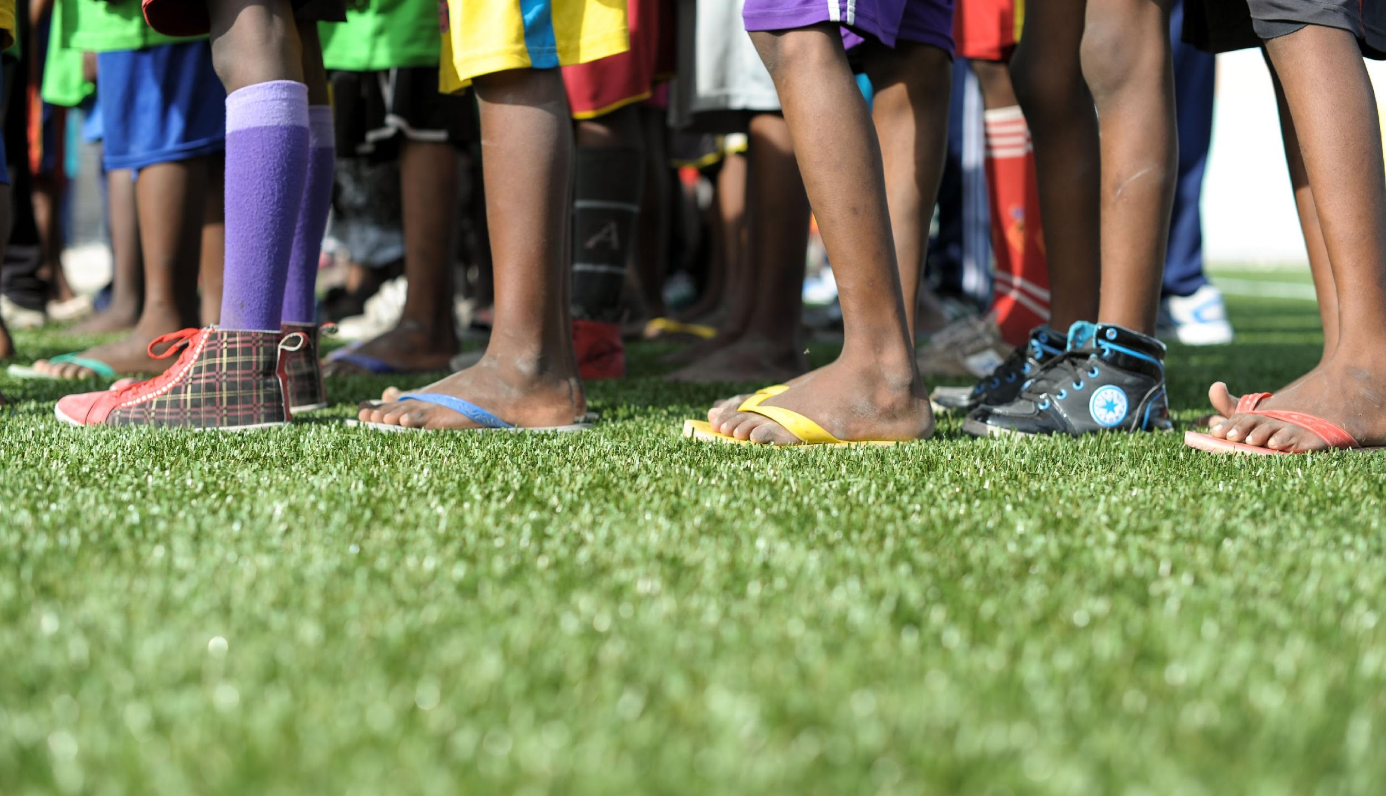
VV’s Selection Ex-post Project Sustainability Evaluations:
At least 2-20 years after projects have closed and donors support has ended
Mixed-method fieldwork that gathers community-based partner and participant voices and shares results with them
We look into why they were sustained or not and how to fund/ design/ implement/ monitor & evaluate differently
We look for what emerged from local efforts ex-post

Slide 6
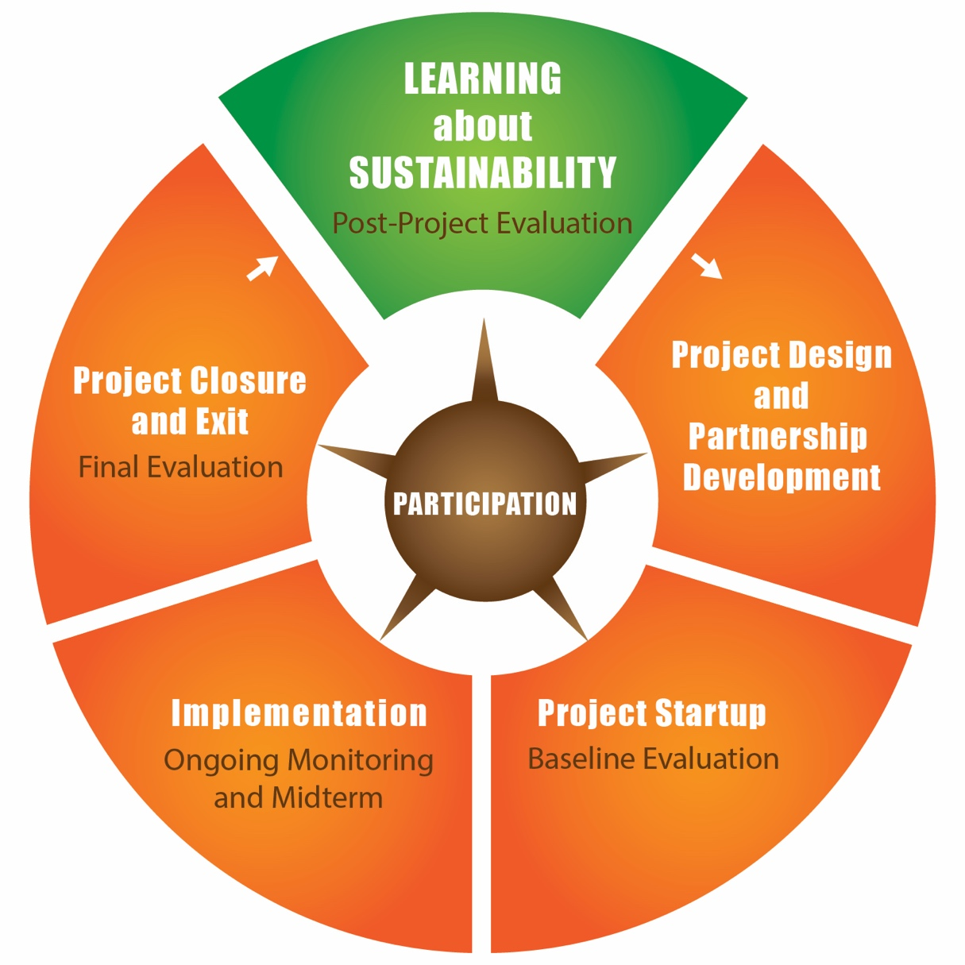
Adding Post-Project Evaluation of Sustainability to the Project Cycle

Slide 7
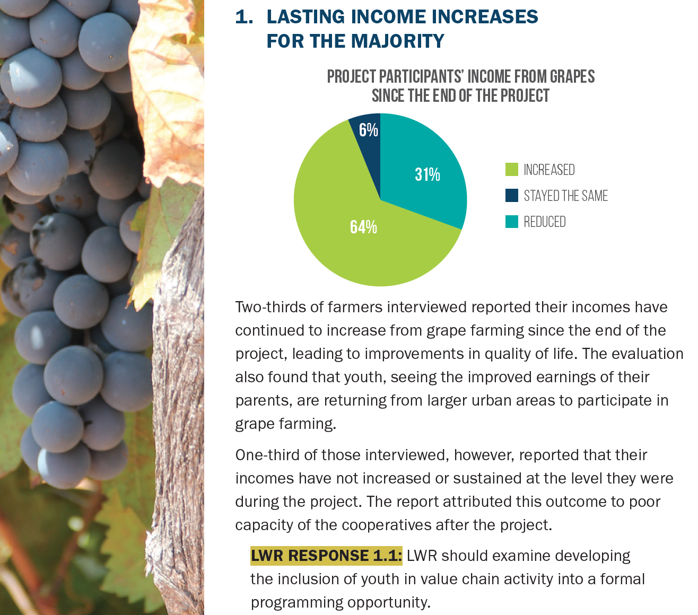
Lutheran World Relief Tanzania, Ex-post Learning, 2018-2020
Source: https://lwr.org/technical-resources/grape-value-chain-and-food-security-dodoma-tanzania

Slide 8
VV Innovation: New, Emerging Local Outcomes from Niger & Nepal
Resources & Partnerships: Communities sustained local health clinic for safe deliveries through innovative local fundraising from contributions from local weddings & baptisms and partnerships with the Ministry of Health, sustaining Catholic Relief Services work (CRS/Niger)
Ownership & Replication: Half of the members of the all-women Village Banks reported creating new Village Bank groups elsewhere and helping one another address domestic violence after Village Bank funding ended, building on project team collaborations (Pact/Nepal)
Unintended Impacts: A food security project improved assets and consumption for women, but it was better water access that led to unplanned decreases in gender violence (LWR/ Niger)
Emerging from local efforts
Sources: Cekan Valuing Voices study for CRS/ Niger, 2016, Cekan for LWR 2008, PACT/ Nepal 2013,

Slide 9
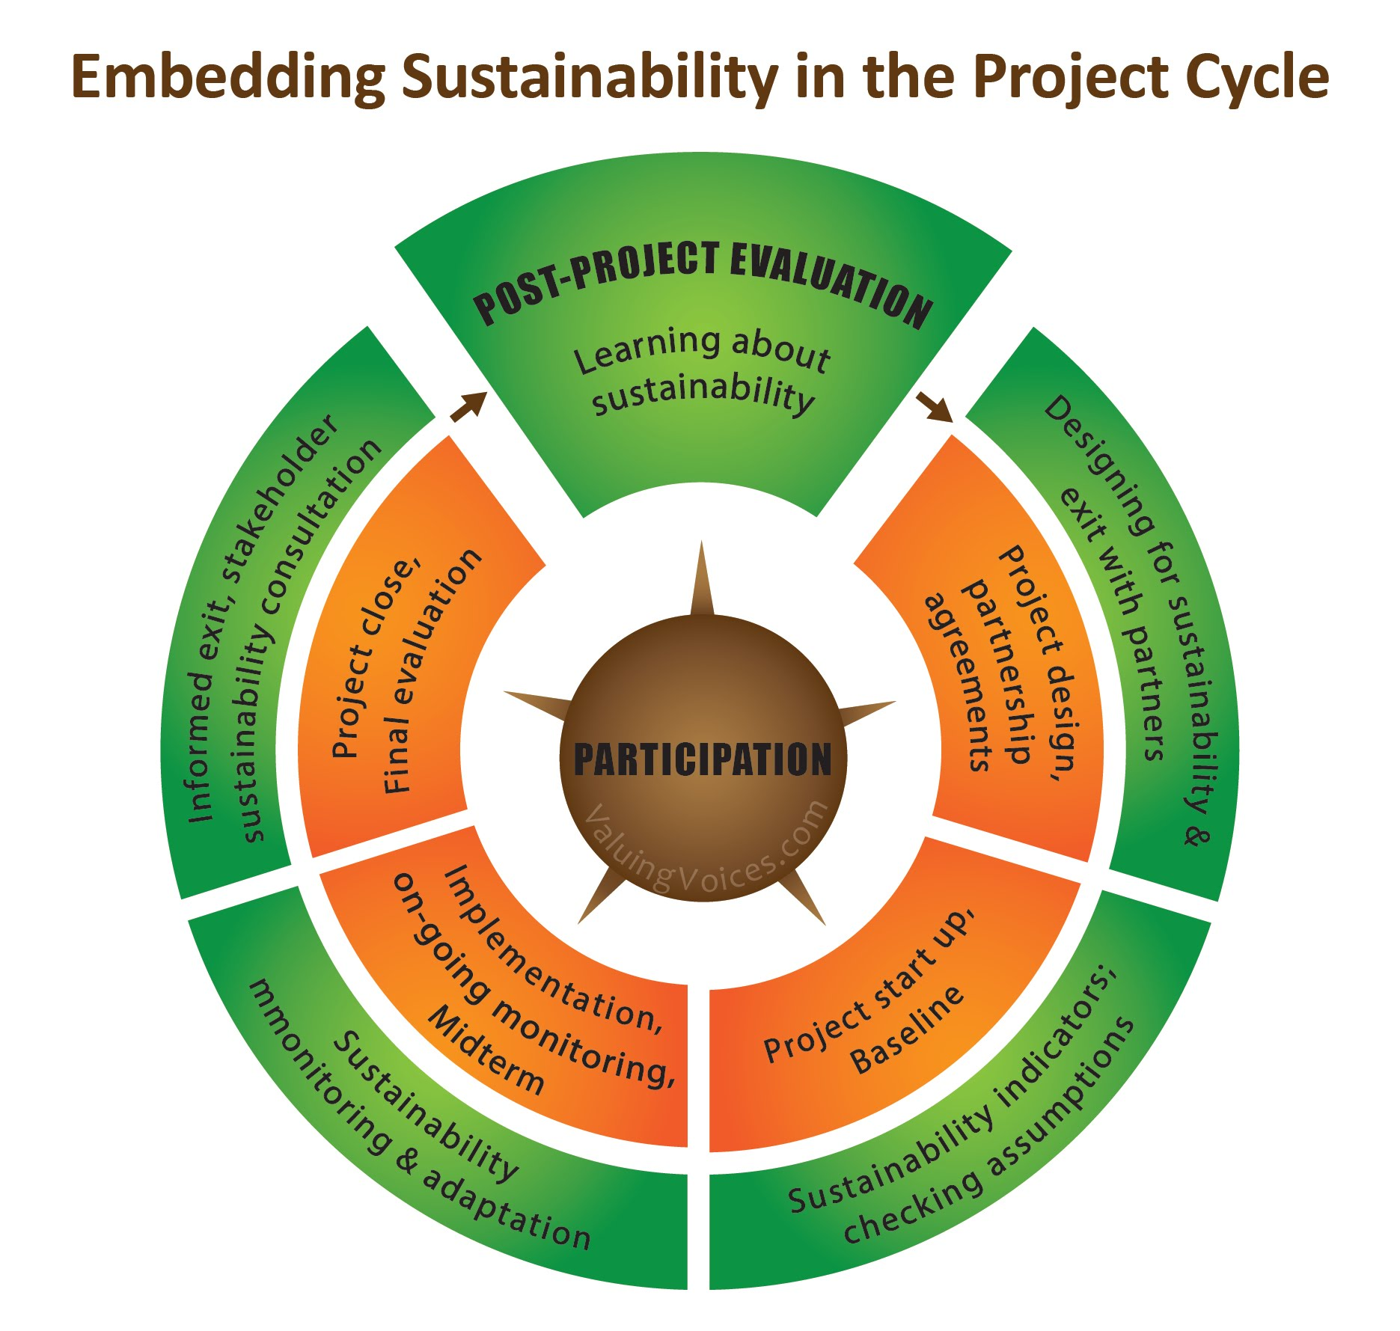

Slide 10
SDG Eval comment, 2017

Slide 11
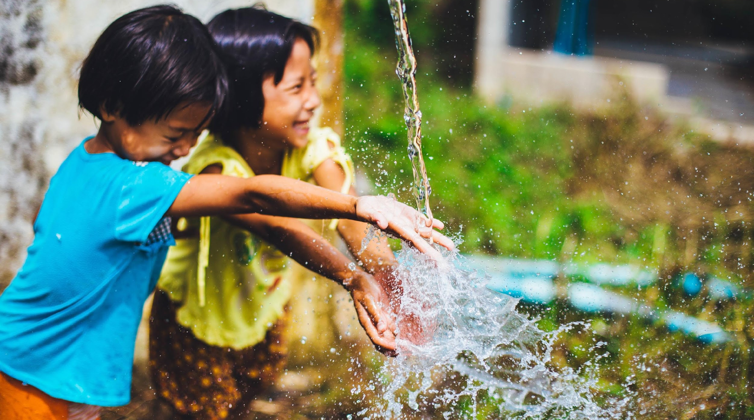
QUESTIONS AND ANSWERS
Join us! http://valuingvoices.com
To Sustain Development!

Slide 12
More to sustainability than the eye can see…
Stories from World Vision ex-post evaluations

Slide 13
A dozen of evaluations in seven countries. Most were cross-sectional studies. All used mixed methods approach. Only two were externally funded.
Top research questions:
What are the long-term outcomes and contributions of programs’ work among those who participated in our programs?
What is being sustained? I.e. outcomes, processes, practices, activities, community groups left behind, other?
(How) have our programs enabled communities to sustain improvements in child well-being?
Notes:
Overall programs had no sustainment definition and pre-set benchmarks of “success” post closure (for community groups or the participants) and there were issues with untested sustainability assumptions and availability and quality of M&E records.

Slide 14
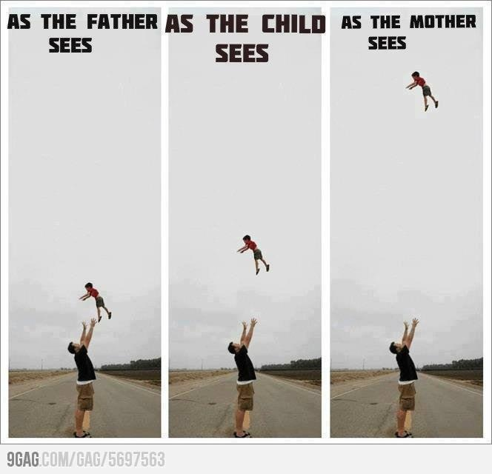
Expectations
Notes:
HOLTA
Organizational culture rooted in who we are and positions we have: 2 min
Ex-post evaluations, especially when new in an organization are exciting. Everyone sees so much potential in them. A common reason for supporting ex-posts esp. funded internally is the belief that good results, sustained achievements are there… We just haven’t measured them. Depending on who you are (your role, experience, and sometimes worldviews) also shapes how you view or what you may expect ex-posts to bring home.
Looking at these pictures we can see how perceptions can differ from one person to another. How far is really the child from the father? I am a mother, when my husband does this with our 2 year old, you know where I stand…
Let’s bring this back to ex-posts though. Our different stakeholders had different hopes of how much sustained achievement was going on and what we could do with the learning and results… If you were to guess from this list of stakeholders (leadership, fundraisers, program staff (including M&E), who do you think had the highest hope of what we could do with results?

Slide 15
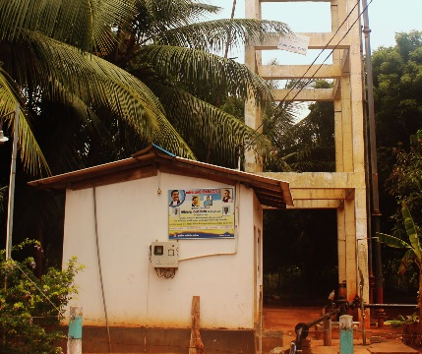
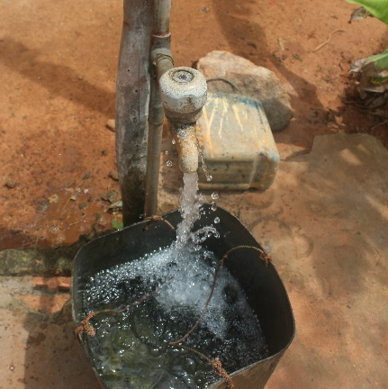
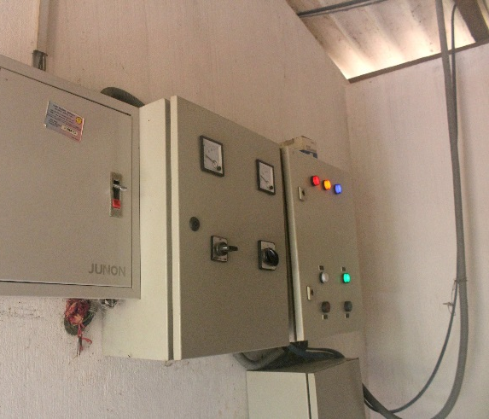
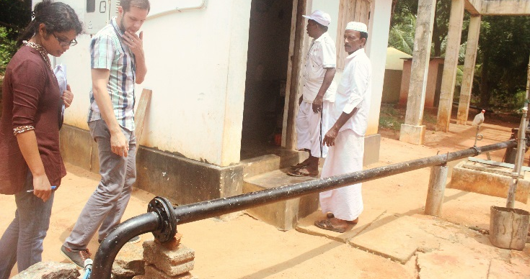
Story #1: Zam-Zam Water Society Putalam, Sri Lanka
WV building the central tall structure in 2007
Two years later the Asian Development Bank built on the investment and provided pumps, pipes, and a tank
WV left in 2012.
In 2013 the Water Consumer Society dug a 400 feet deep pump.
In 2014 the government provided a third water tank.
In 2016 WV conducts an ex-post evaluation
Plant serves 1,700 families. Caretaker lives on premise. Facility is maintained by each family paying for units of water used.
Notes:
Examples of results to anchor what was controversial: 3 min story telling and then do a quick voting:
What do you think thus far? Is this project sustainable?
Can you quickly write in the box why you think it’s sustainable? Yes, you can state the obvious.
But there’s more to this story… Let’s continue.
HOLTA
Zam -Zam water project serves three communities (Karathieuv South, Mahalawilluwa, Karathieuv North, Serakkuliya, and part of Mangalapura).
It started with WV building the central tall structure in 2007 and then two years later the Asian Development Bank built on the investment and provided pumps, pipes, and a tank. In 2013 the Water Consumer Society dug a 400 feet deep pump. In collaboration with the local government the WCS now has also an office building which is also used to operate the water station. In 2014 the government provided a third water tank.
This plant serves 1,700 families. The caretaker lives on the premises. The expenses are covered by each family paying for units of water used. If the families use more than 15 units, they have to pay five rupees per unit. The total cost comes to 400-1,200 rupees per family per month. The operating costs are around 100,000 rupees per month.
When constructed the water was used for a number of years for all purposes. Currently, after more water analysis on the quality of water, it has been agreed that the water is not the best choice for drinking. The water is used mostly for washing, cooking, and cleaning. Families buy drinking water.
Was this a successful water project or not? Our purpose was to provide drinkable water to the population. From that aspect, we did not succeed. But looking at how these communities have come together, and been able to maintain and grow and benefit from the project since WV left in 2012… From that aspect, one can consider this a success story… When we talk about mixed results this is one of those stories that we brought back… Not BLACK and WHITE

Slide 16
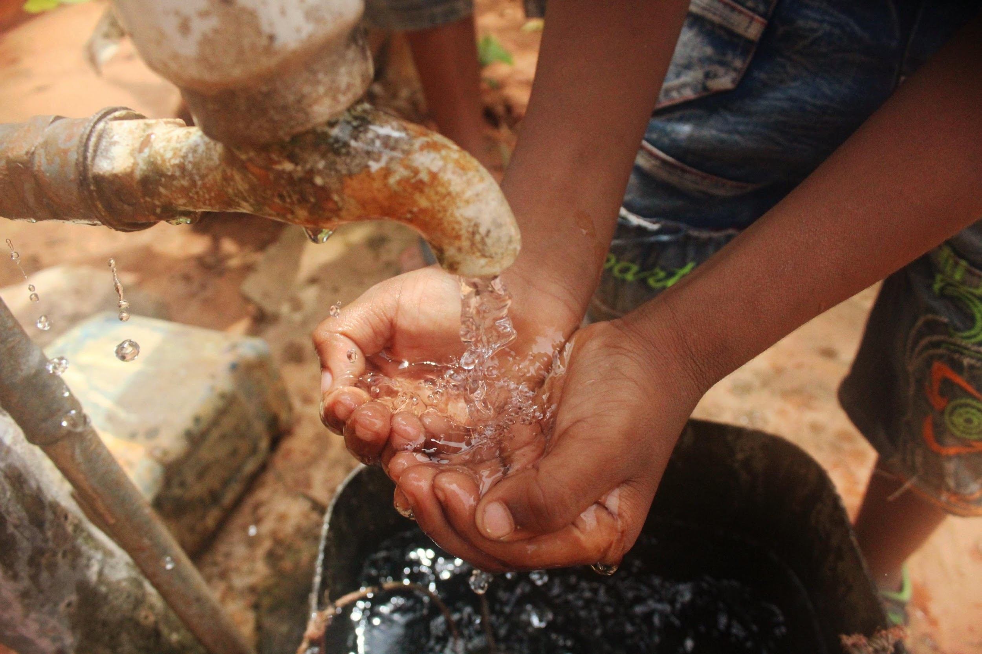
After the first construction (water-tower), the water was used for a number of years for all purposes.
Currently, after more water analysis on the quality of water, it has been agreed that the water is not the best choice for drinking.
The water is used mostly for washing, cooking, and cleaning.
Families buy drinking water.
Notes:
Let’s do another quick voting:
What do you think now? Is this project sustainable? Simple Yes or No voting for now.
I want to ask those that switched from yes to no to type very briefly (think one short sentence) why they changed their minds?
Now let’s ask those that were still a “yes” despite this additional information. Why do you still think this is a successful sustainability story?
Holta’s summary of her views and what she struggled with and what her resolution on the story was (Yes –the community is investing, the leaders are investing, people are maintaining a structure but it’s not what we were thinking and it’s not as great or glamorous or but it’s real). It’s grey. It’s muddy. It asks you to wrestle. No simple solutions.

Slide 17
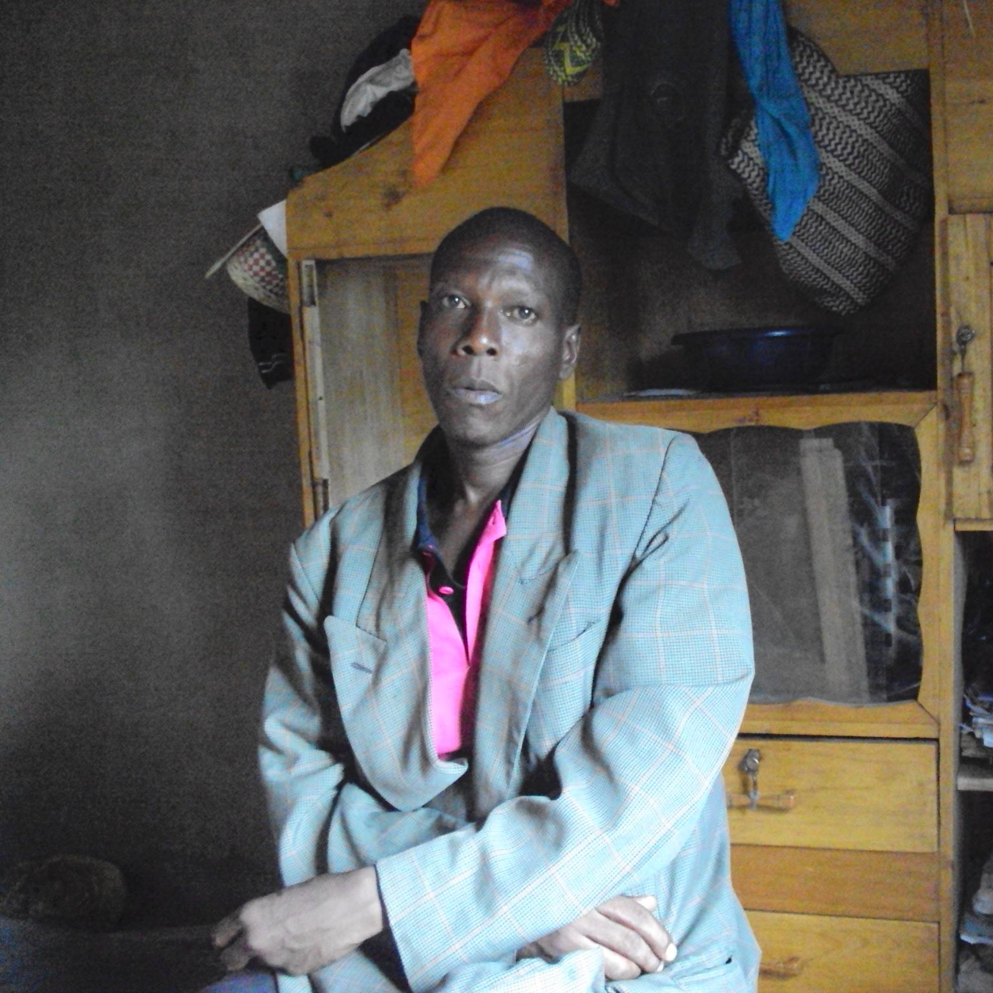
Story #2: Talk about resilience! The story of the Interpersonal Psycho-Therapy Groups (Rakai, Uganda)
This facilitator joined the IPT-G as a member of a group in 2005.
In 2007 he became a facilitator and started up three IPG-G groups, two of them very active and pronounced in the entire area in 2016.
Behind are all the books, records, attendance lists, groups’ constitution and all the necessary documents for these groups, as well as the original training manuals.
Photo taken in 2016: IPT-G facilitator
Notes:
The self-help groups of IPT are one of the community groups that the Rakai Kakuuto programme worked with. The groups were formed as a coping mechanism for those suffering from depression symptoms related to HIV. During the life of the ADP, at the end of the programme (16 weeks) many groups chose to remain as a group - continuing to offer psycho-social support to members, but also start Income Generating Activities (IGA) to generate income for their members primarily, as well as to using a portion to reach out to others in need.
The ex-post evaluation adapted a previous methodology used by John Hopkins and Columbia University to evaluate these very groups in Rakai (see side bar on next page). Unfortunately, the available programme records were scarce with no information on location, contact details or how long any of the groups had been operational. Nonetheless, we were able to track seven out of twenty-three IPT-G which were functional at programme closure (2010).
Rapid qualitative assessment and programme formative research

Slide 18
Early development (2000-2003): Low-cost, high-effective community based intervention aimed at the reduction of depressive symptoms including depression related to HIV-positive status.
Rakai Kakuuto program selected as testing site.
Model designed, tested, validated through randomized controlled trials led by John Hopkins University.
Scale-up (2004-2009): A follow-up study by John Hopkins University, published externally in 2006, determined “Participants in a 16-week group interpersonal psychotherapy intervention continued to confer substantial mental health benefit 6 months after conclusion of the formal intervention”
World Vision scales up the model.
Program closure (2010): World Vision exits the communities in 2010, leaving behind 23 groups.
Columbia University investigates the long-term impact (beside mental health) of the groups two months prior to World Vision’s exit. Study reports five changes linked to IPT-Gs: (1) Improved school attendance for children of those in IPT-G; (2) Improved productivity in agriculture and animal husbandry; (3) Improved sanitation; (4) Greater cohesion among group members; (5) Reduced conflict in families
Program ex-post (2016): Unknown number of groups to track, and therefore participants to track; Limited records for the known groups; No sustainment definition or pre-set benchmarks of “success” post-closure (for the group or the participants)
Notes:
The self-help groups of IPT are one of the community groups that the Rakai Kakuuto programme worked with. The groups were formed as a coping mechanism for those suffering from depression symptoms related to HIV. During the life of the program, at the end of the programme (16 weeks) many groups chose to remain as a group - continuing to offer psycho-social support to members, but also start Income Generating Activities (IGA) to generate income for their members primarily, as well as to using a portion to reach out to others in need.
The ex-post evaluation adapted a previous methodology used by John Hopkins and Columbia University to evaluate these very groups in Rakai (see side bar on next page). Unfortunately, the available programme records were scarce with no information on location, contact details or how long any of the groups had been operational. Nonetheless, we were able to track seven out of twenty-three IPT-G which were functional at programme closure (2010).
Rapid qualitative assessment and programme formative research

Slide 19
Methodology used for IPTG sustainability measurement
7 IPT-G groups tracked
5 in-depth Interviews with IPT-G Facilitators
Free listing interviews with 29 IPT-G members
12 KII with adults referred as knowledgeable by IPT-G members
Methodology adapted from Lewandowski, R.E., Bolton, P.A., Feighery A., et al. Local perceptions of the impact of group interpersonal psychotherapy in rural Uganda. (2016). Global Mental Health, 3(23).
Notes:
Using a free-listing approach, interviews were conducted with 29 members from the seven IPT-Gs. Semi-structured interviews were afterward conducted with five available IPT-G facilitators and 12 nominated referrals (community members referred by the IPT-G members as knowledgeable about the benefits stemming from these groups).

Slide 20
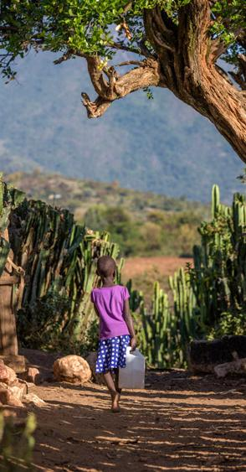
IPT-G Findings
IPT groups existing (MUCH) longer than expected from the model. All seven groups tracked were still operational in 2015-2016.
Four of the groups had been operational for over a decade. Three appear to have formed towards the last two years of the program.
Groups have evolved in terms of membership and group size.
All groups continue to offer psycho-social services to their members on a case by case basis but they no longer hold group IPT sessions. Techniques have become more general than in their curricula.
The core activities for all groups currently revolve around income generation and supporting each other in agriculture activities.
Notes:
MEMBERSHIP: The membership criteria has evolved (from category of people to membership fees; from one sex to majority being mixed-sex groups). New members may join based on new criteria.
For all groups, membership at the start was based on belonging to the category of people in need of psycho-social support. However, overtime as a group started to implement IGA, membership fees were introduced. Currently, all groups have established a membership fee system. Fees range from as low as less than one US dollar annually to as high as 37 US dollars (one-time fee). Another change overtime has been shifting to mixed group composition. During IPT sessions groups were either composed of women or of men, while now as groups are primarily focused on IGA, gender seems to be no longer a criterion. Out of all groups, only one group was explicit about wanting to remain as a women’s group, the rest either already had mixed membership or were open to accept new members from both sexes.
IGA:
The most common income generation activities are: renting tents and chairs, providing catering services and making and selling handicrafts. One group also generated income by being hired for community sensitisation campaigns through dramas on hygiene, nutrition or HIV/AIDS. Additionally, the groups offered services to their own members e.g. all group members working on a member’s land at one time, group members helping a member with casual labour to build a house or providing child care. In terms of other services offered to their community, two groups mentioned that they provide some support to orphans in their community using their group savings and earnings. The support includes mainly purchasing of school supplies.
TECHNIQUES: Similar to 2010 study, all interviewed IPT-G facilitators continued to employee more general group facilitation techniques than the specific IPT strategies in the training curricula.
The 2010 study on IPT-Gs found that facilitators employed more general group facilitation techniques than the specific IPT strategies in their training curricula. Our study concludes the same regarding the strategies and techniques used when dealing with disagreement, while also observing that techniques used for loneliness, grief and life changes have merged more or less into one and the same technique. Facilitators were able to provide a wide range of concrete examples on how they deal with these IPT issues.

Slide 21
Continued…
Positive self-perception of group effectiveness --out of 255 change statements generated from free-listing only 8 were negative. Most impactful areas include:
Improved economic situation*
Improvement in child education*
Increased group cohesion*
Improved mental health for members but also health practices and habits, etc.
Enhanced personal development for group members
* Three of the top most impactful changes are similar to the findings of the 2010 study.
Notes:
255 change statements from which only eight were negative. The top five areas where IPT-G are perceived to have had the most impact are:
Improved economic situation (increased finances and financial management of resources; increased assets, productivity, etc.);
Improvement in child education (children of group members able to attend school and increased parental involvement in child education);
Group cohesion (unity, peers support, sharing of personal and family struggles and joys, sharing of knowledge, skills and resources)
Health (improvement in mental health of group members, improvement in health practices and habits, overall improved health among adults and families, etc.)
Personal development of group members (self-confidence, self-reliance, self-awareness, improved self-image, critical thinking, development of communication and counselling skills, etc.)
There were no contradictions between the referrals statements and those made by IPT-G members.

Slide 22
in their words...
Economic Situation: “As a group, we have a piece of land set aside for our agricultural activities. It is in [name] village. It has boosted our agricultural skills and we are able to learn from each other during the group activities. We are also able to practice the same in our garden. Actually, at the moment we are very proud of the gardens and better yields. This is because we share ideas and knowledge on good agricultural practices”. -IPT-G member #7
“The families of those who were participating in a group are now better off, like [name removed] has two cows, [name removed] built a house, and [name removed] bought a plot of land and many others... [Name removed] also bought a plot of land and planted eucalyptus trees. In general peoples’ family income
increased and are now well off.” - IPT-G member #3

Slide 23
Health: “The other change-there is improvement in the quality of life that we live now. Many members have fewer hospitalisations than was the case before. I think because of the stress, we would be weak most of the time and lack strength to do our daily activities with vigour. We would end up with many health complains and health centre visits. The other change is that even the members who used to seclude themselves live no more in isolation because of the friendship created in the group. We share our problems, so “a friend in need is a friend indeed”. - IPTG member #17
“...It also helped us especially the women because most of us are widows –it helped us to know and accept our situation. The individual group members have developed social, emotional and intellectual skills this has helped them to be happily despite lack of professional assistance.” - IPT-G member #23
Group cohesion: “Most of the members in this group usually or even often times share their disappointments with each other. They also share their joys and achievements. Members have formed friendships with other members of the group and help each other where need be and we also share about our daily experiences”. - IPT-G group #25

Slide 24
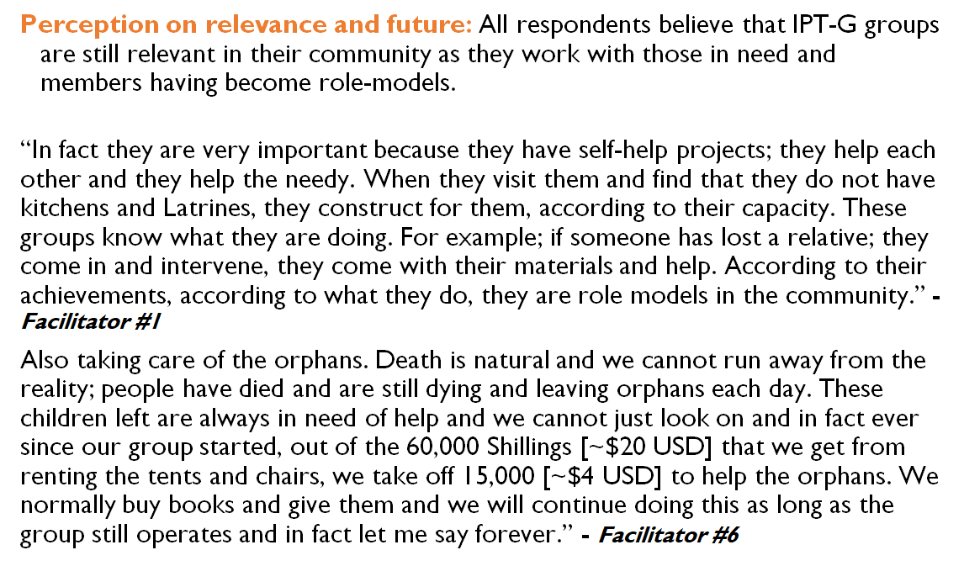

Slide 25
High-level learning beyond just hunting for good results…
There are no benchmark to measure success on sustainability or set expectations on how long should smth last [but we won’t get there if we don’t press with measurements, reflection, learning]
Create a stronger link between sustainability, resilience, transition, community led-development from start to post-end [JICA’s example ex-post monitoring as a new practice]
Start with the need for learning not [just] accountability
Expand your tool box on methodology to investigate sustainability.

Slide 26
Source:
The evidence base on Anticipatory Action (World Food Program, 2020)

Slide 27
Our (not-so) secret tips
What to anticipate
Good, bad and unclear findings
Natural internal and external champions and detractors
Lack of program records
Lack of standards to measure sustainment
Need to channel your creativity (esp. in choices of methodology)
What to avoid
Hiding bad findings
Recommendations that aren’t future-oriented
Becoming a cynic on the ideals of sustainability
What to mitigate
Bring the project team into design and analysis
Identify ‘bigger picture’ opportunities to feed in findings beforehand
Involve your comms colleagues early on
Identify evaluators genuinely interested in the topic
Notes:
Wrapping up: 2 min
RAMU

Slide 28
Sustainability of outcomes and downstream impacts of aid: local perspectives
Isabella Jean, Independent Consultant
ijean@brandeis.edu

Slide 29
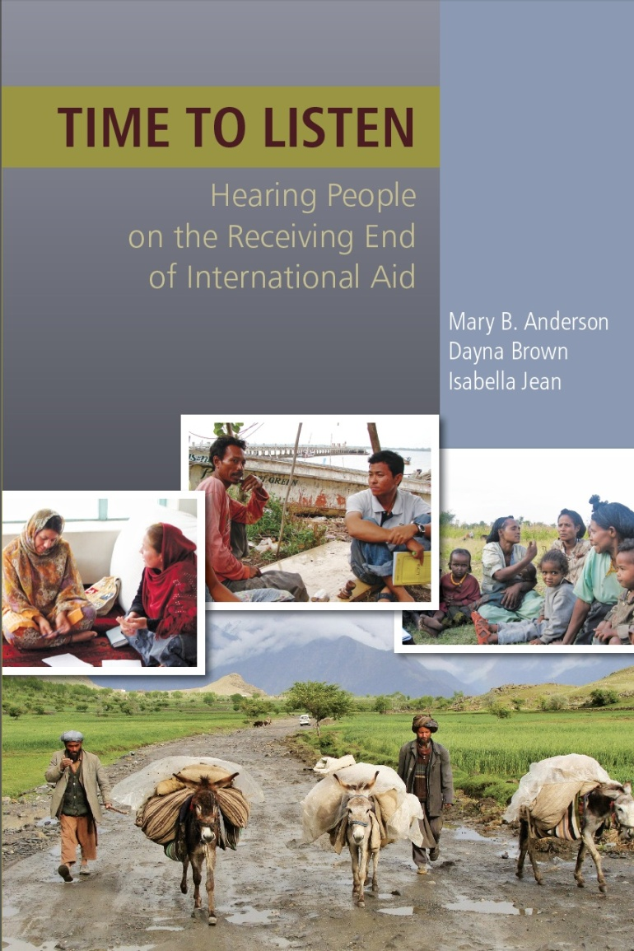
Cumulative analysis on impacts of externally driven aid
People feel like objects of others’ decision-making & planning, not as subjects in their community’s & society’s progress.
The system focuses on gaps and needs to be filled vs. existing capacities & structures to be reinforced.
Resulting top-down direction and supply-driven aid violates principles of participation, ownership, and sustainability essential for development.
Externally-driven deliveries are an inadequate mechanism for promoting positive change in the recipient societies.
Need to integrate resources and experiences of outsiders with the assets and capacities of insiders to develop context appropriate strategies for change.
Real and meaningful help involves joint analysis of the context, identification of existing capacities, generation of options, and shared decisions about the best strategy for pursuing the desired changes.
Notes:
Time to Listen is online: Time to Listen: Hearing people on the Receiving End of International Aid https://www.cdacollaborative.org/wp-content/uploads/2016/01/Time-to-Listen-Hearing-People-on-the-Receiving-End-of-International-Aid.pdf
People look for improvements in their current and future well-being – want aid that enables them to improve their lives economically, as well as physical safety and governance structures.
They judge impacts based on whether or not what is provided, and how it is provided, improves the likelihood of a secure livelihood: i.e. roads that open markets, water that allows improved crops, schooling and training that lead to employment or productive skills

Slide 30
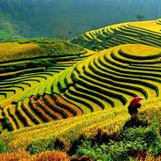
Where do we miss the mark on sustainability?
Shifting Agendas Undermine Sustainability
“The lack of flexibility and short time spans for projects creates difficult conditions. Short-time approaches are one of the main factors that instigate failure. In spite of this, the donors ask for sustainability! A government official in Afghanistan
Participation, Ownership, and Sustainability Are Interconnected
“If people are not involved with the project, they will not own it and take care of it. If the people are invested in the development, they will take care of that development.” A local NGO staff person, Cambodia
“If you work with the local government you build more capacity and ensure sustainability. We’ve learned our lessons from mistakes we made. In the past, we focused almost entirely on village-based or community-based organizations, trained local village committees to write proposals and apply for funding. After we phased out, these committees fell apart because they didn’t have a proper network with the local government.” - Local staff of an INGO, Sri Lanka
Notes:
Also, projectitis ---- many people criticized the “project mentality” among donors and aid agencies, saying that it lacked a long-term vision and impact and that more money was wasted with short-term thinking. Some noted that when projects are started by outsiders, the projects are often left to deteriorate and even called by the name of the “owners” (i.e., donors or NGO). People were critical of how most projects do not help communities identify their own resources and how to build on them.

Slide 31
Why don’t they come back?
In Bosnia, Afghanistan, Cambodia, Angola, Bolivia, East Timor, Mali and elsewhere…
A consistently repeated and sincere question:
Why don’t they come back? Why would they invest that much money and effort and not check on what happens?
And revealing commentary:
“No one ever came back after projects ended to check on the status of equipment or other investments they had provided, and to see whether they were still being used in accordance with their original intentions.” Bosnia
“It was better under the Russians. At least they checked!” Kabul, Afghanistan
“We haven’t seen anyone that belongs to that project celebration sign ever since the group photo.” Cambodia
“They left their logo on our houses so they can come back and find us one day.” Thailand
Notes:
Afghanistan: “

Slide 32
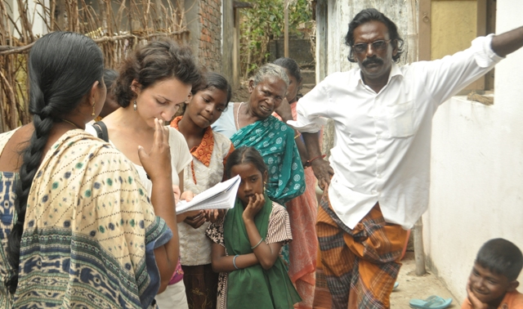
Sustainability of outcomes: so what else happened here?
This is not about projects. It is about people.
Oxfam International Tamil Nadu Listening Exercise 7 years after tsunami response
Downstream impacts of decisions and support
Boats
demand equation in the labor market
shifts in cultural norms and positive changes in caste relations
Overfishing
Property titles
Listening Exercise Report from Tamil Nadu, Southern India
https://www.oxfam.org/en/research/listening-exercise-report-tamil-nadu-southern-india
Notes:
Downstream impacts from a decision to provide boats:
Sudden increase in motorized boats (boats provided to fishing villages, but also to villages that did not used to fish, non-fishing castes, and to women in some cases)
Chain of effects from new motorized boats includes overfishing and a decline in fish population. Dolphins in the area can’t get sufficient food. In addition, inter-state boundary disputes between Tamil Nadu state and Sri Lankan government have increased due to Tamil fishermen boats straying too far into the international seas.
Labor equation: tsunami rehabilitation efforts which affected the demand equation in the labor market. With too many mechanized boats distributed as part of the INGO and government rehabilitation package many former wage laborers from fishing castes became boat owners. This resulted in a shortage of laborers on boats and fishermen had no choice but to reach out and hire members of dalit communities to fish with them8. As a result, some dalits gained access to a more stable employment and an increase in their income in cases where they managed to develop good working relations with fishermen nearby. More importantly, however, dalit people spoke about how these new ties between neighboring villages helped to increase social acceptance of dalits, a development that has significant psychological effects and is linked to issues of dignity, respect, and social inclusion.
Decision to register newly constructed homes with joint property titles, a stark change in traditional practice, was actively promoted and instituted by several aid agencies, including Oxfam. During the height of post-tsunami housing construction, several NGOs were successful in lobbying the government to have the legal deeds to the houses be arranged in the name of the woman. We heard people refer to this development as a significant cultural change which has had effects on the nature of decision-making in the households.

Slide 33
Sustainability of local institutions
Stopping as Success learning consortium (2017-2020)
Institutional capacities require partnerships that focus on mutual capacity strengthening, learning and adaptation
Exits and transitions can support legitimate and respected local institutions.
Early and joint planning is key.
Power dynamics and equity issues re: funding, competition, dominance.
“I will step out of the spotlight. Sustainable solutions to poverty come from within, are bottom-up, and flow from local leaders who are taking the risks of holding their politicians accountable and challenging the status quo.” Sidekick Manifesto
Stopping as Success case studies and practical resources: https://www.stoppingassuccess.org/
Sidekick Manifesto http://sidekickmanifesto.org/manifesto/
Notes:
Mercy Corps to Partner Microcredit Foundation: https://www.stoppingassuccess.org/resources/partner-microcredit/
Oxfam to Bridge transition case study: https://www.stoppingassuccess.org/resources/bridge-georgia/

Slide 34
Resources we used and mentioned in the presentations
Valuing Voices (esp. check the rich dtb. of ex-posts and the insights from the blogs) http://valuingvoices.com/valuing-voices/
Stopping as Success (check cases studies that speak to program and organizational successful transitions) https://www.stoppingassuccess.org/
In the story of poverty’s end, we cannot be heroes. But, we can be Sidekicks. Take a pledge! http://sidekickmanifesto.org/manifesto/
New insights into how we need more tools in our toolbox. Check these out: (a) Anticipatory Action https://docs.wfp.org/api/documents/WFP-0000110236/download/?_ga=2.163525237.879884154.1591270020-1997132059.1591107108 AND (b) Realist Evaluation https://www.betterevaluation.org/en/resources/website/brief_introduction_to_realist_evaluation
Time to Listen: Hearing People on the Receiving End of Development (book): https://www.cdacollaborative.org/wp-content/uploads/2016/01/Time-to-Listen-Hearing-People-on-the-Receiving-End-of-International-Aid.pdf
For more on the IPT-G read:
Bass, J., Neugebauer, R., Clougherty, K.F. et al. Group Interpersonal Psychotherapy for Depression in Rural Uganda: 6-month Outcomes: Randomised Controlled Trial. (2006). British Journal of Psychiatry, 188, 567-573.
Bolton, P., Bass, J., Neugebauer, R., et al. Group Interpersonal Psychotherapy for Depression in Rural Uganda A Randomized Controlled Trial. (2003). JAMA. 289(23), 3117-3124.
Lewandowski, R.E., Bolton, P.A., Feighery A., et al. Local perceptions of the impact of group interpersonal psychotherapy in rural Uganda. (2016). Global Mental Health, 3(23). Available at: https://www.ncbi.nlm.nih.gov/pmc/articles/PMC5454764/

