Slide 1
The Role of Spiritual Values in Developing Vibrant Community Based on Best Practises in using Asset Based Community Development as an Approach in Jembul Village, Jatirejo, Mojokerto, East Java, Indonesia Presented at: International ABCD (un) Conference 24 Juni 2020
Moh. Ansori
Departement of Islamic Community Development, Faculty of Da’wa and Communicatioan, State Islamic University Sunan Ampel Surabaya

Slide 2
Profile of Facilitators
Academic Community from Department of Islamic Community Development, Faculty of Da'wah and Communication, State Islamic University Sunan Ampel, Surabaya.
The concept of da'wah which has developed in this department can be called as “da’wah bil hal” (da’wa with action) .
That’s mean developing, empowering, fasilitating, stimulating, encouraging and engaging communities to do their best for better qualities of life, for them and others.

Slide 3
An Example of Our Community…
“ Forestry Community ” (Komunitas Petani Hutan) Desa Jembul, Kec. Jatirejo, Kab. Mojokerto, Prop. Jawa Timur, Republik Indonesia.

Slide 4
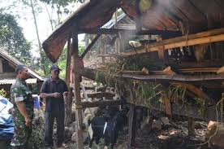
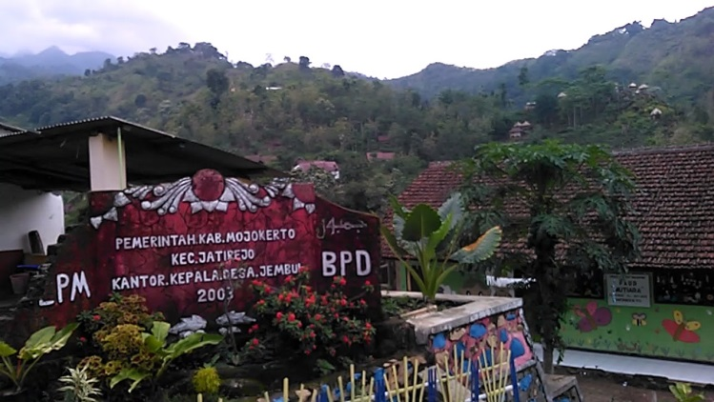
Assets of Jembul; Nature, Physic, Economy
Goat Livestock Community in Jembul
The golden plant, “Porang”
Exotic Views of Jembul Village

Slide 5
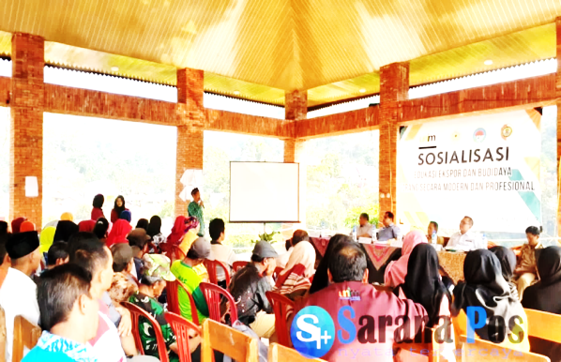
Social Assets
social cohesiveness
Inclusiveness of Jembul Community

Slide 6
Local wisdom as it’s Assets;
Keeping the forest sustainable
Keeping the springs
Local Values
Local Cultures
Local Leaders

Slide 7
During the Facilitation Process…
The spiritual values become the guidance
Meeting process of the facilitators values and local values of the community
The collaboration of two powers of good values and behaviors (Fasilitators and Community) happened.
The process of COMMUNITY DRIVEN DEVELOPMENT occured .

Slide 8
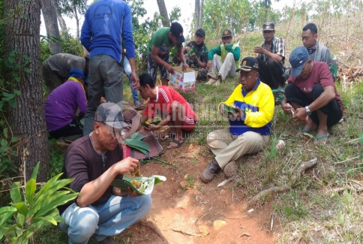
Strengthening TOGETHERNESS
The Greening Program
Working, Relax, and eating together

Slide 9
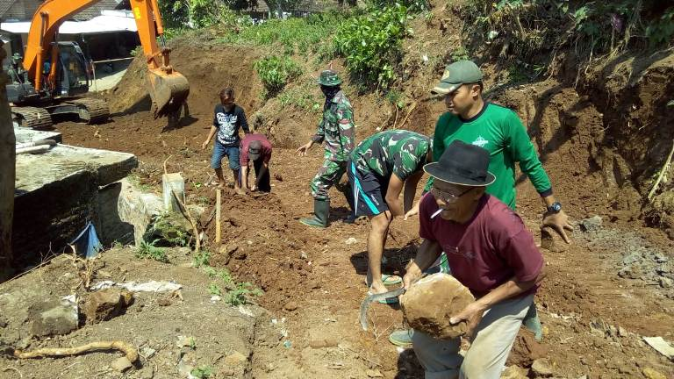
Building Shared RESPONSIBILITY…
Build a village hall
Build a connector road

Slide 10
The Results :
The Jembul community become:
- better understanding
- more confident
- more powerfull
Finally, Jembul has changed significantly to be better than before.

Slide 11
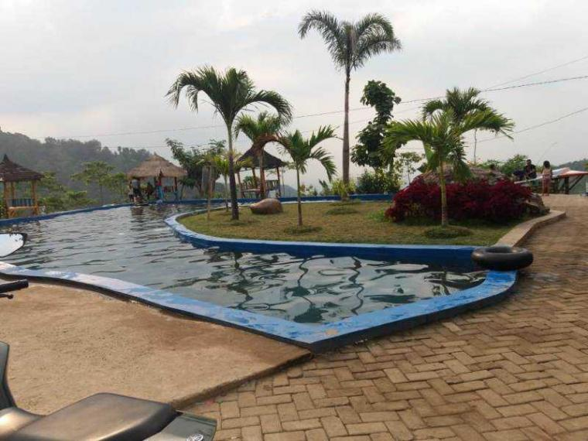
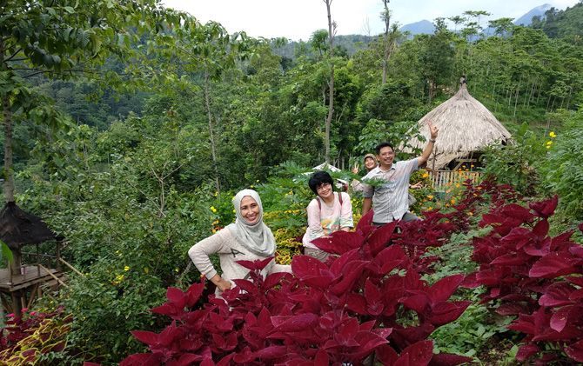
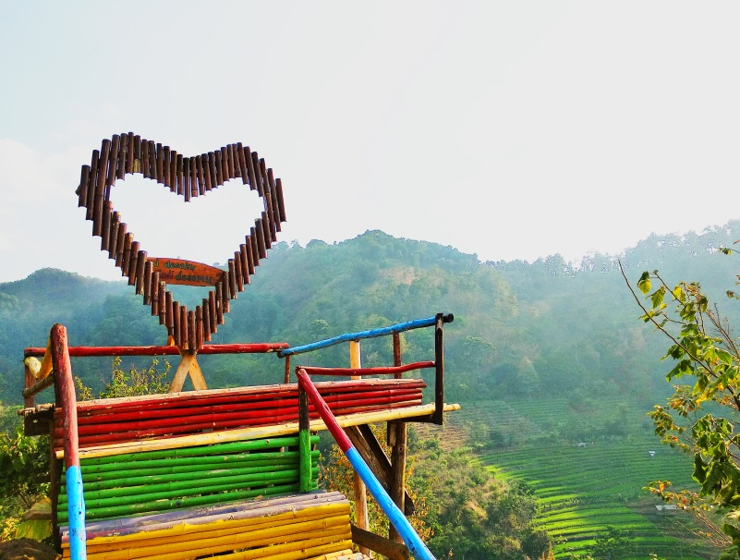
Jembul at Present …

Slide 12
Thanks...
Terima Kasih…
Matur Suwun...

